Slide 1


#1City

Slide 2
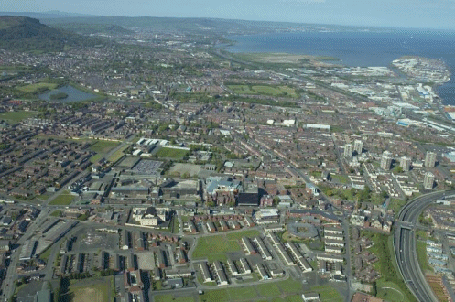
Patricia McKeown
Regional Secretary
UNISON

Slide 3
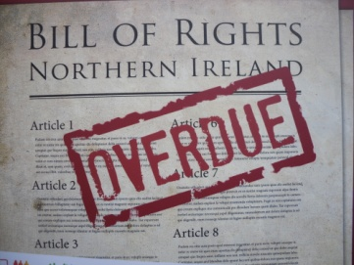

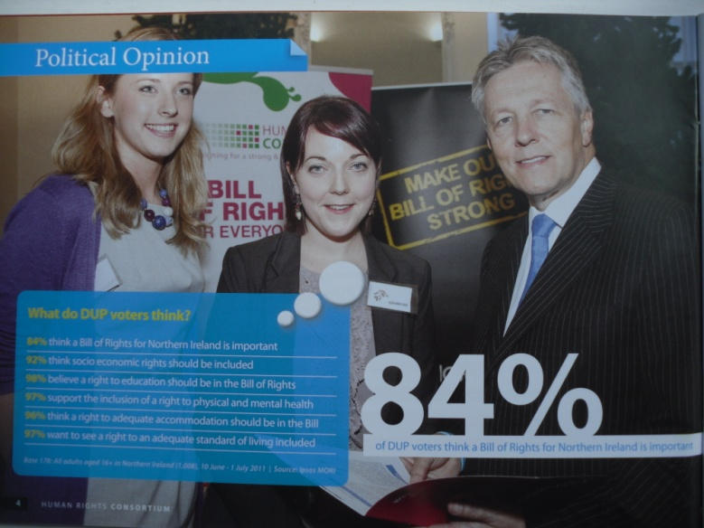
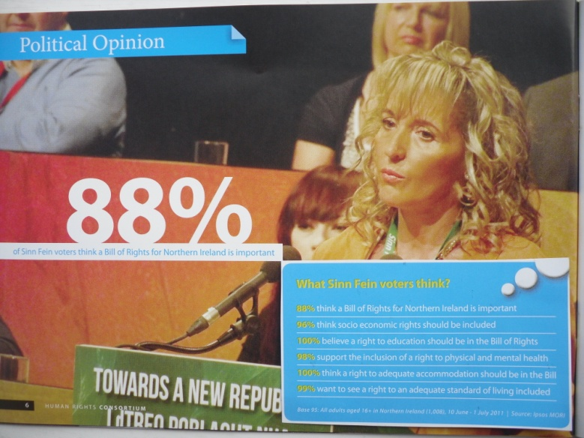
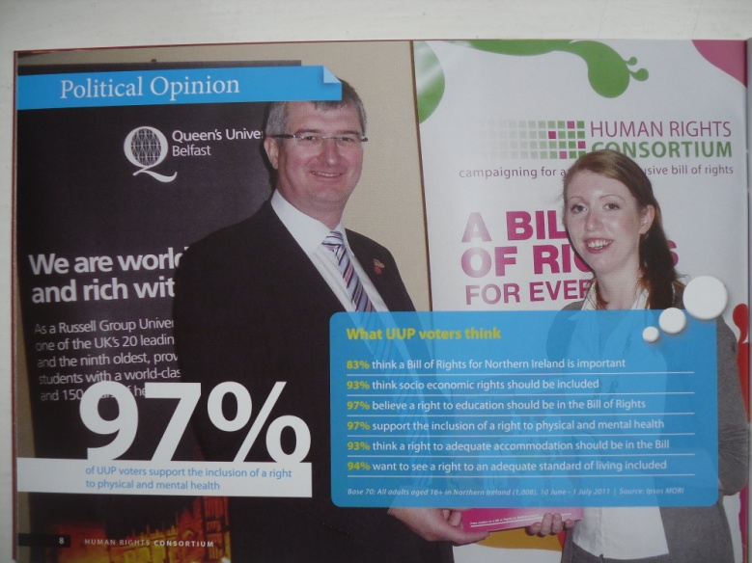
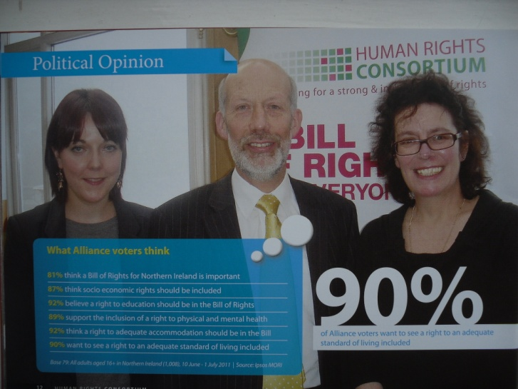
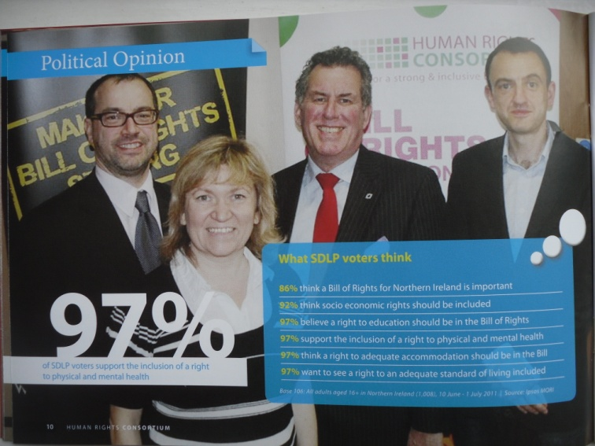
Common Cause

Slide 4

West Belfast, Shankill and the Bronx

Slide 5
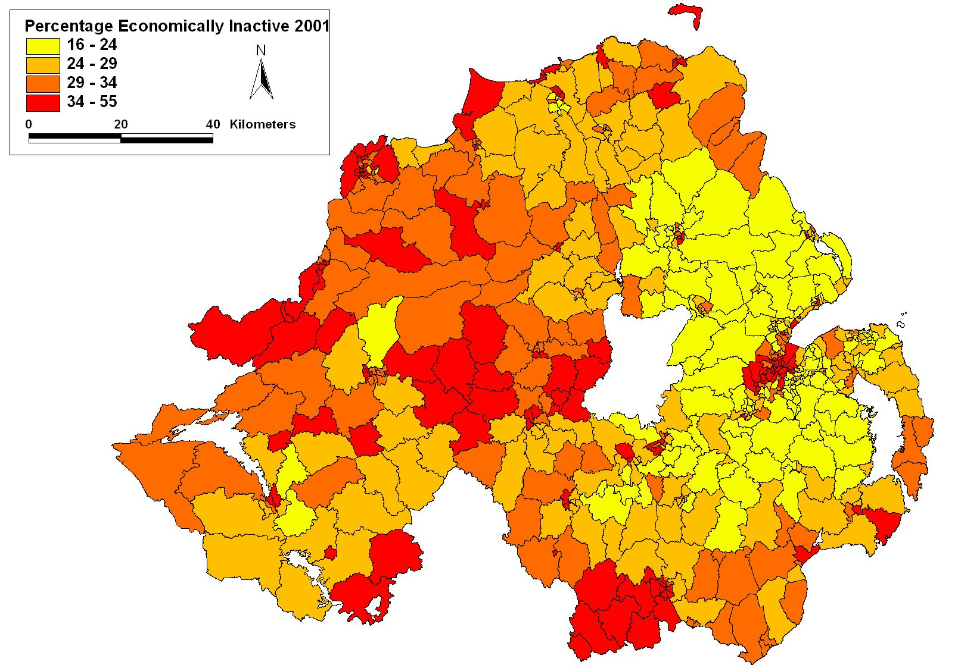
Objective Need

Slide 6
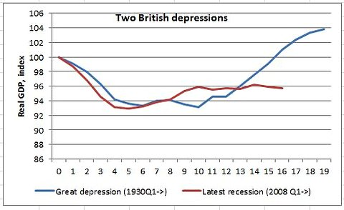
Austerity Doesn’t Work!
New York Times 2012

Slide 7

A Fresh Approach
RoI:
Proposed Plan B
NI:
Public Procurement
£4.2bn stimulus Plan
Green New Deal
Pension funds

Slide 8

Public Procurement
€21/£19 billion all-island Public Procurement Opportunity
OPPORTUNITIES Achieved?
SMEs
Communities and social enterprise
OPPORTUNITIES Missed?
Dismissing the pro-active tools
Redefining long term unemployment
Apprenticeship = 1 per £million

