Slide 1
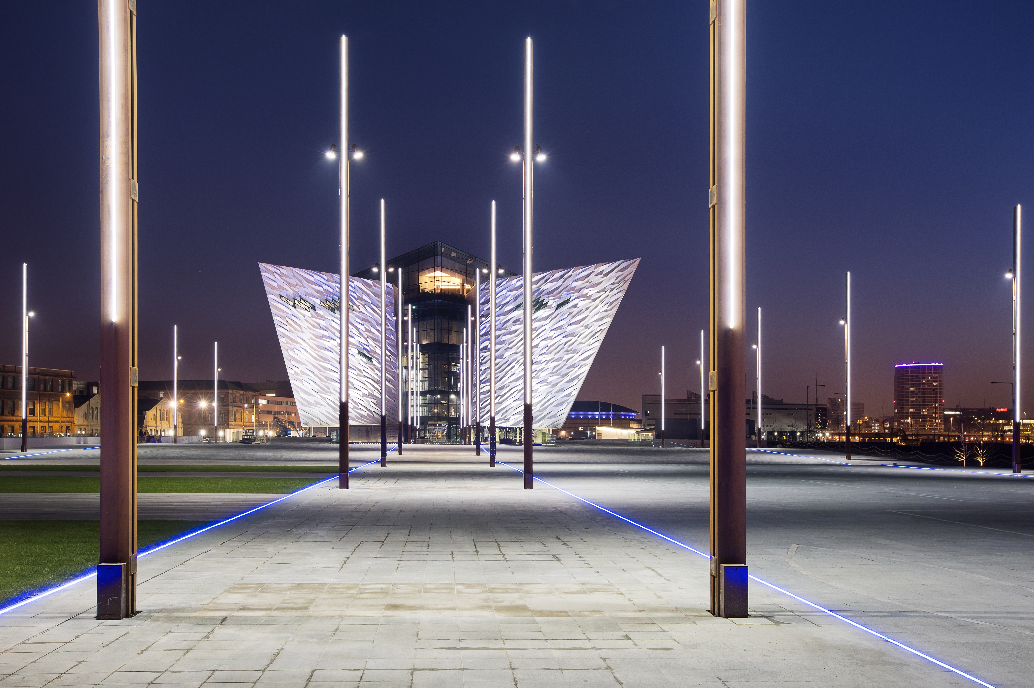

#1City

Slide 2

ONE YEAR ON…
Belfast
Northern Ireland
Mike Smith, Chief Executive
Titanic Quarter Ltd
Notes:
2

Slide 3
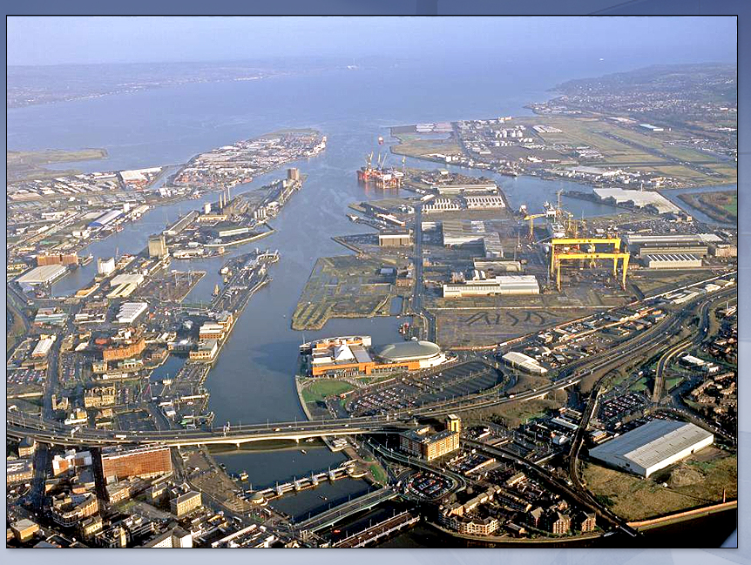

Slide 4
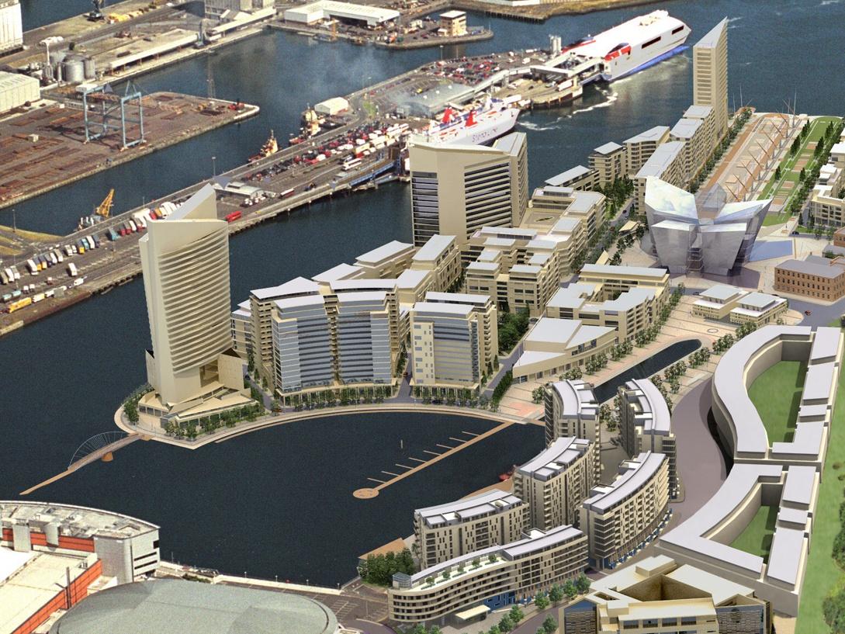

Slide 5
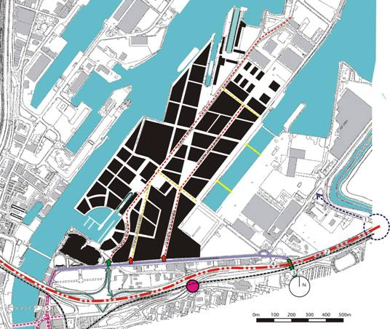
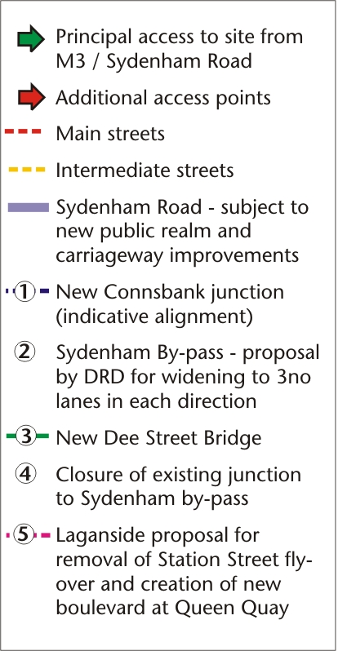
Access & Movement
Notes:
5

Slide 6
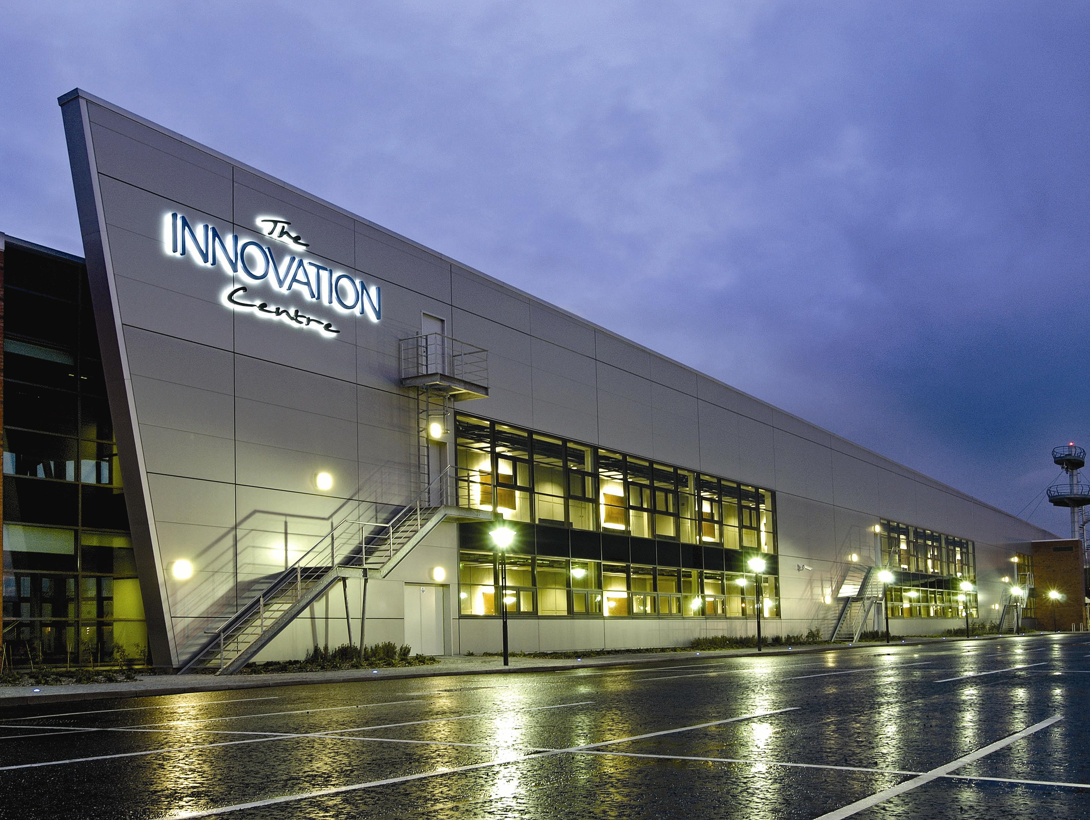
Northern Ireland Science Park

Slide 7
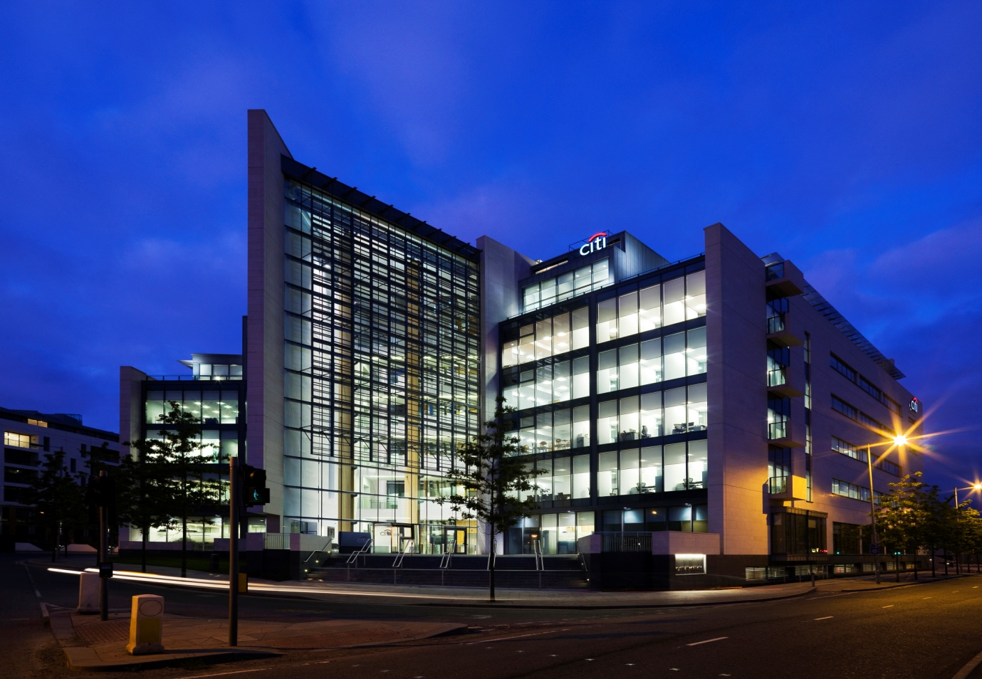
Gateway Offices

Slide 8
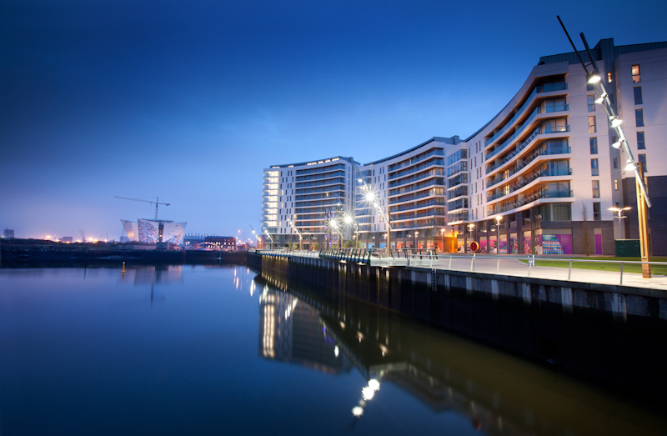
Abercorn Basin Residential Complex

Slide 9
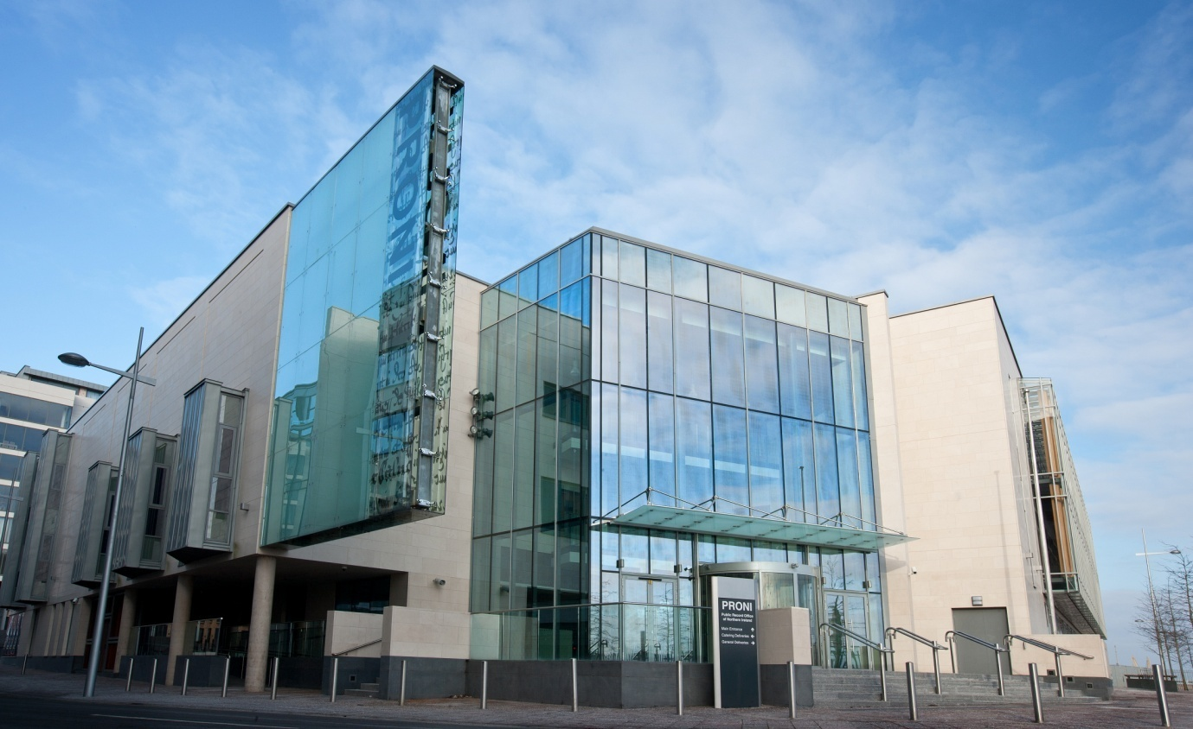
Public Records Office Northern Ireland

Slide 10
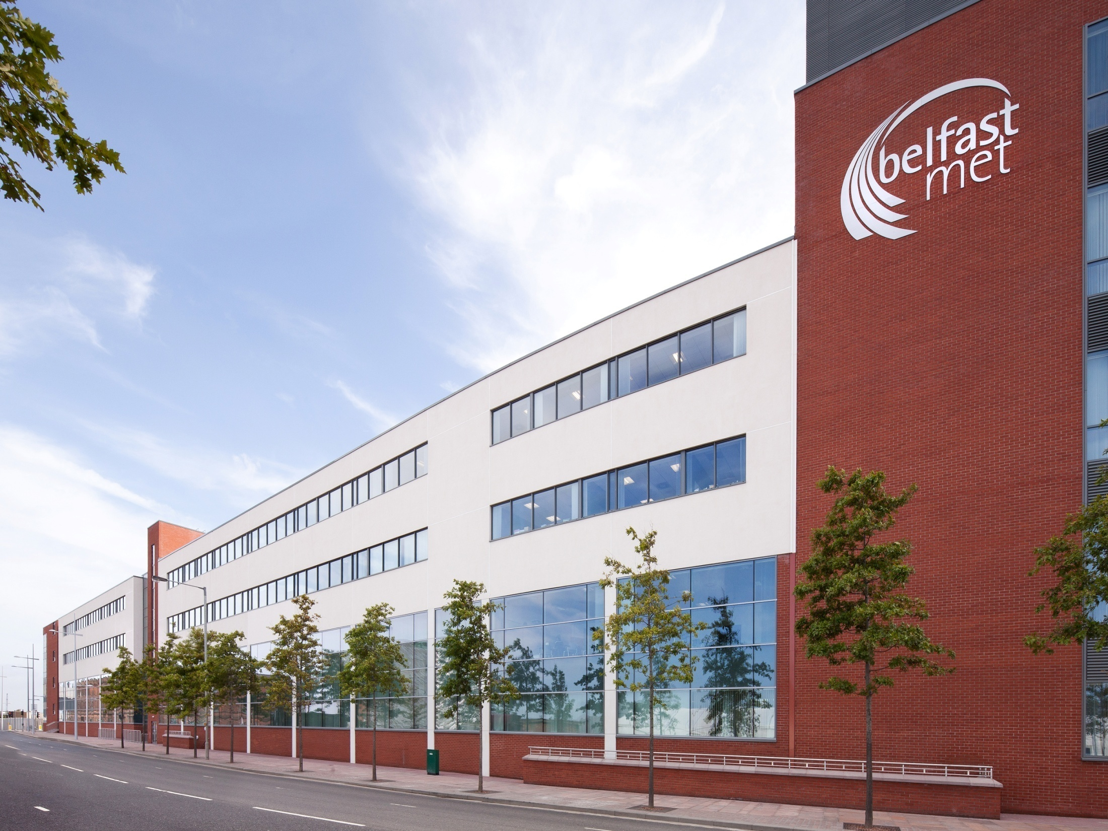
Belfast Metropolitan College

Slide 11
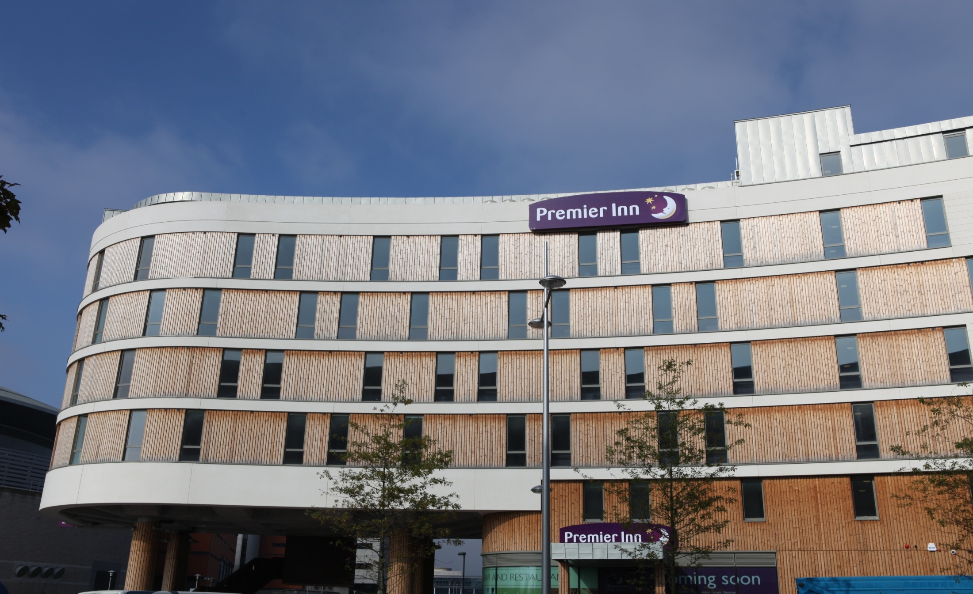
Gateway Hotel
Notes:
11

Slide 12
Challenges
Global recession/weak market demand
NI Economy remains weak
Consumer confidence is fragile
Significant decline in development pipeline
Bank lending problematic
Planning process slow and bureaucratic
Notes:
12

Slide 13
What Can We Do?
Reduction in Corporation Tax
Planning system more responsive
Strengthen alliance between BCC and business
Other tax based incentives
Innovative public/private partnerships
Notes:
13

Slide 14
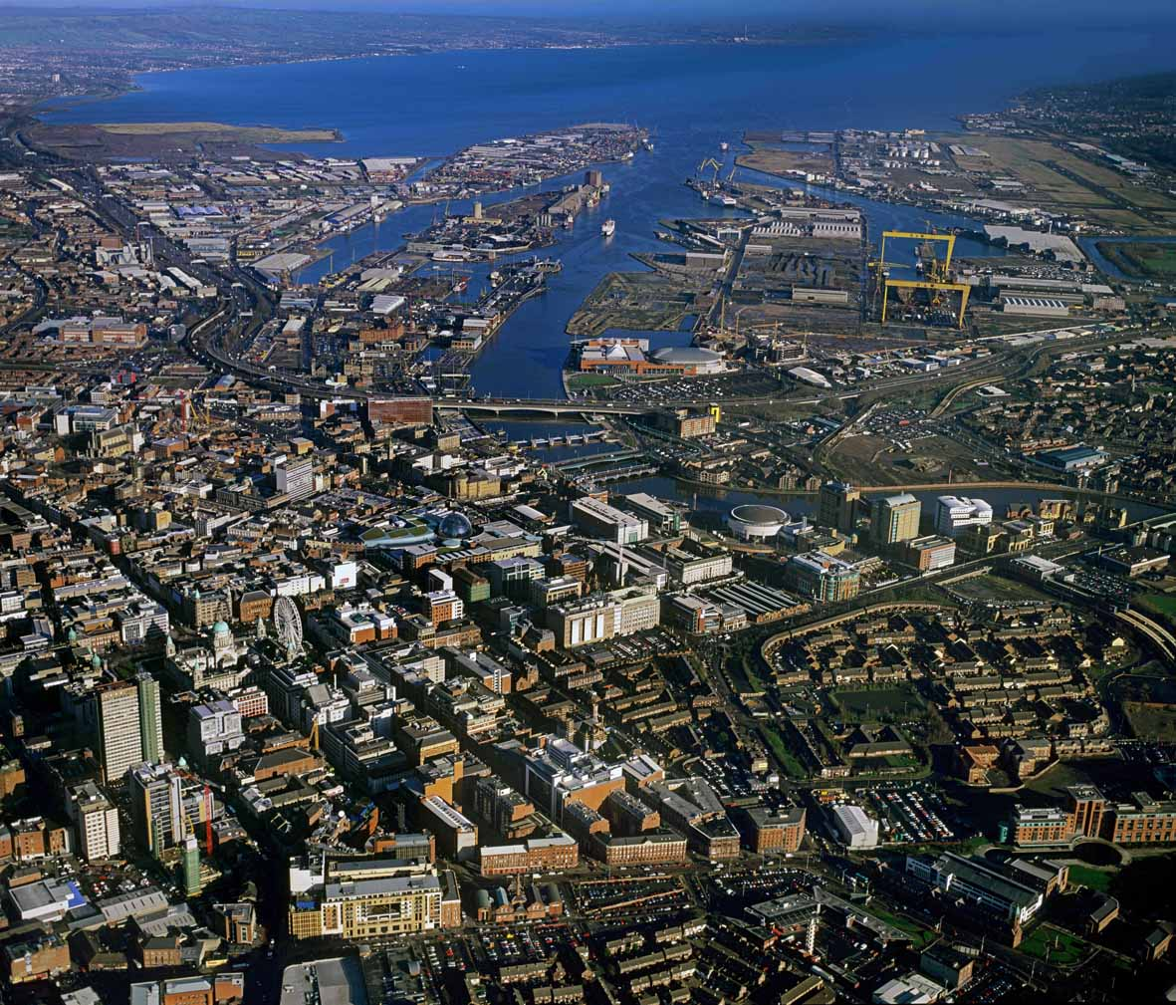
Opportunities (New Economic Drivers)
Financial Services
Connected Health
Creative Media
Tourism & Leisure
Notes:
14

Slide 15
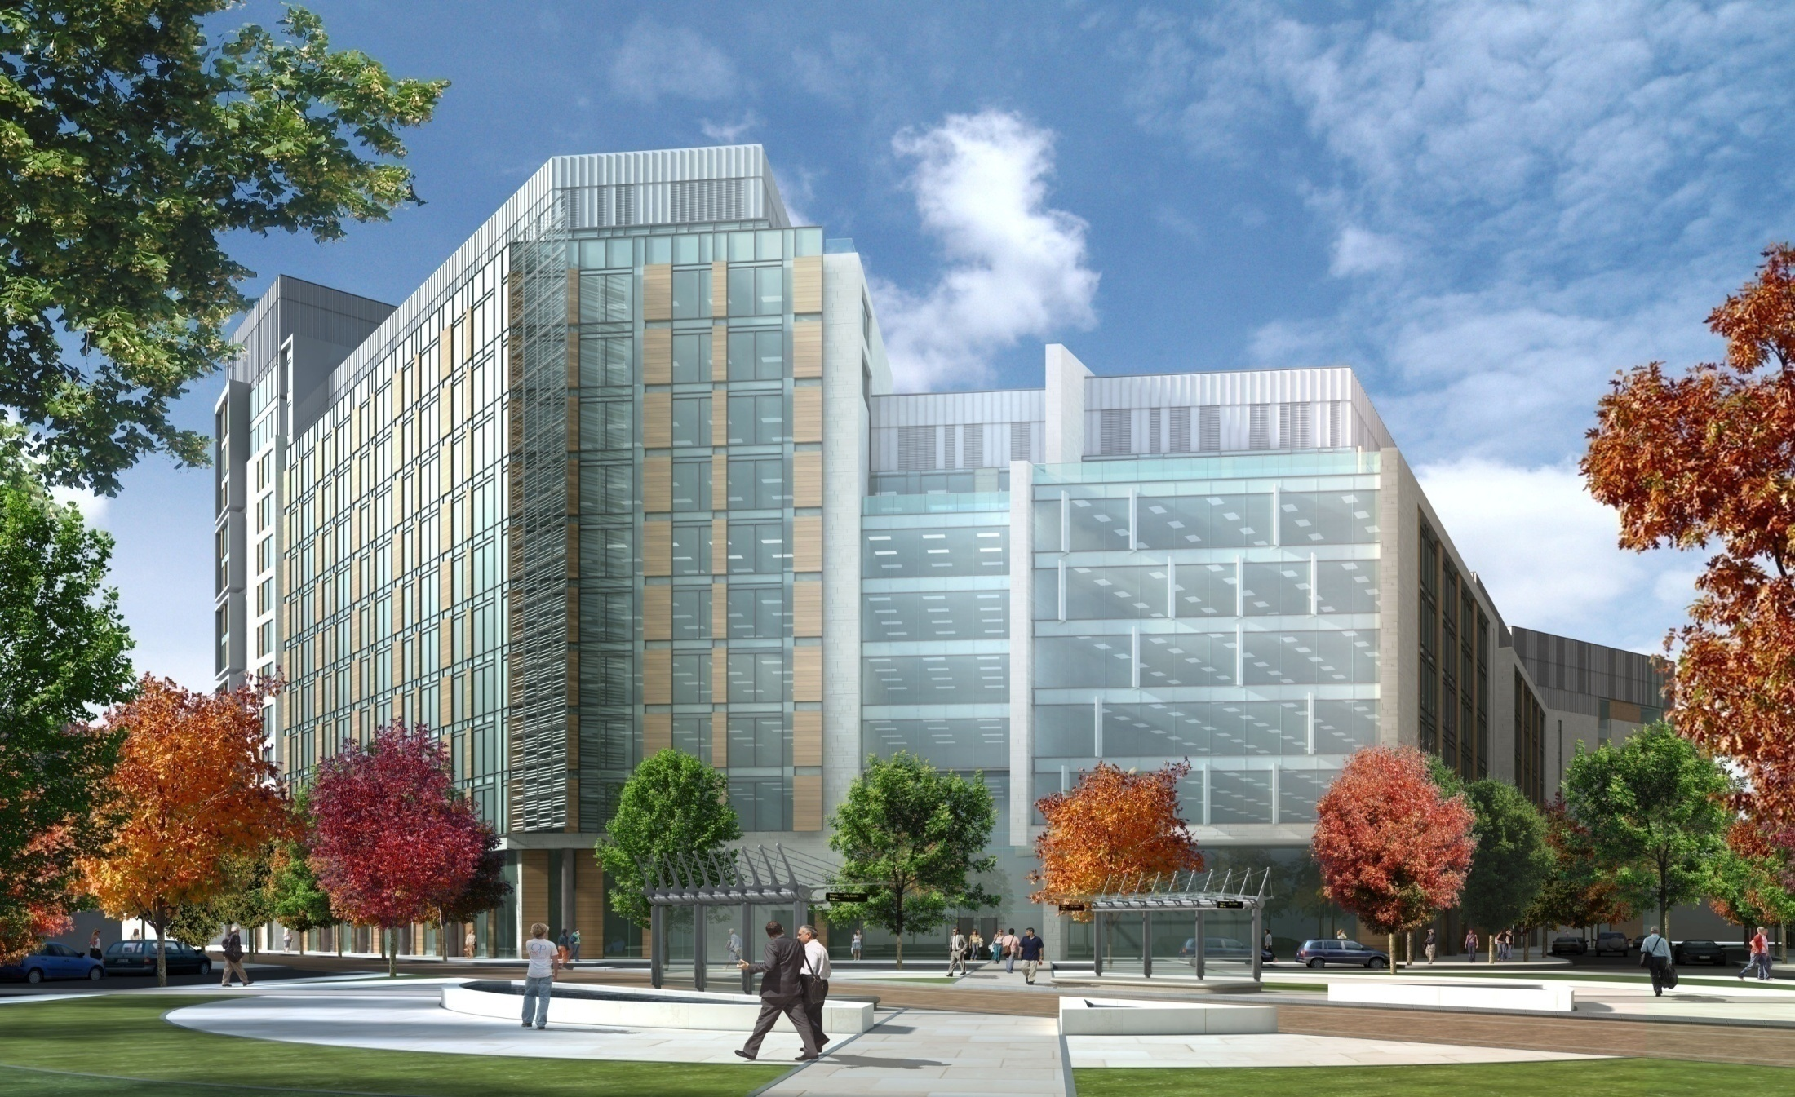
Financial Services Centre
Notes:
15

Slide 16





The European Connected Health Campus
Notes:
16

Slide 17
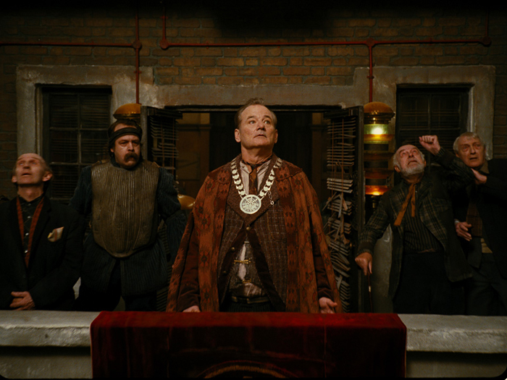
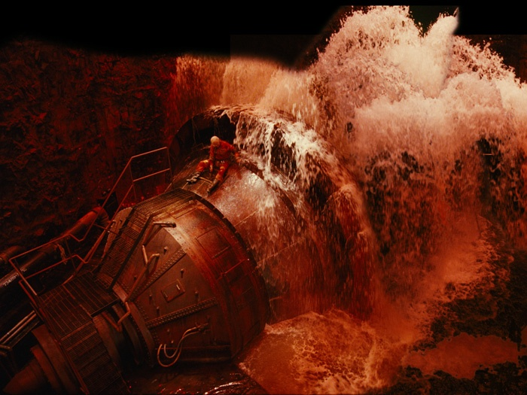


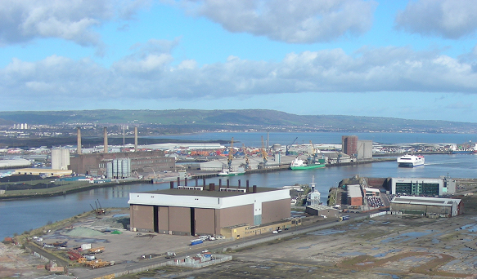

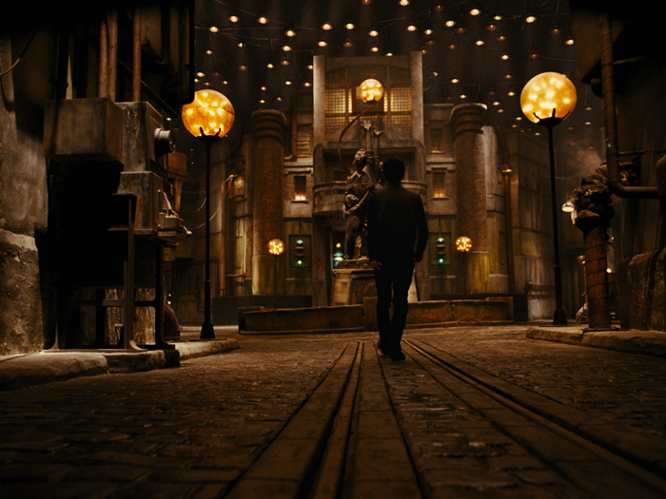
Hollywood comes to
Titanic Quarter!
Paint Hall Studio

Slide 18
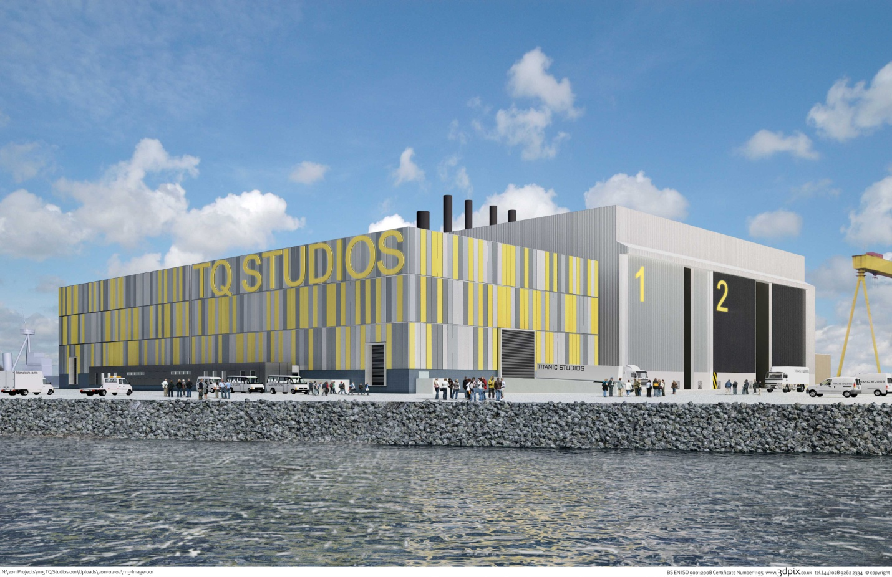
Titanic Studios
Notes:
18

Slide 19
Titanic Signature Project
Titanic Belfast
Create a world-class visitor attraction
To provide a rich cultural and educational experience
To foster pride in Belfast’s heritage
To deliver significant economic, social and cultural benefits to the people of Belfast and Northern Ireland
Notes:
19

Slide 20
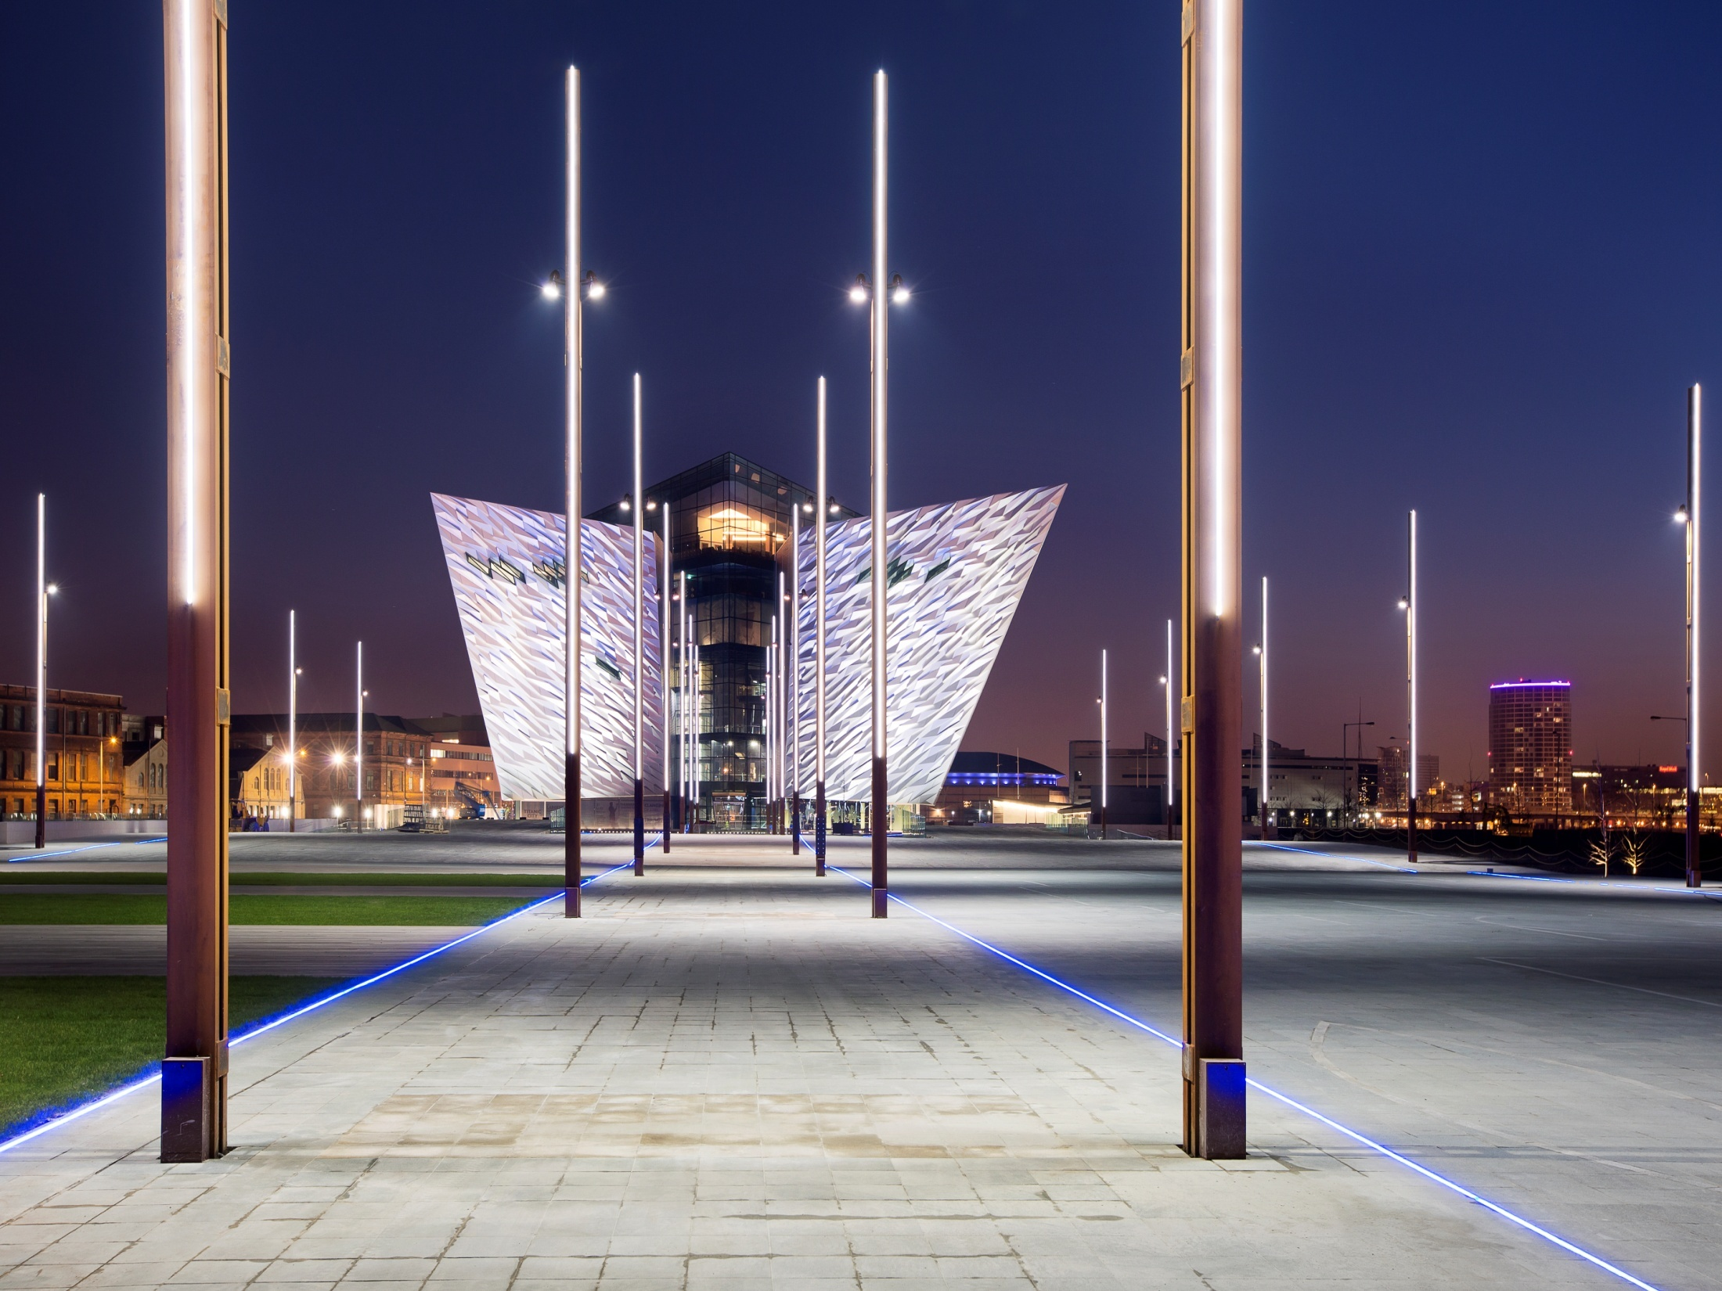
Titanic Belfast
Titanic Belfast
Titanic Signature Project
“Titanic Belfast”

Slide 21
Memorandum of Understanding
Belfast City Council / Titanic Quarter Ltd
Promote Partnership and Regeneration
Other public sector bodies
Notes:
21

Slide 22
Corporate and Social Responsibility
Employment, Education and Skills
Accessibility and Transport
Community Outreach
Housing
Tourism Development and Promotion
Quality Open Space & Public Art
Notes:
22

Slide 23
Benefits
 | 2011 | All Phases
Investment | £400 million | £8 – 10 billion
Jobs Created | 4,100 | 30,000 – 40,000
Construction Jobs | 300+ | 20,000
Rateable Income | £4.0 million | £33 million
Notes:
23

Slide 24
Belfast
Northern Ireland
Mike Smith
Chief Executive
Titanic Quarter Ltd
Notes:
24

