Slide 1
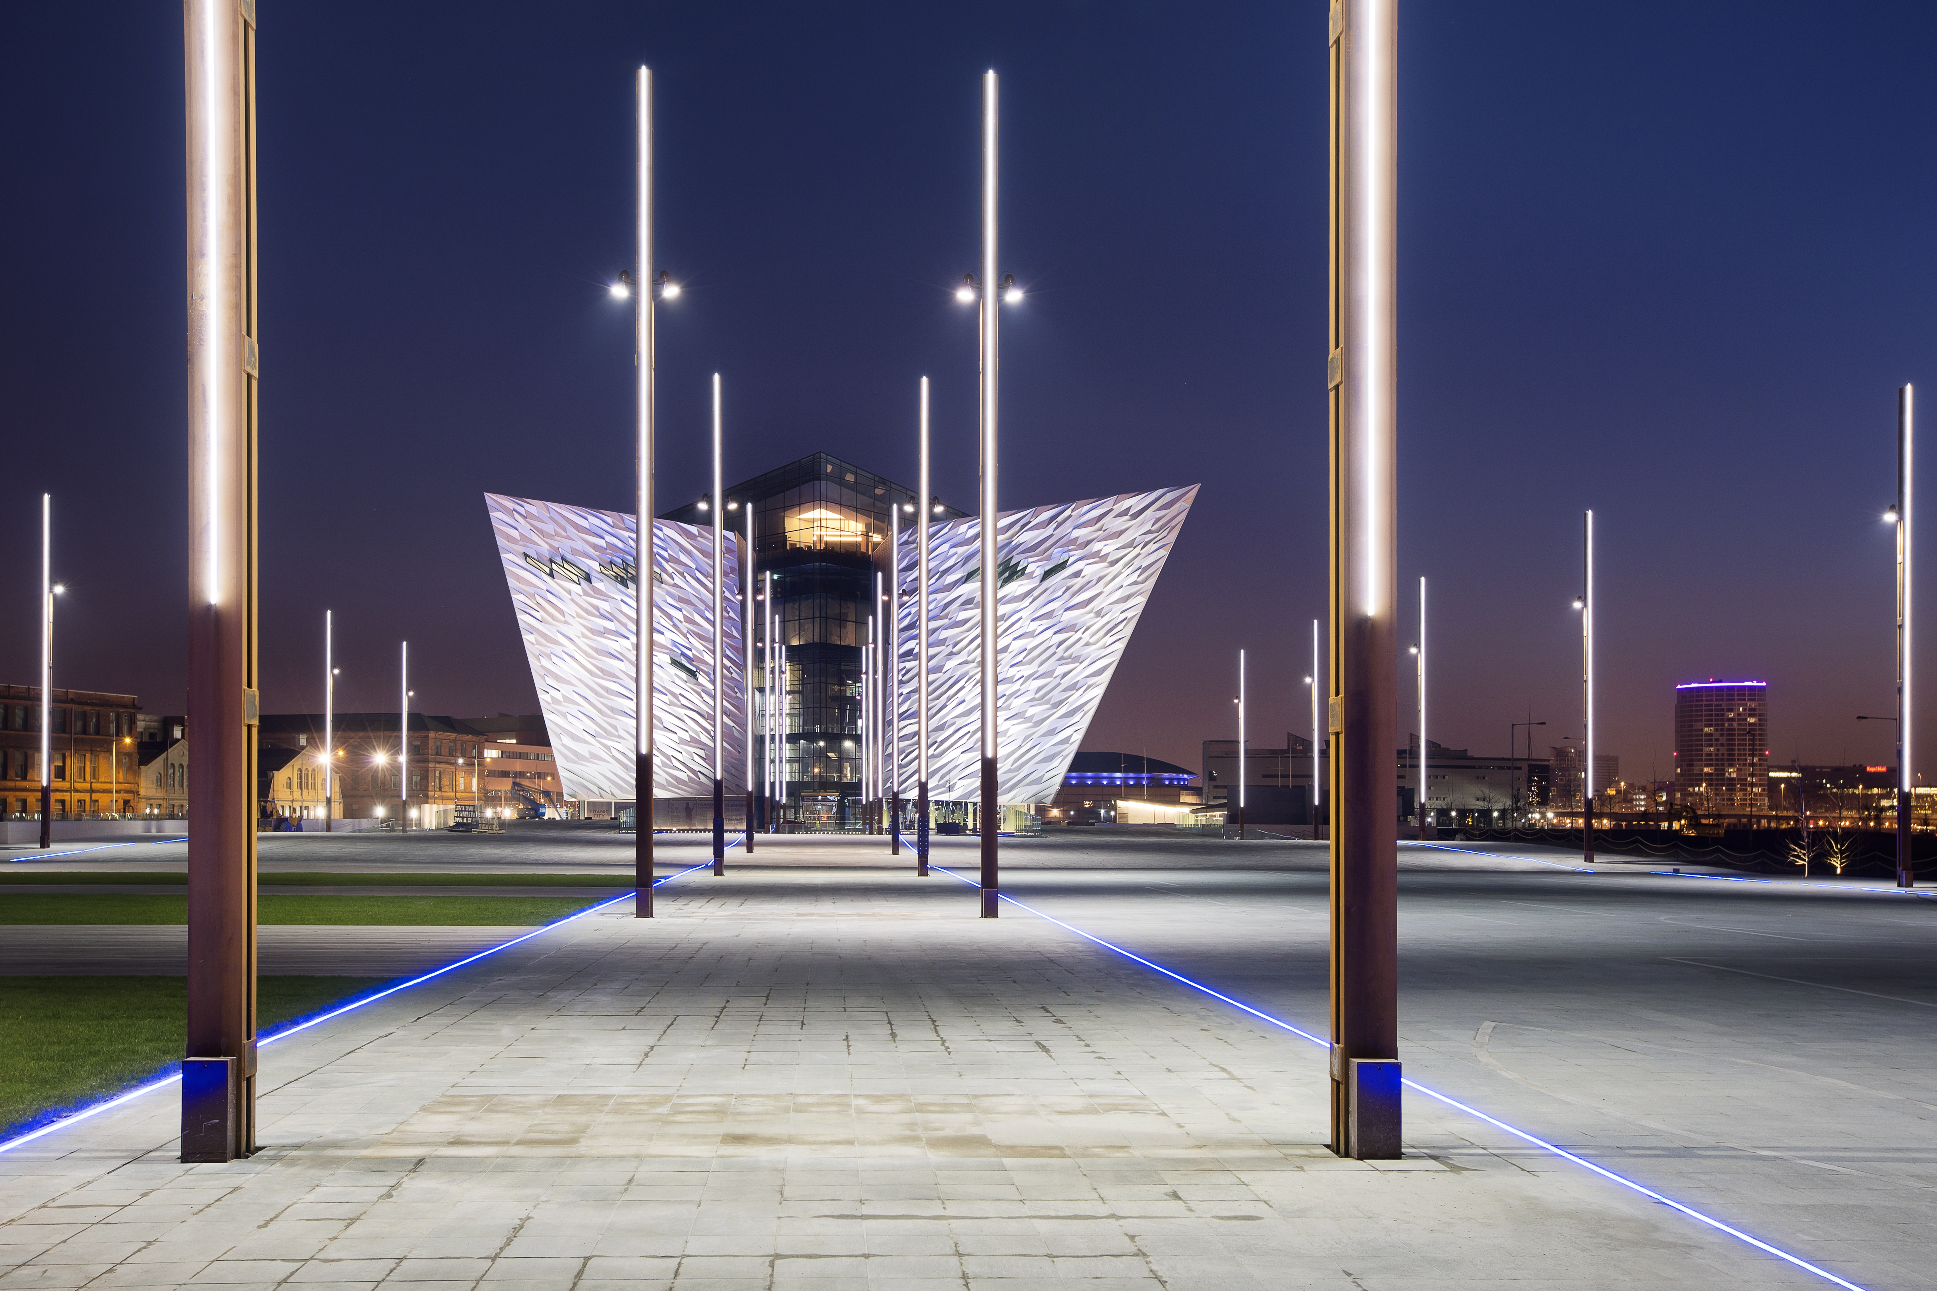

#1City

Slide 2

Pride in tomorrow’s Belfast
Simon Rea
Belfast Pride

Slide 3

A long time ago in a country far far away…
…..
Notes:
New York 1969 to be precise
Local police were harassing the patrons of the stonewall bar on the 28th of June the staff and customers stood their ground, what followed was the stonewall riots and the first Pride civil rights march
In 1982 Homesexuality was decriminalised in Northern Ireland, forced by a decision in the European court of Human rights by Jeff Dudgen

Slide 4
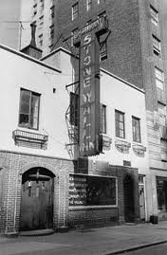
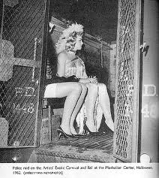
1969

Slide 5
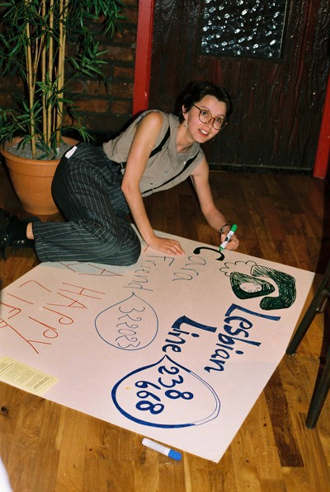
1991

Slide 6
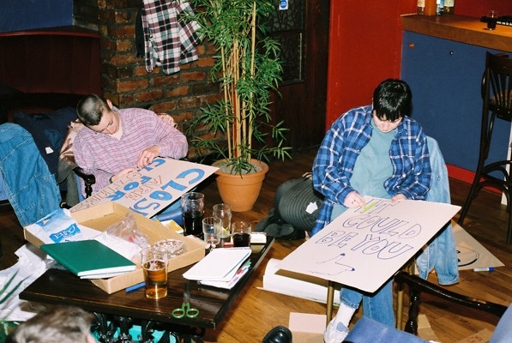

Slide 7
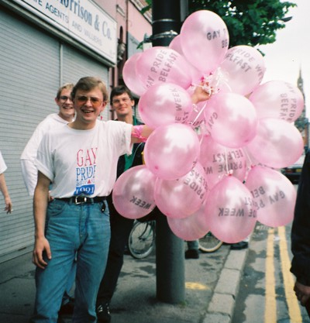

Slide 8
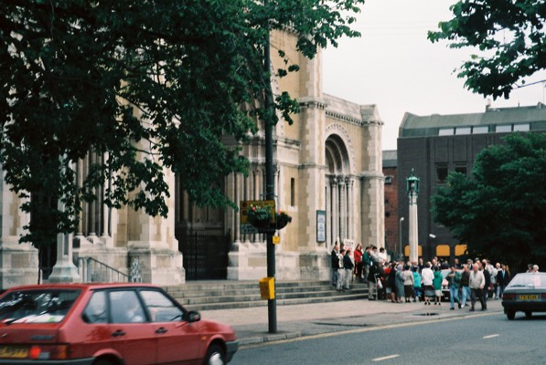

Slide 9
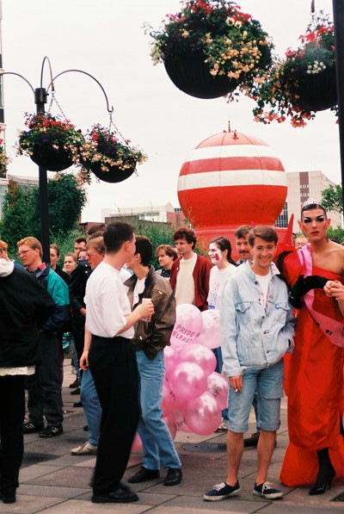

Slide 10
There's no place like home……
Impressions of the city

Slide 11
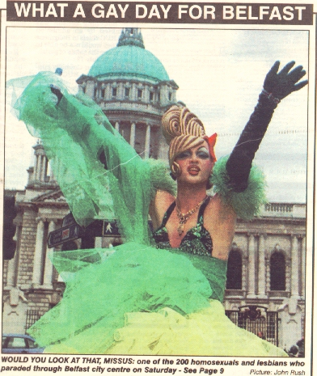
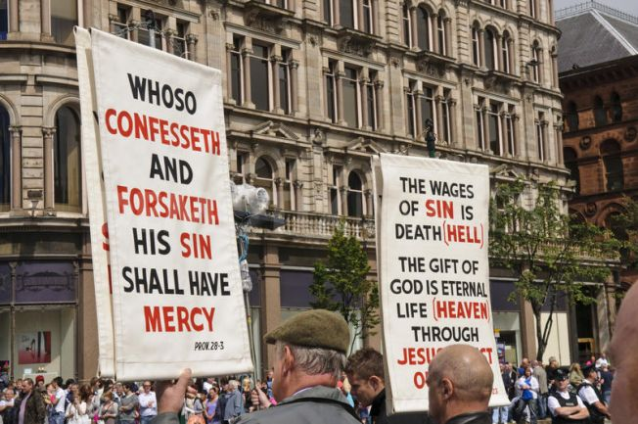
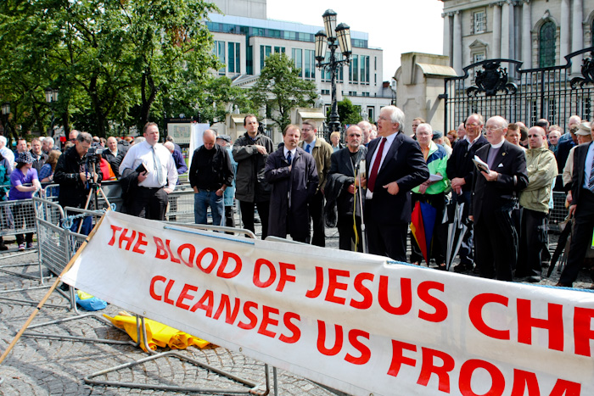

Slide 12
Today’s Belfast
Between 6 and 12 % of the worlds population are LGBT
LGBT specific market is saturated, LGBT accepting market has massive growth

Slide 13
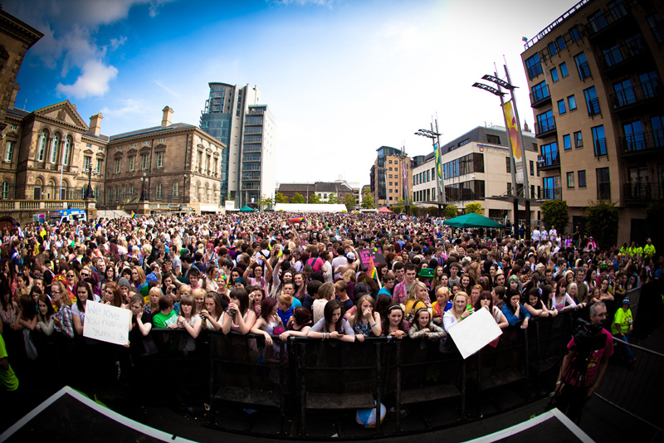
Our time our Plaice?

Slide 14
Belfast Re-imaged
LGBT accepting is respectful
Person centred –V- hetronormativity
Ulster welcomes are really special
Belfast Brand

Slide 15

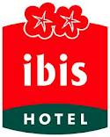

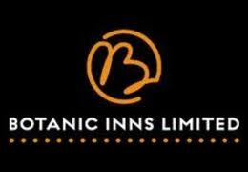

Slide 16
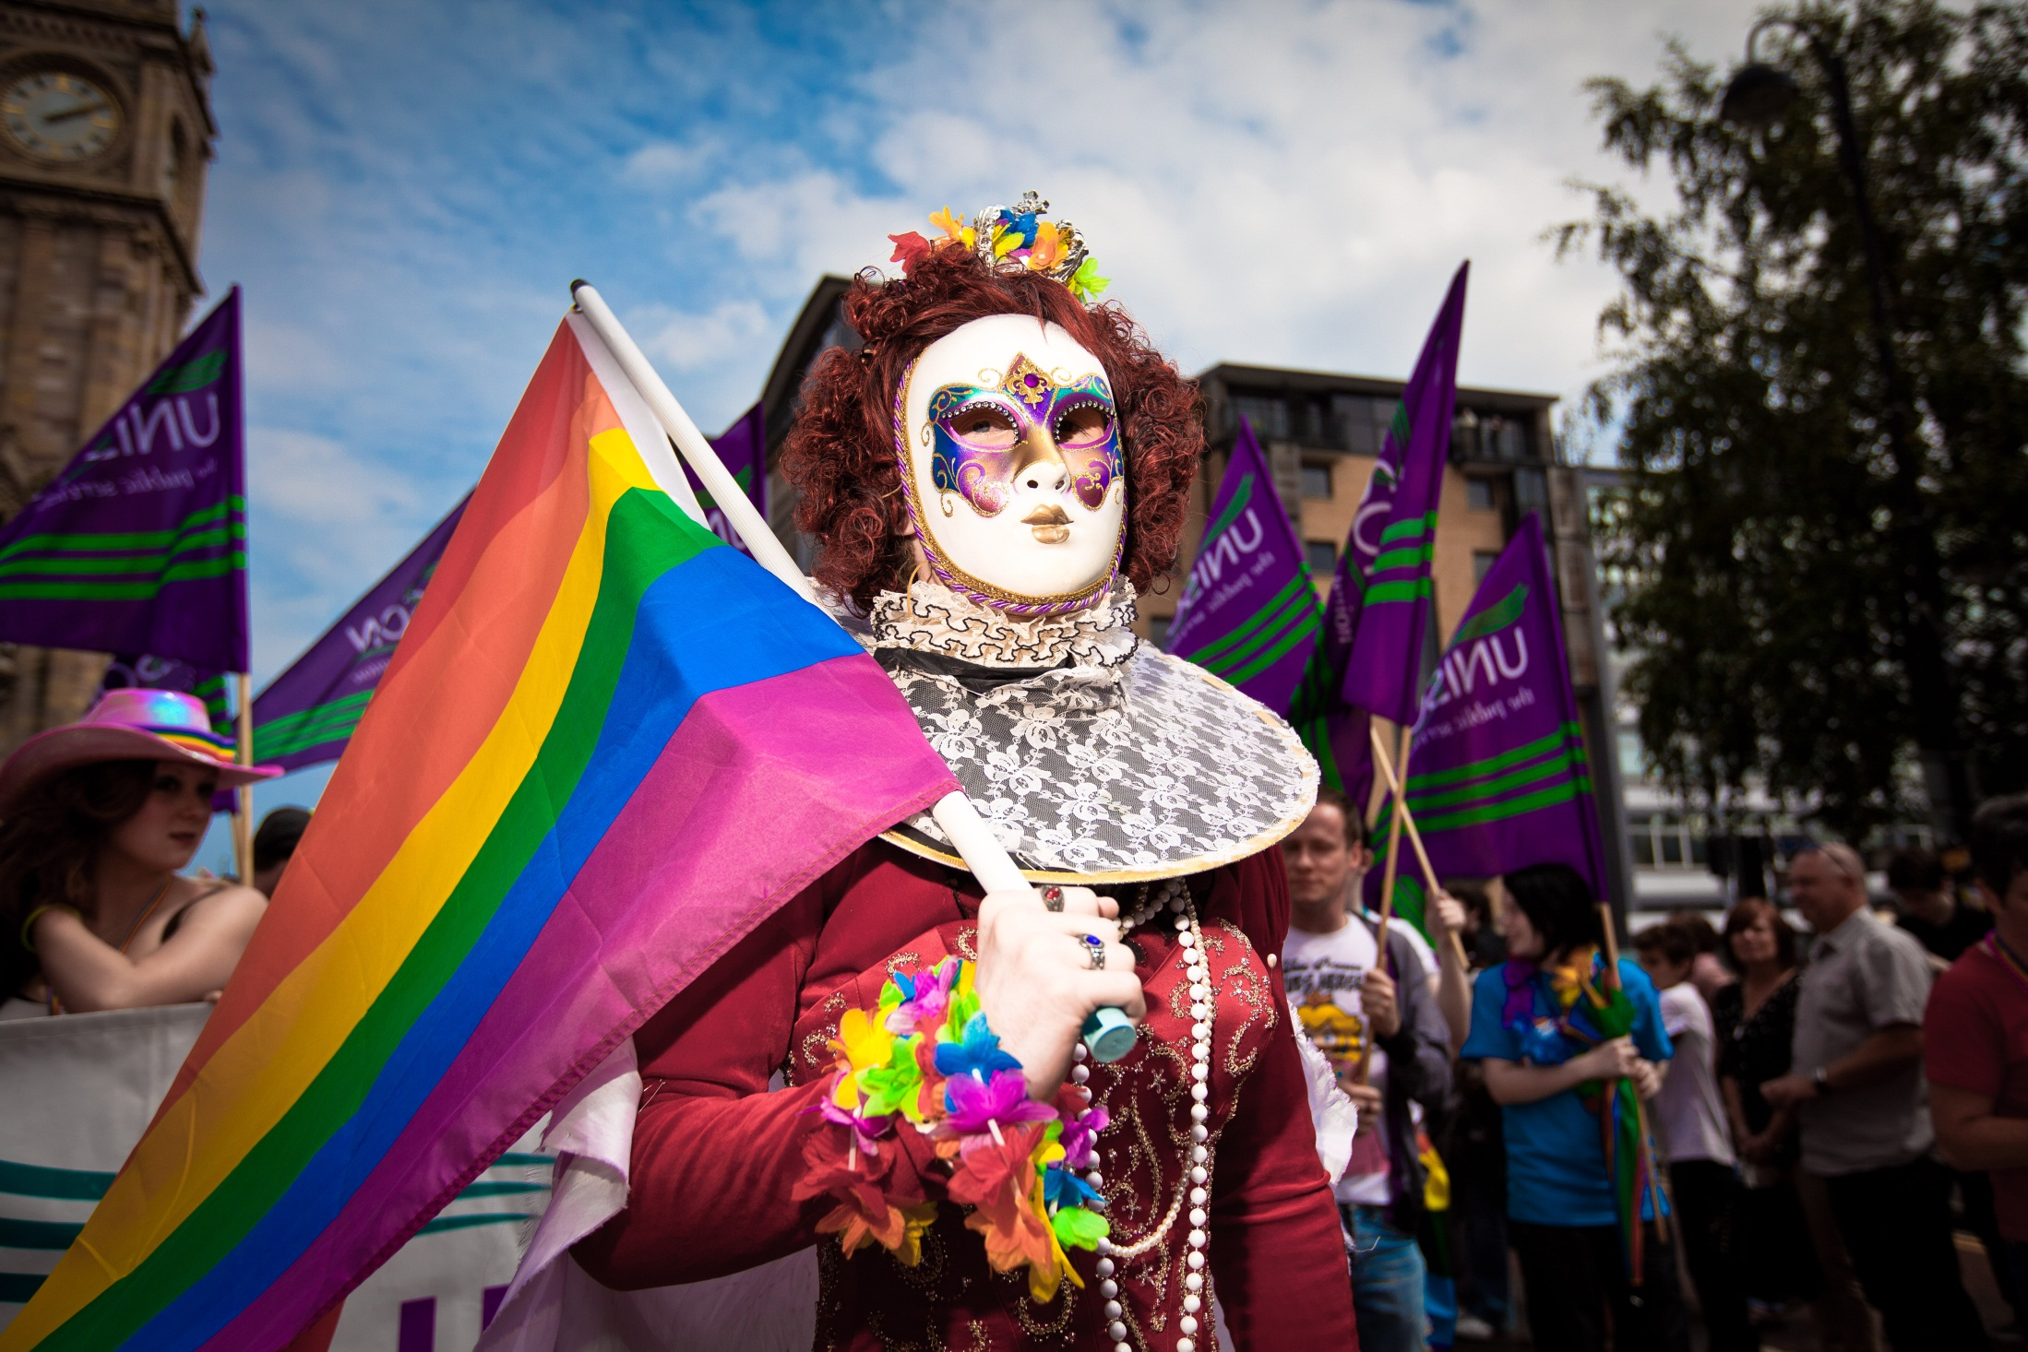

Slide 17
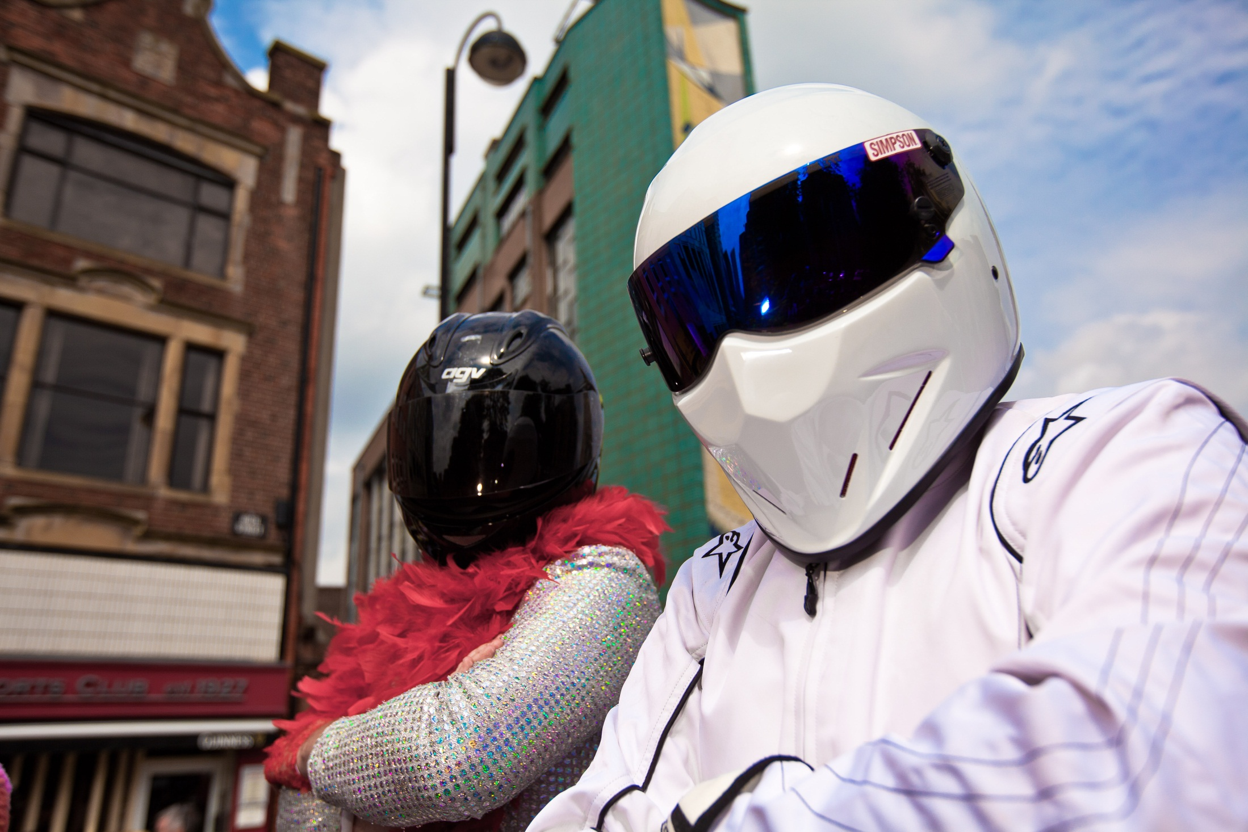

Slide 18
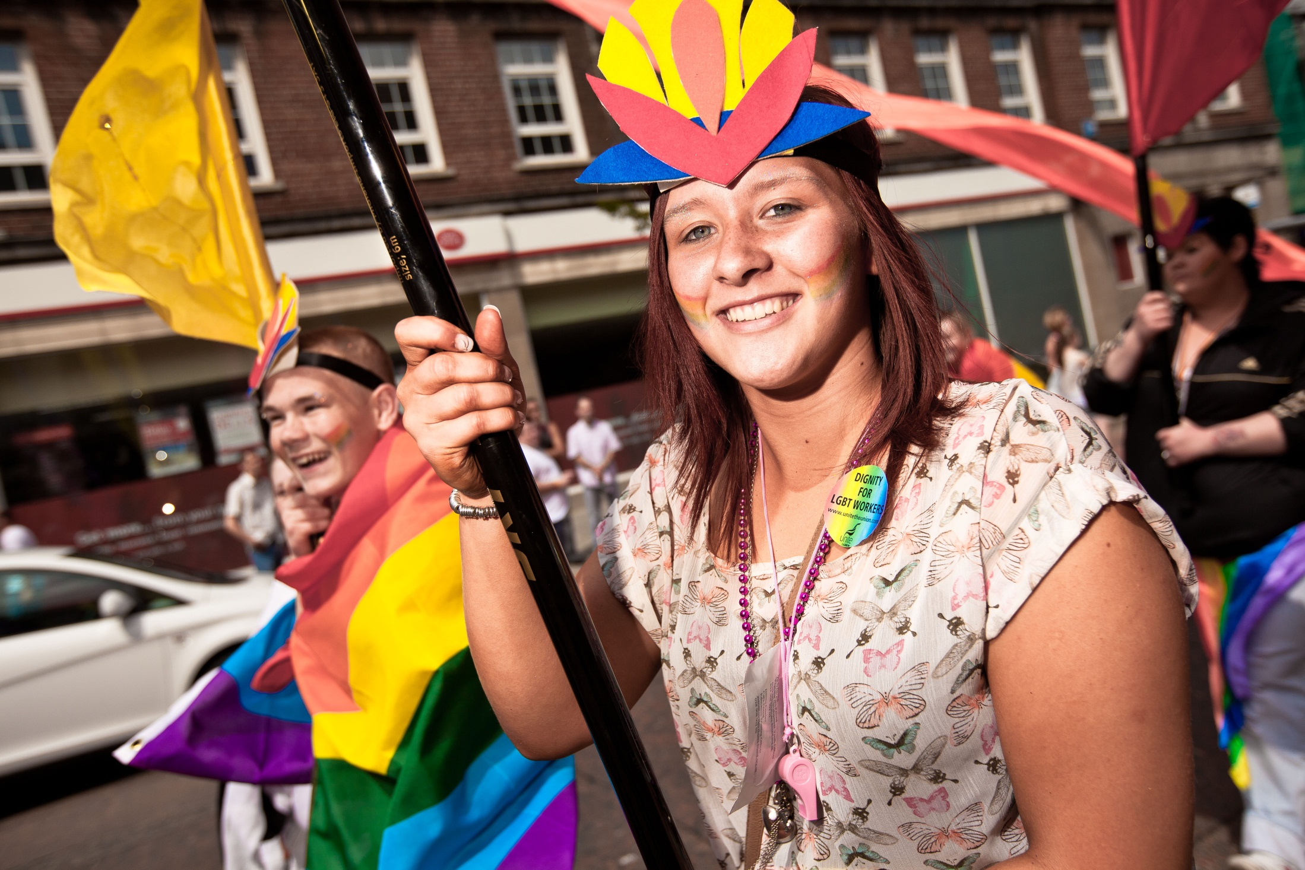

Slide 19
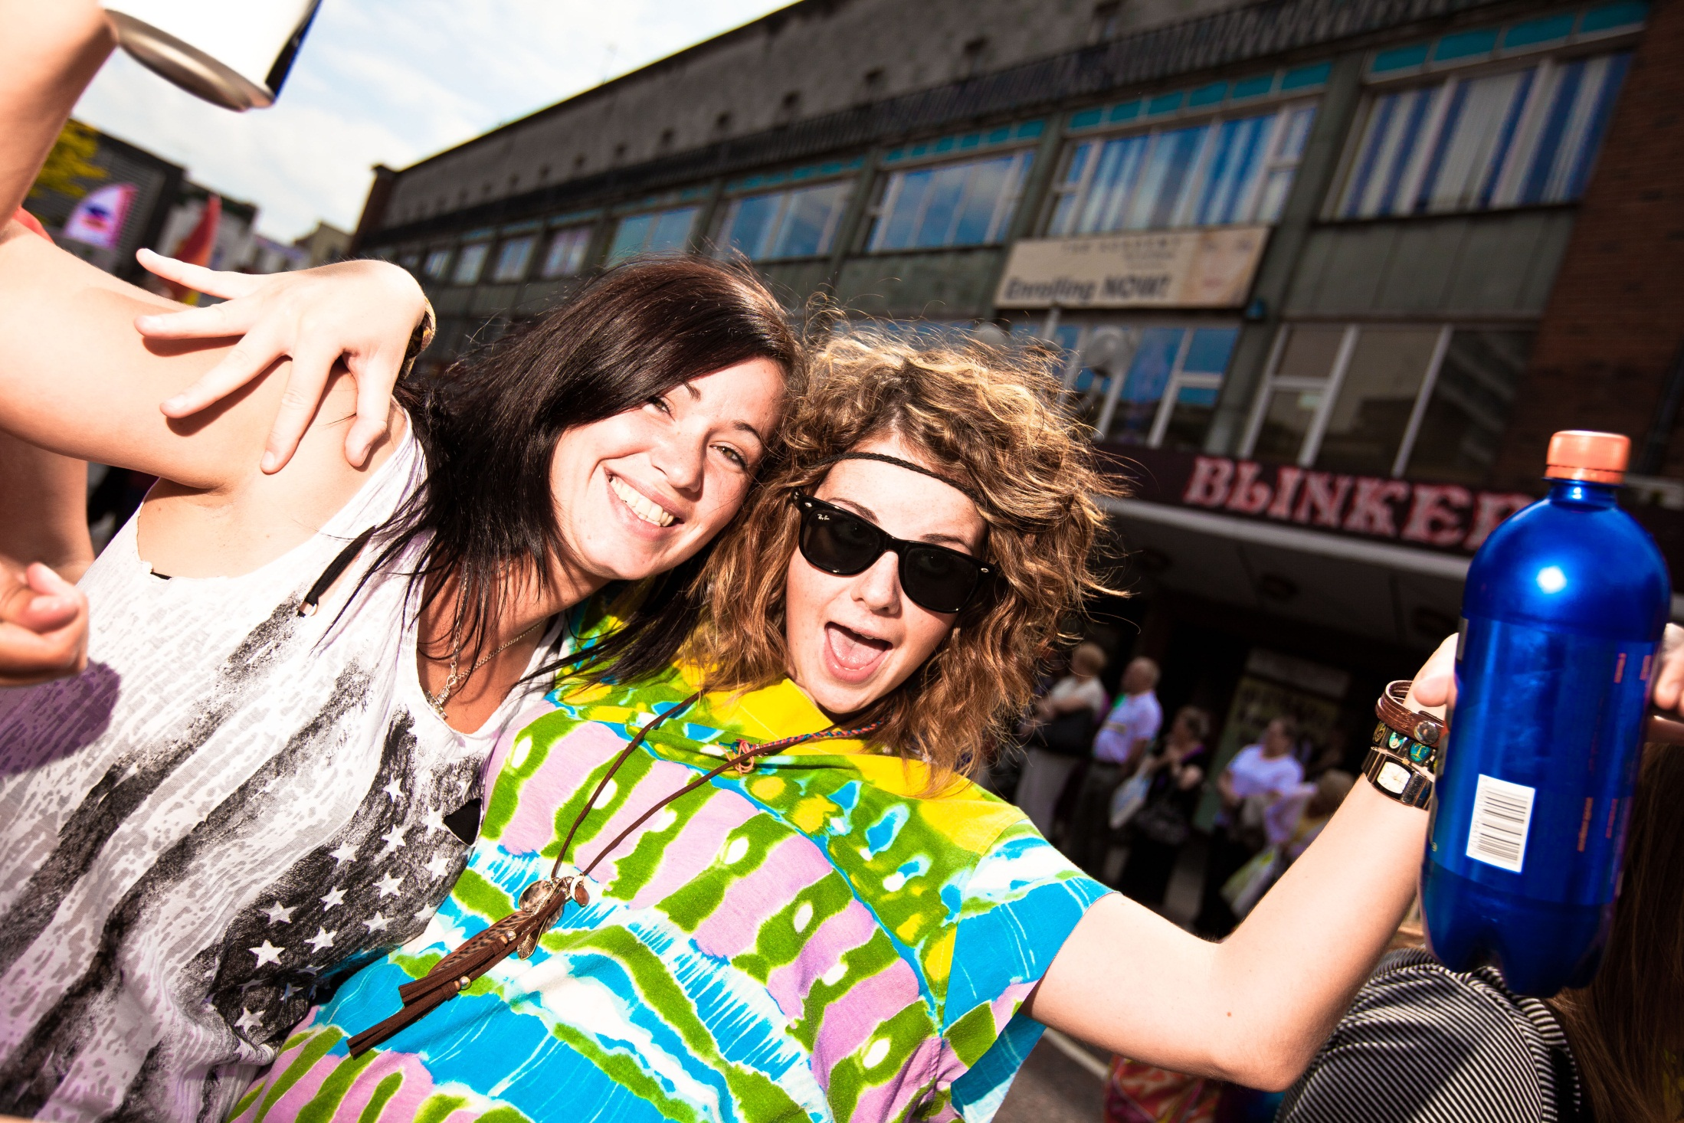

Slide 20
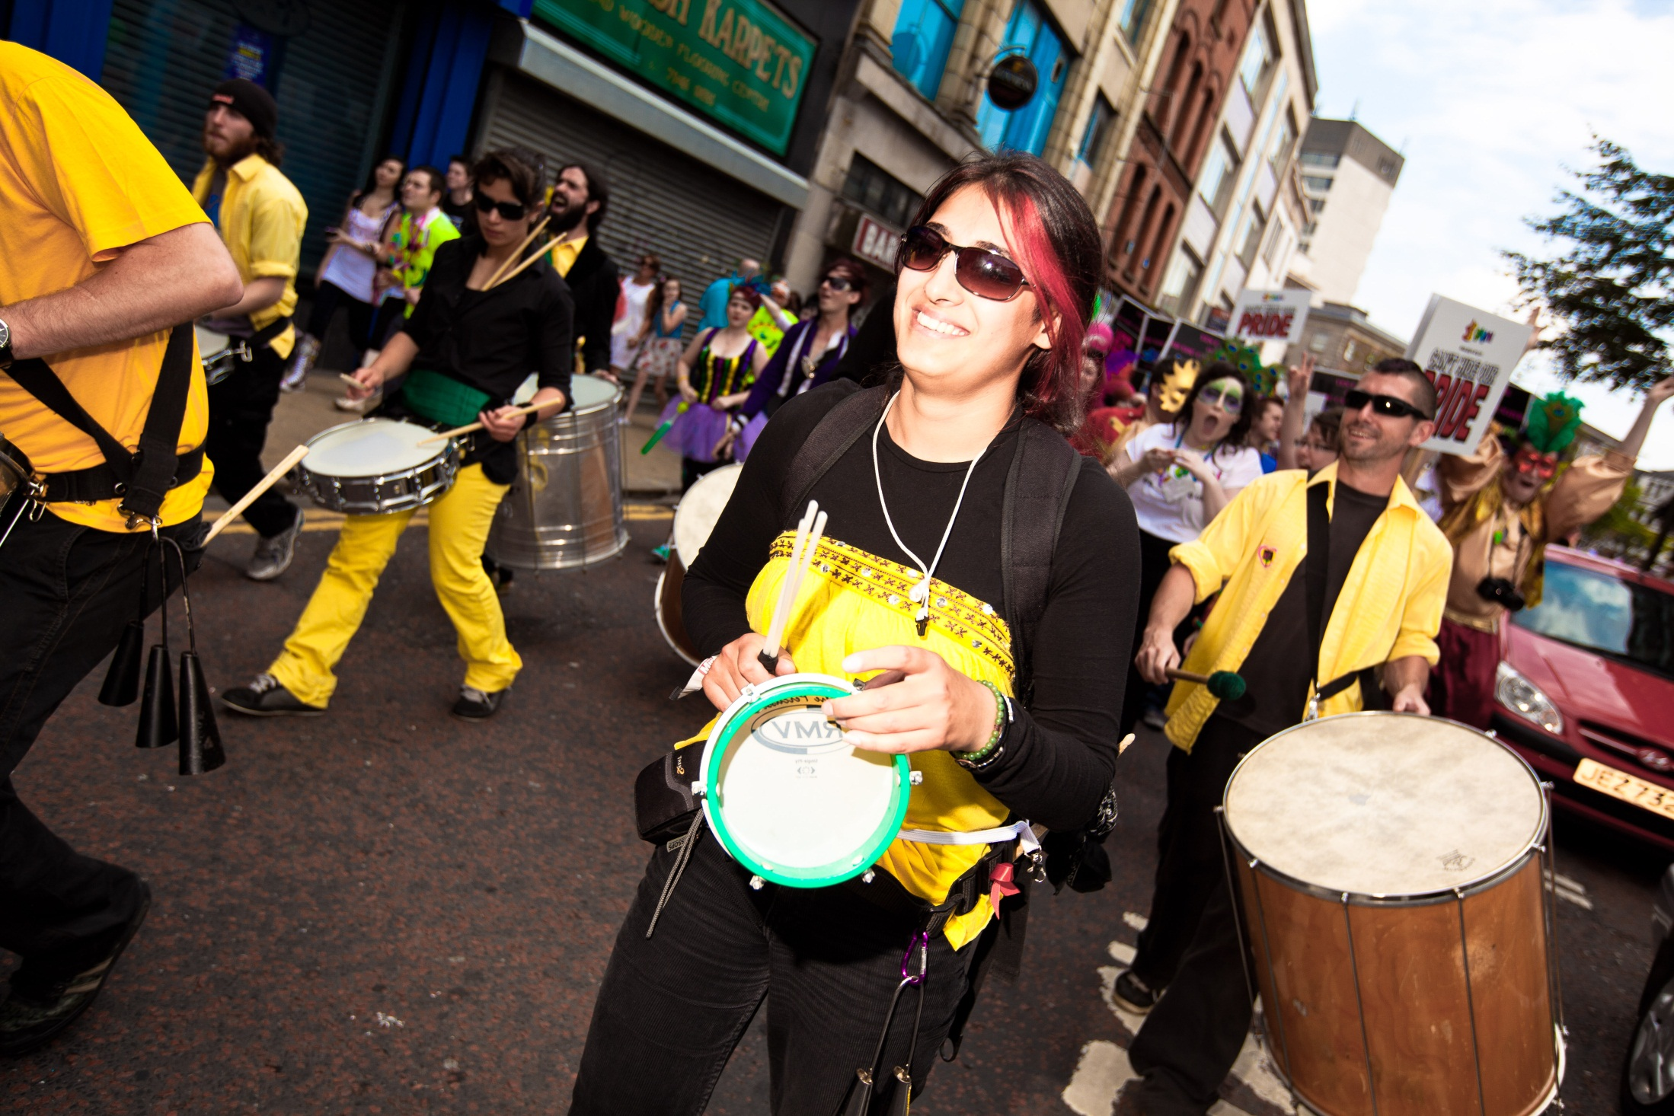

Slide 21
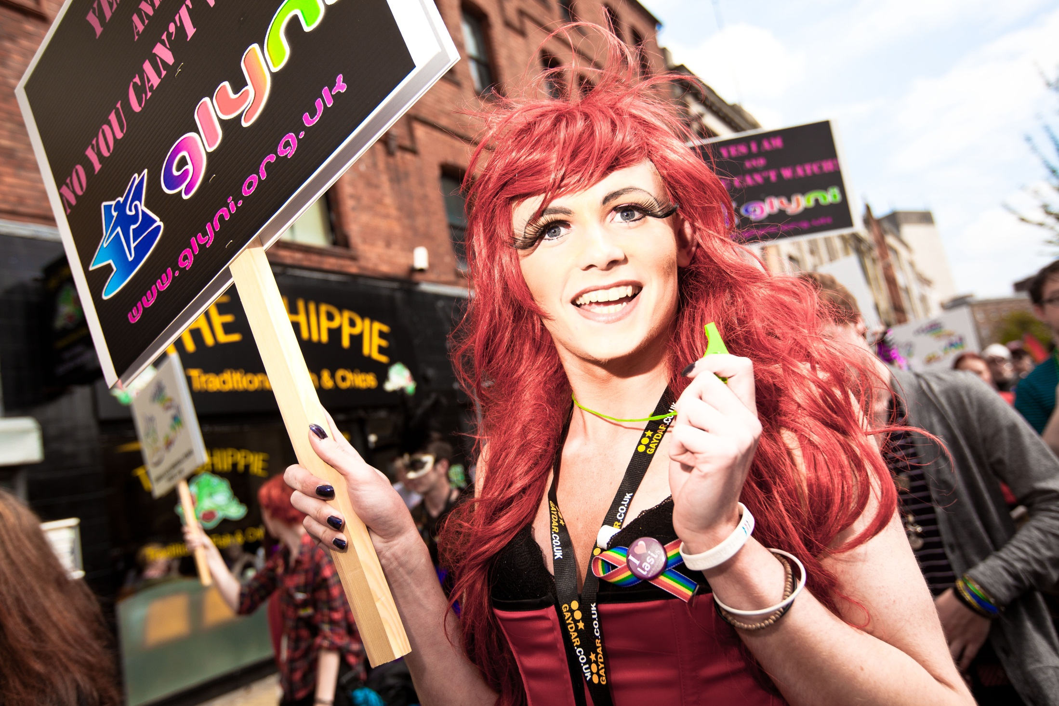

Slide 22
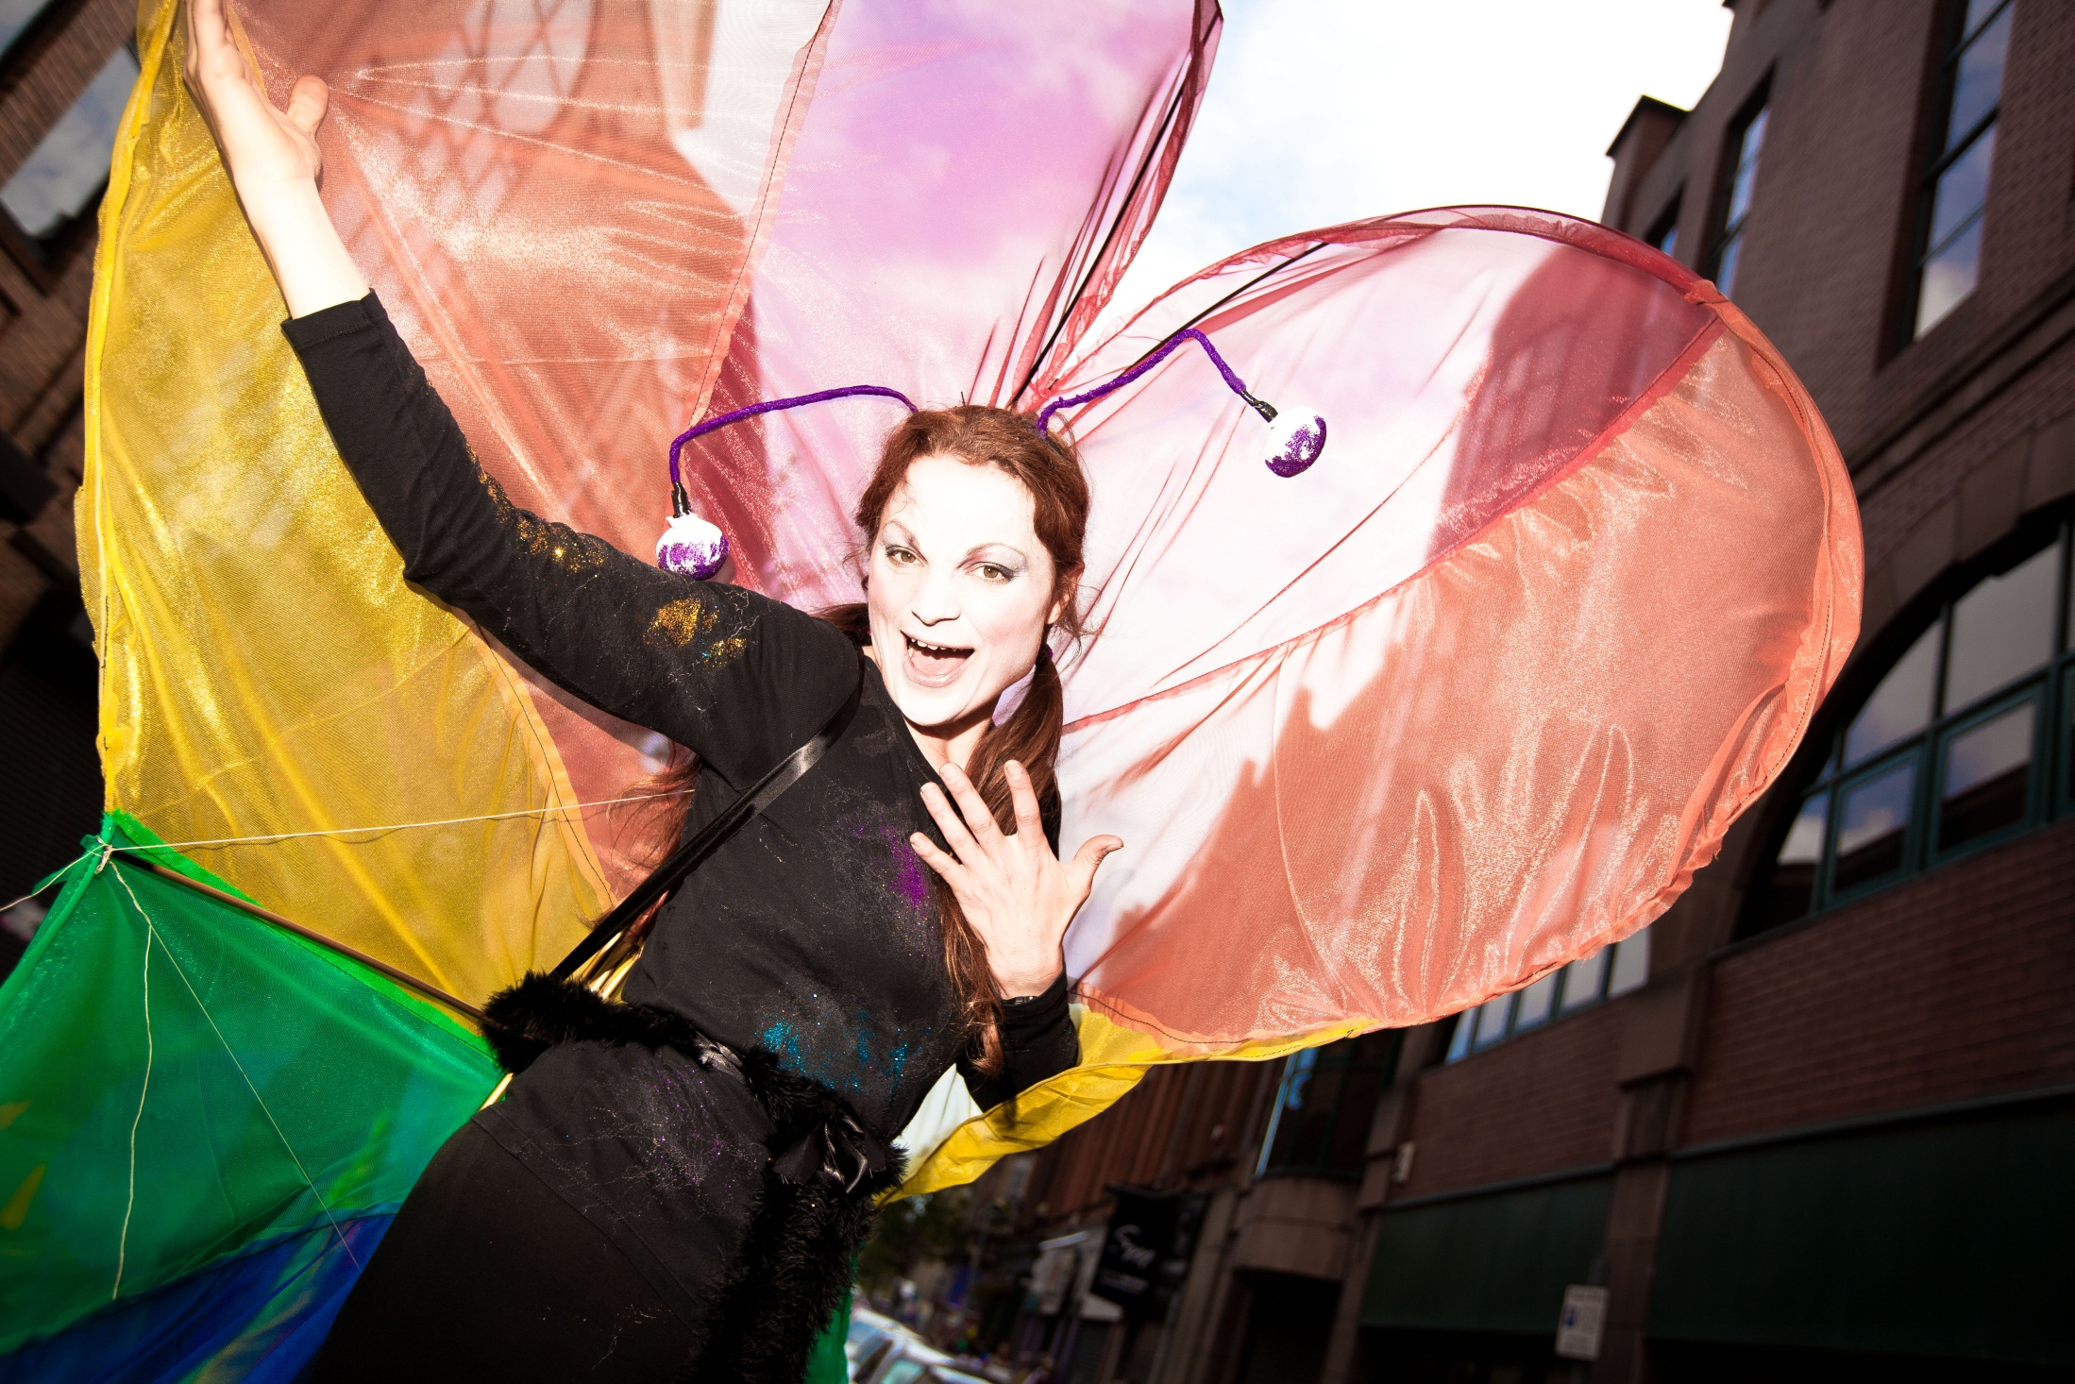

Slide 23
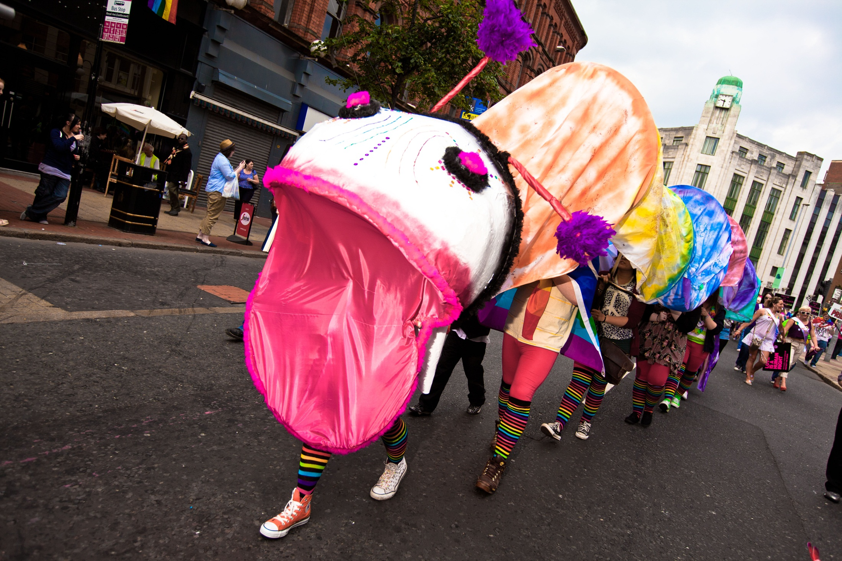

Slide 24
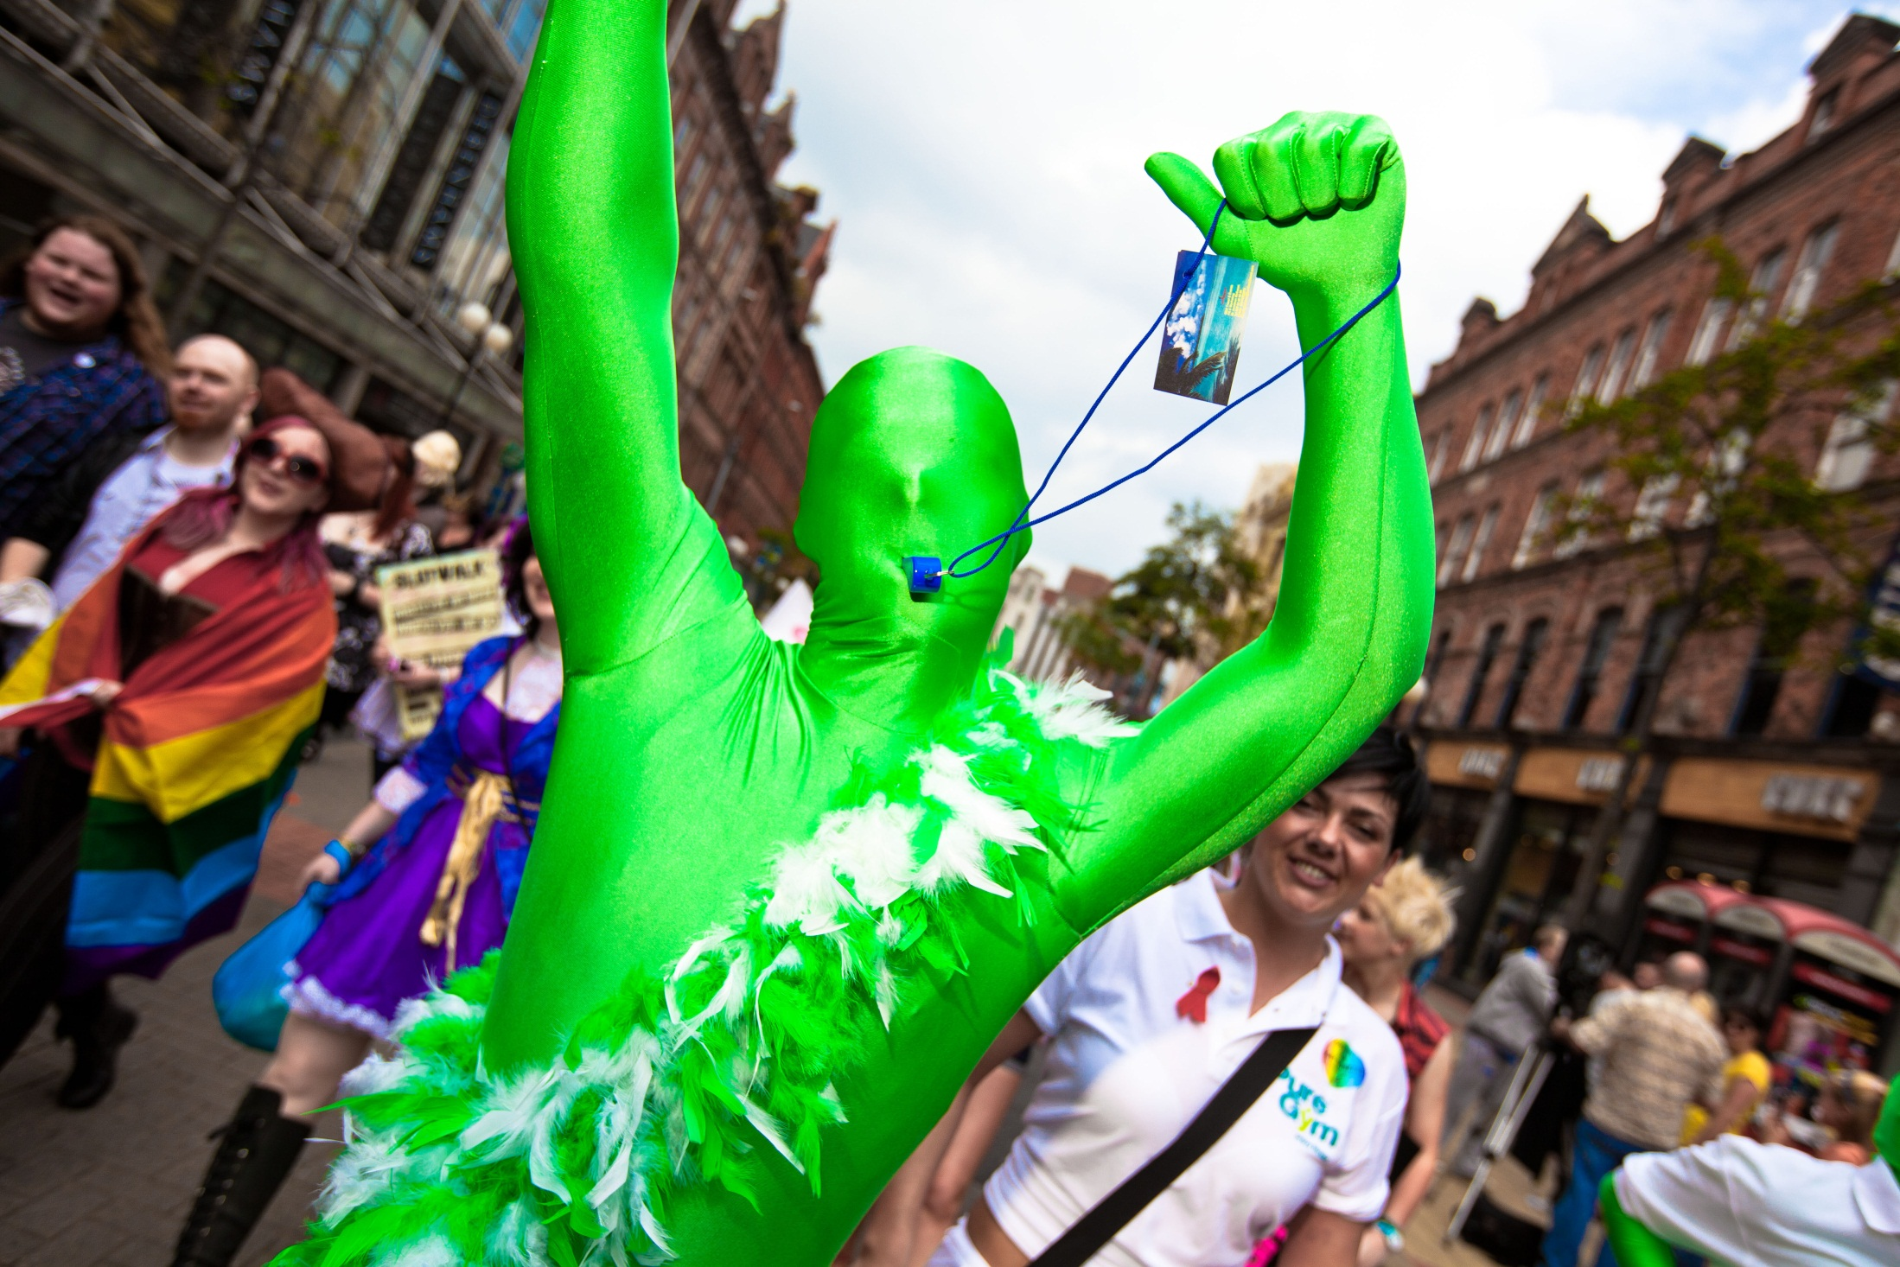

Slide 25
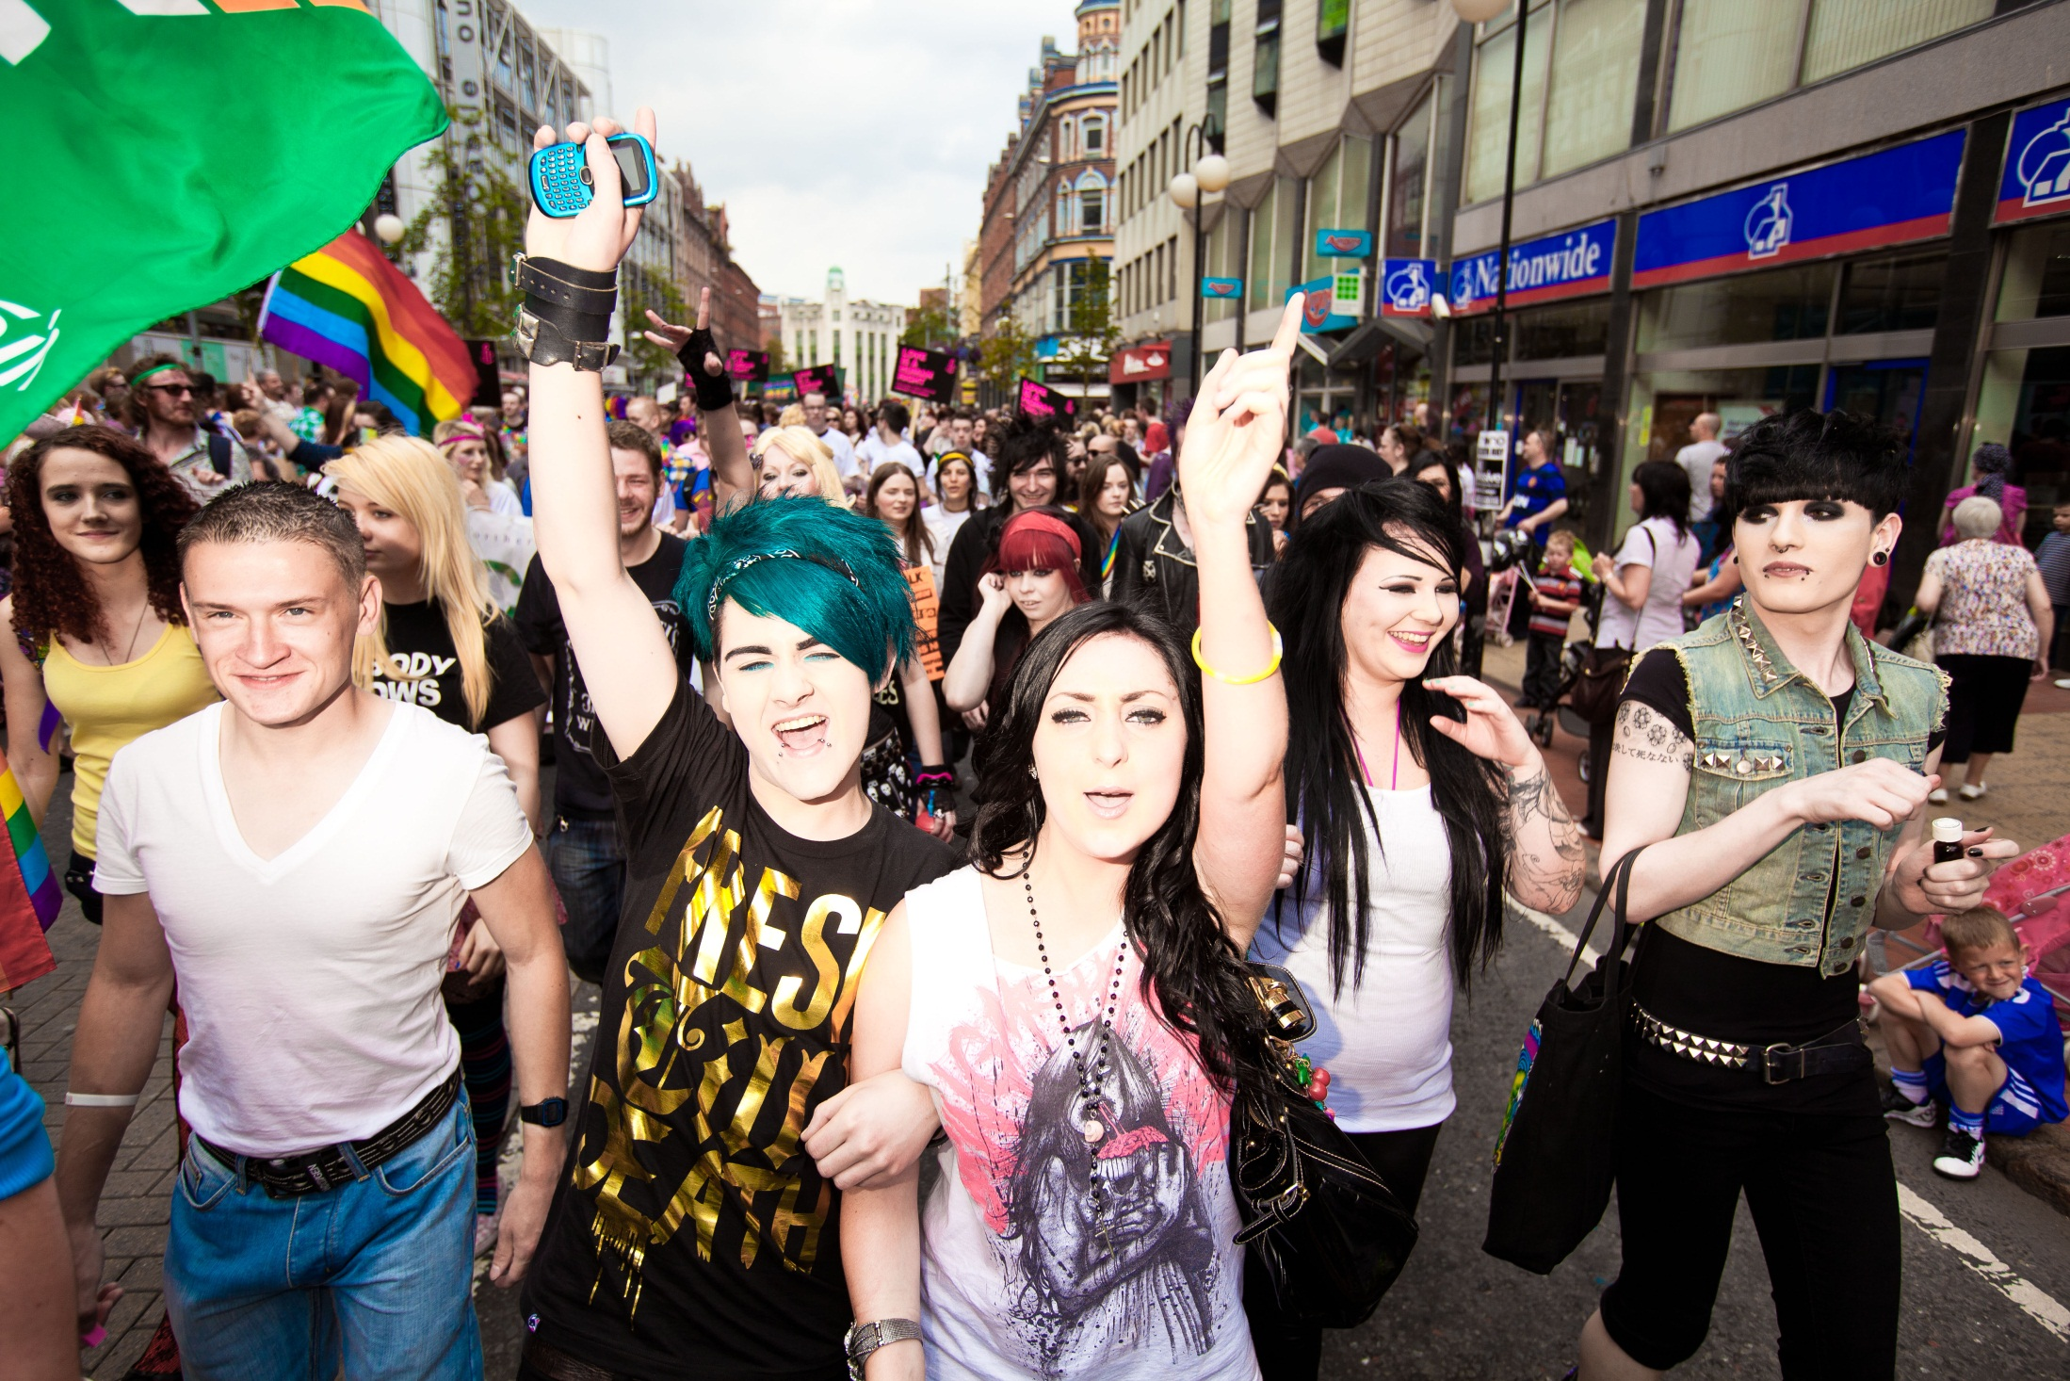

Slide 26
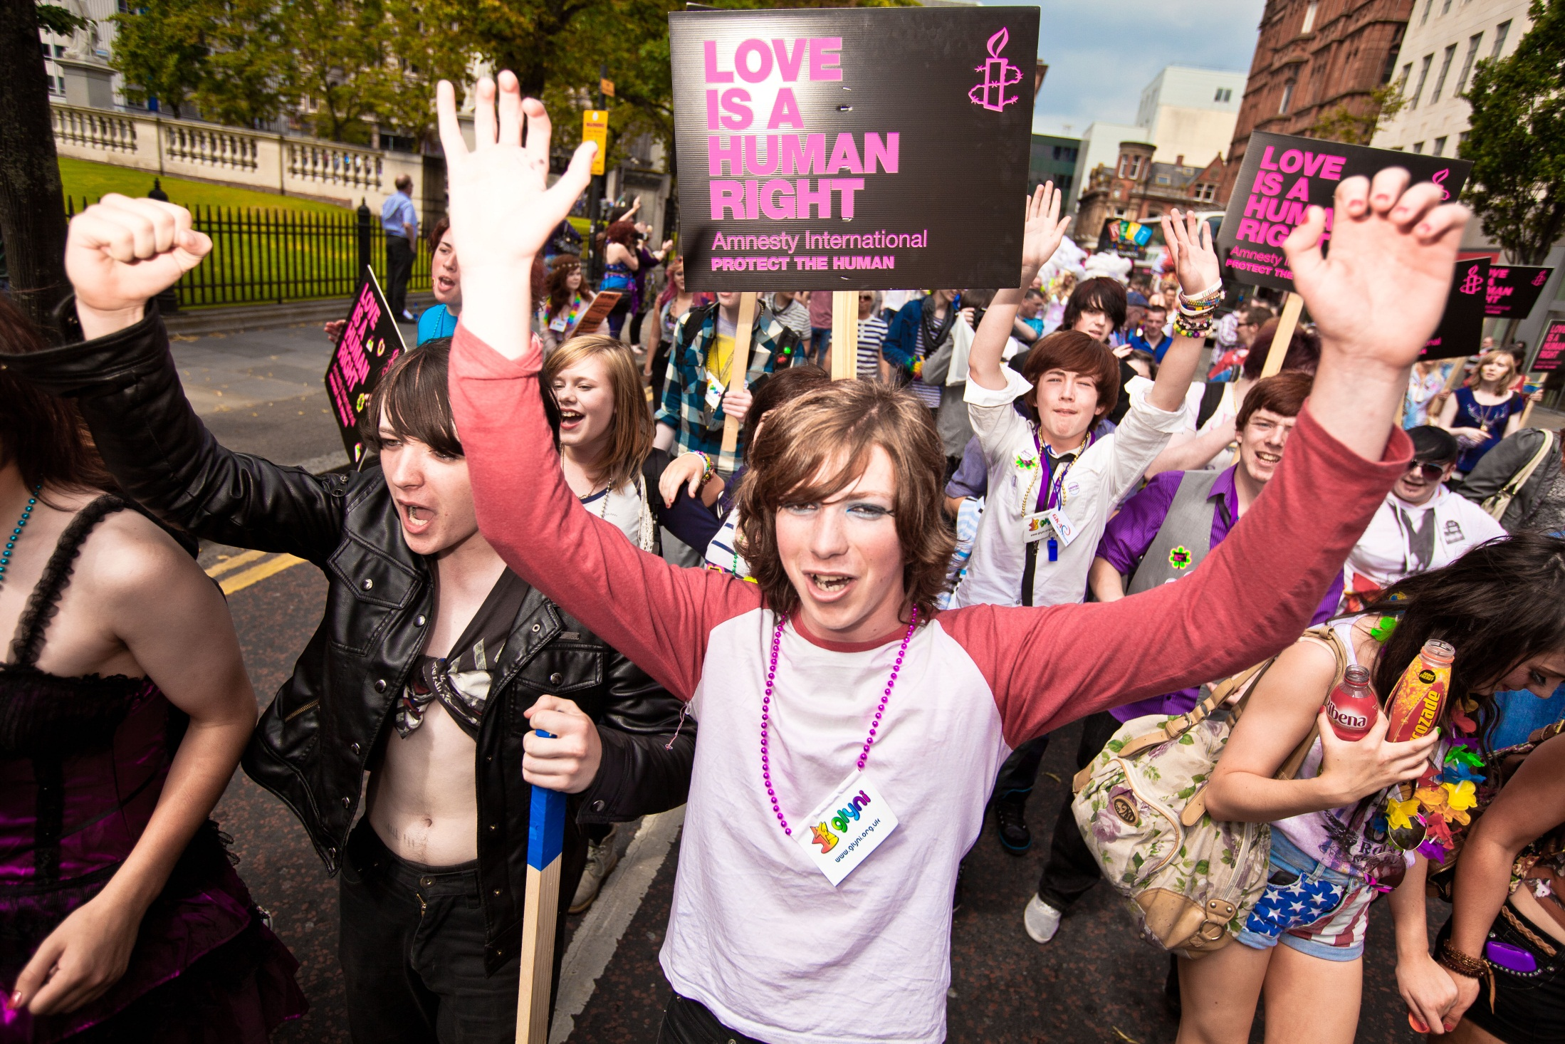

Slide 27
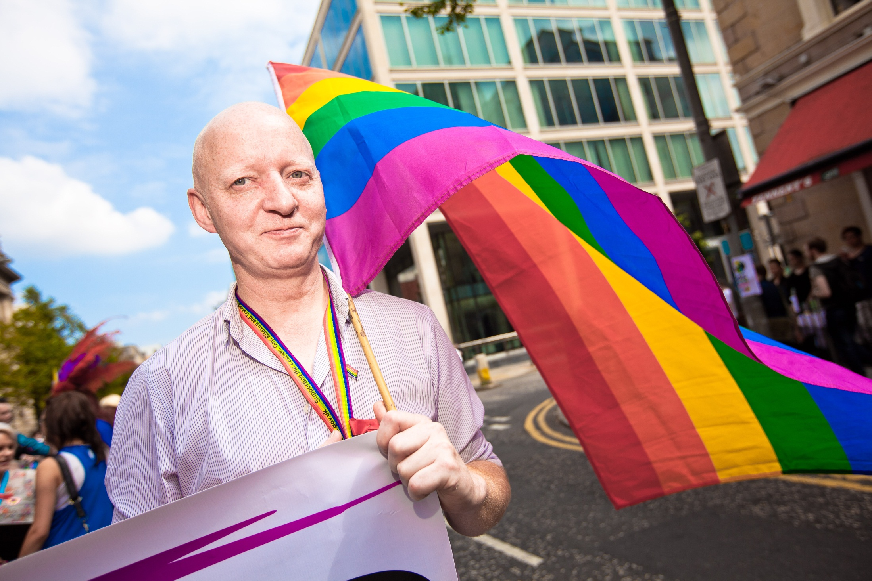

Slide 28
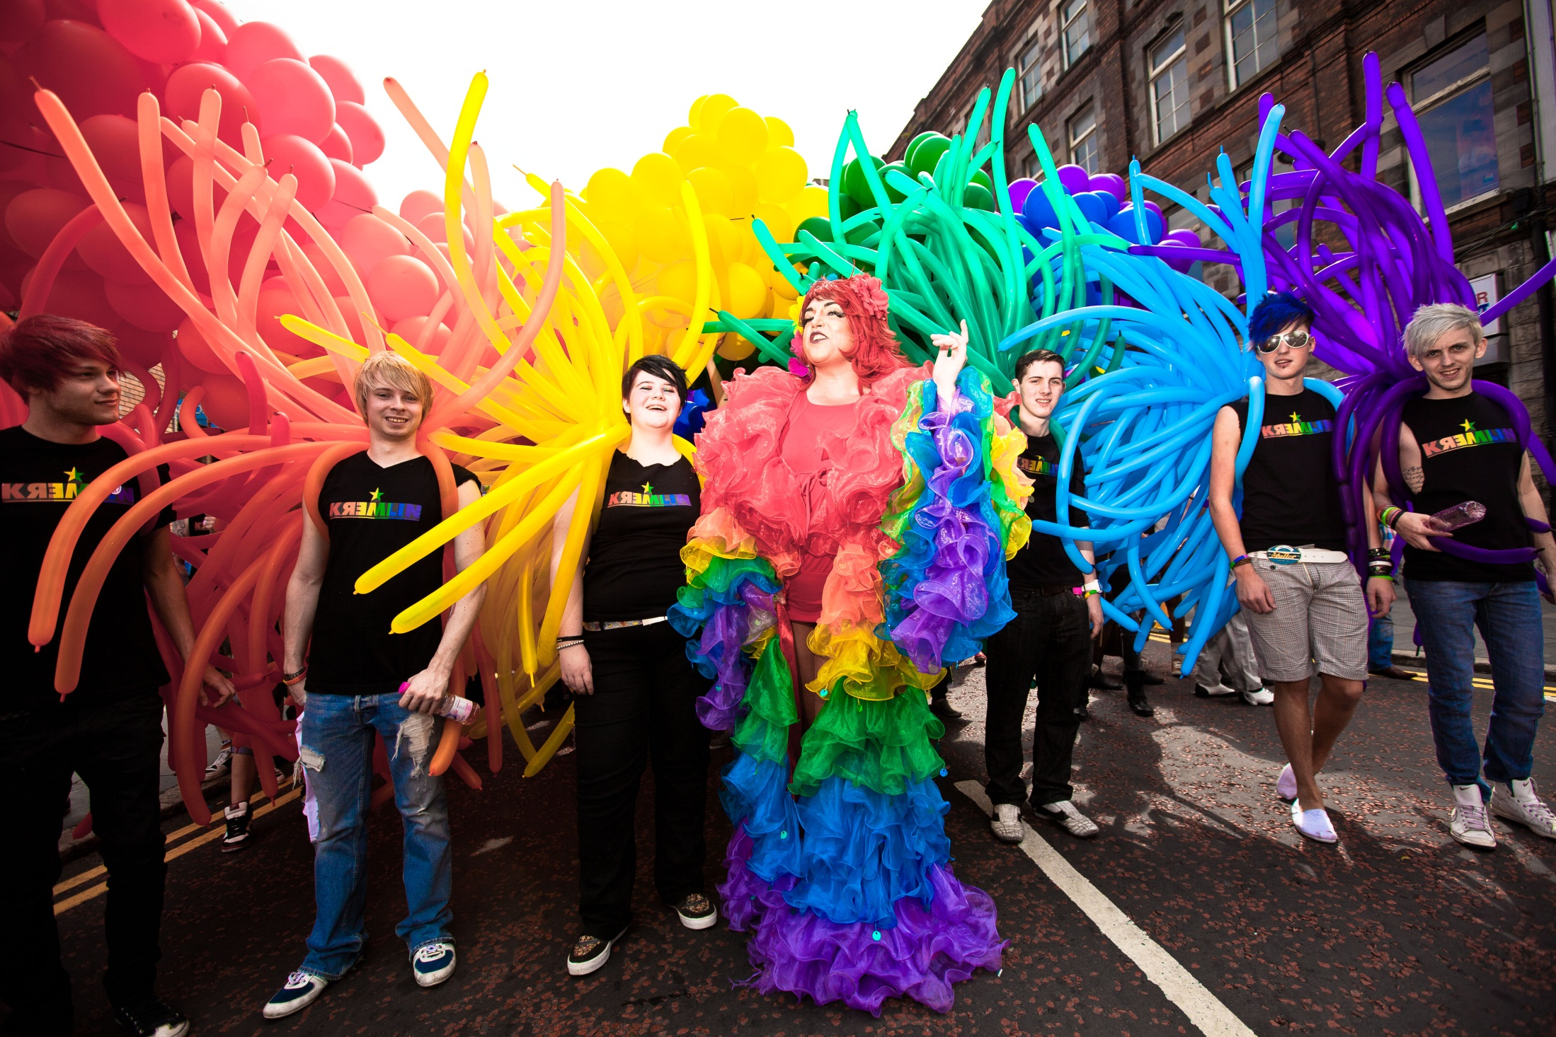

Slide 29
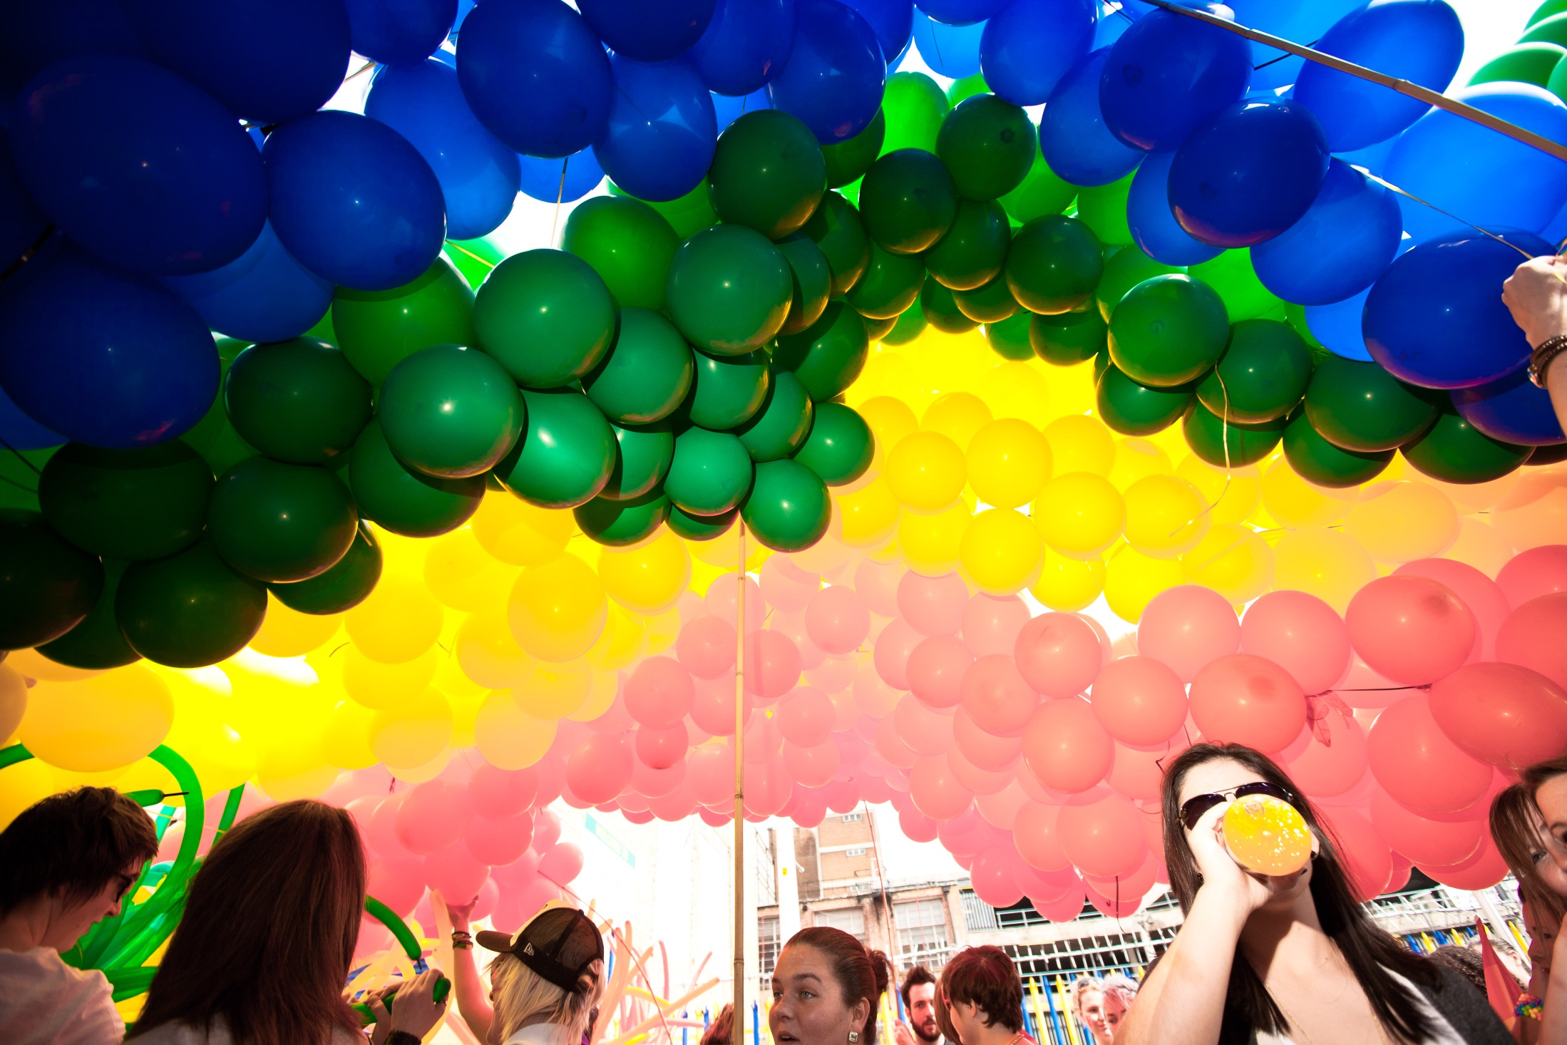

Slide 30
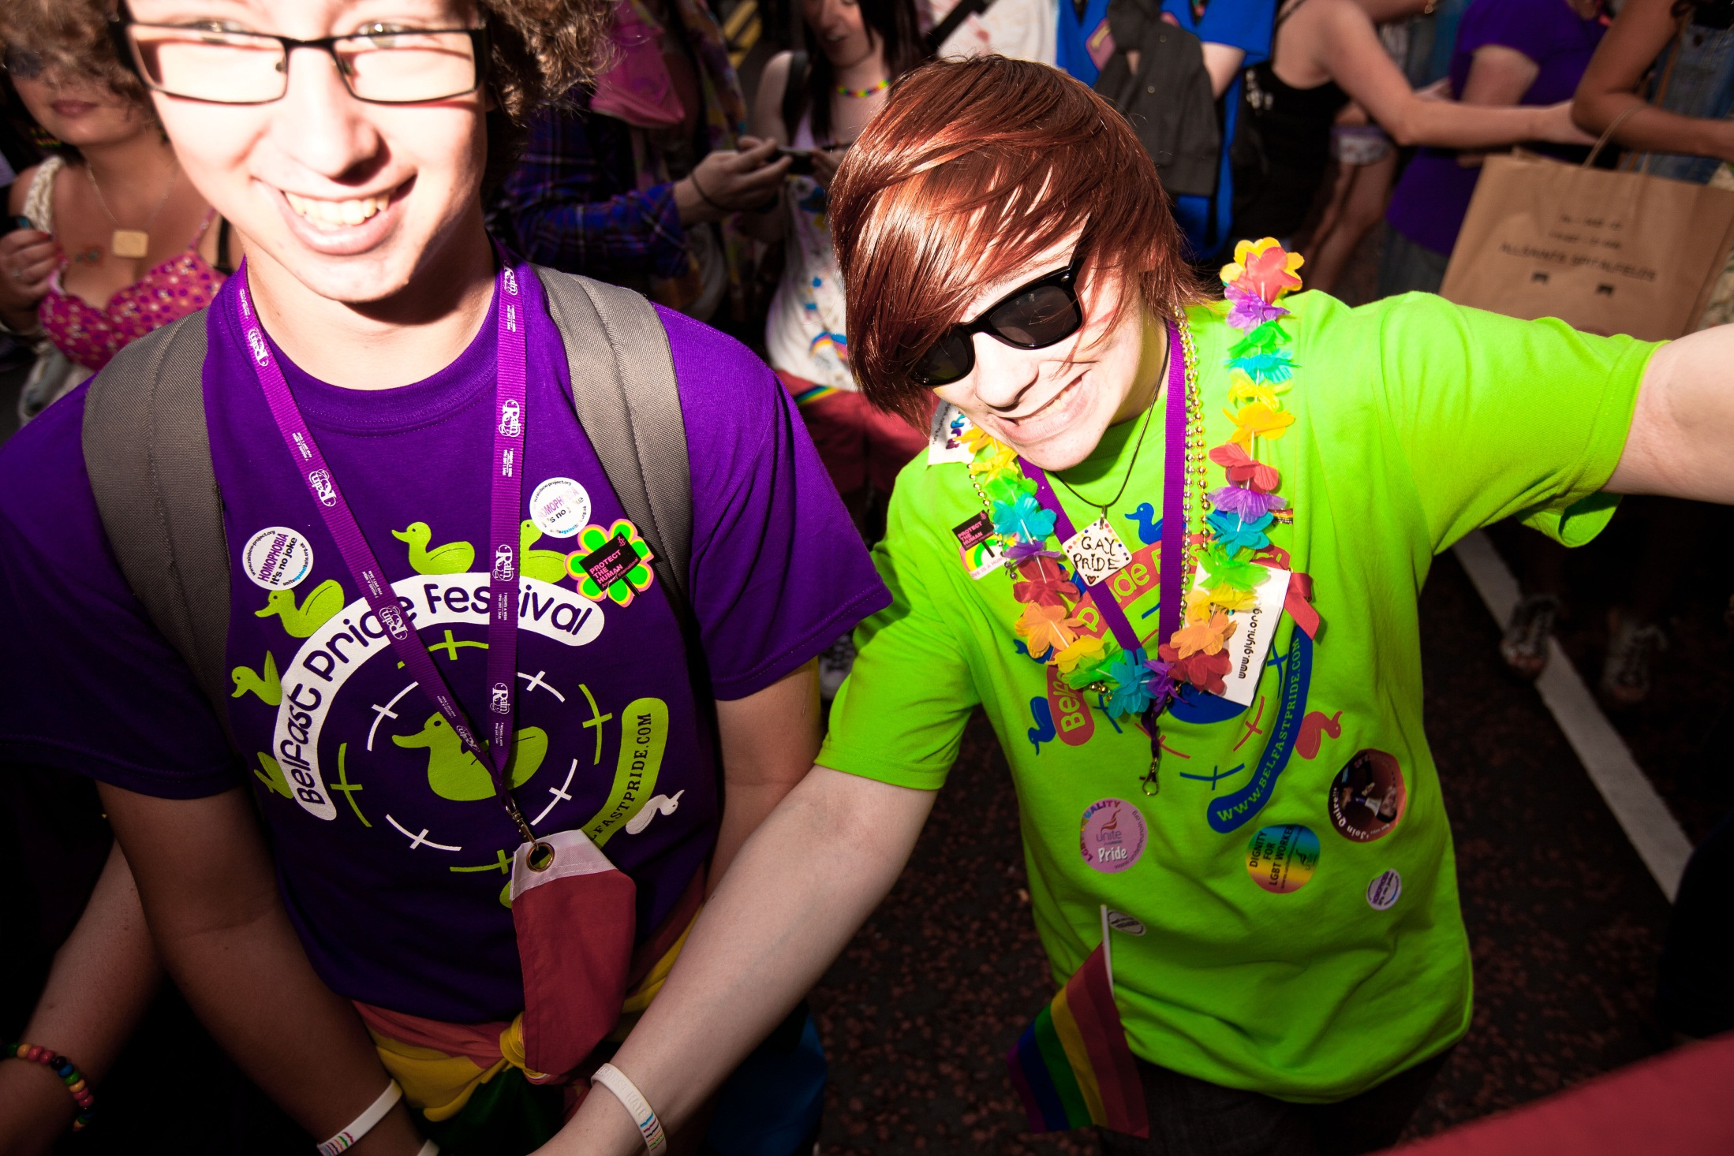

Slide 31
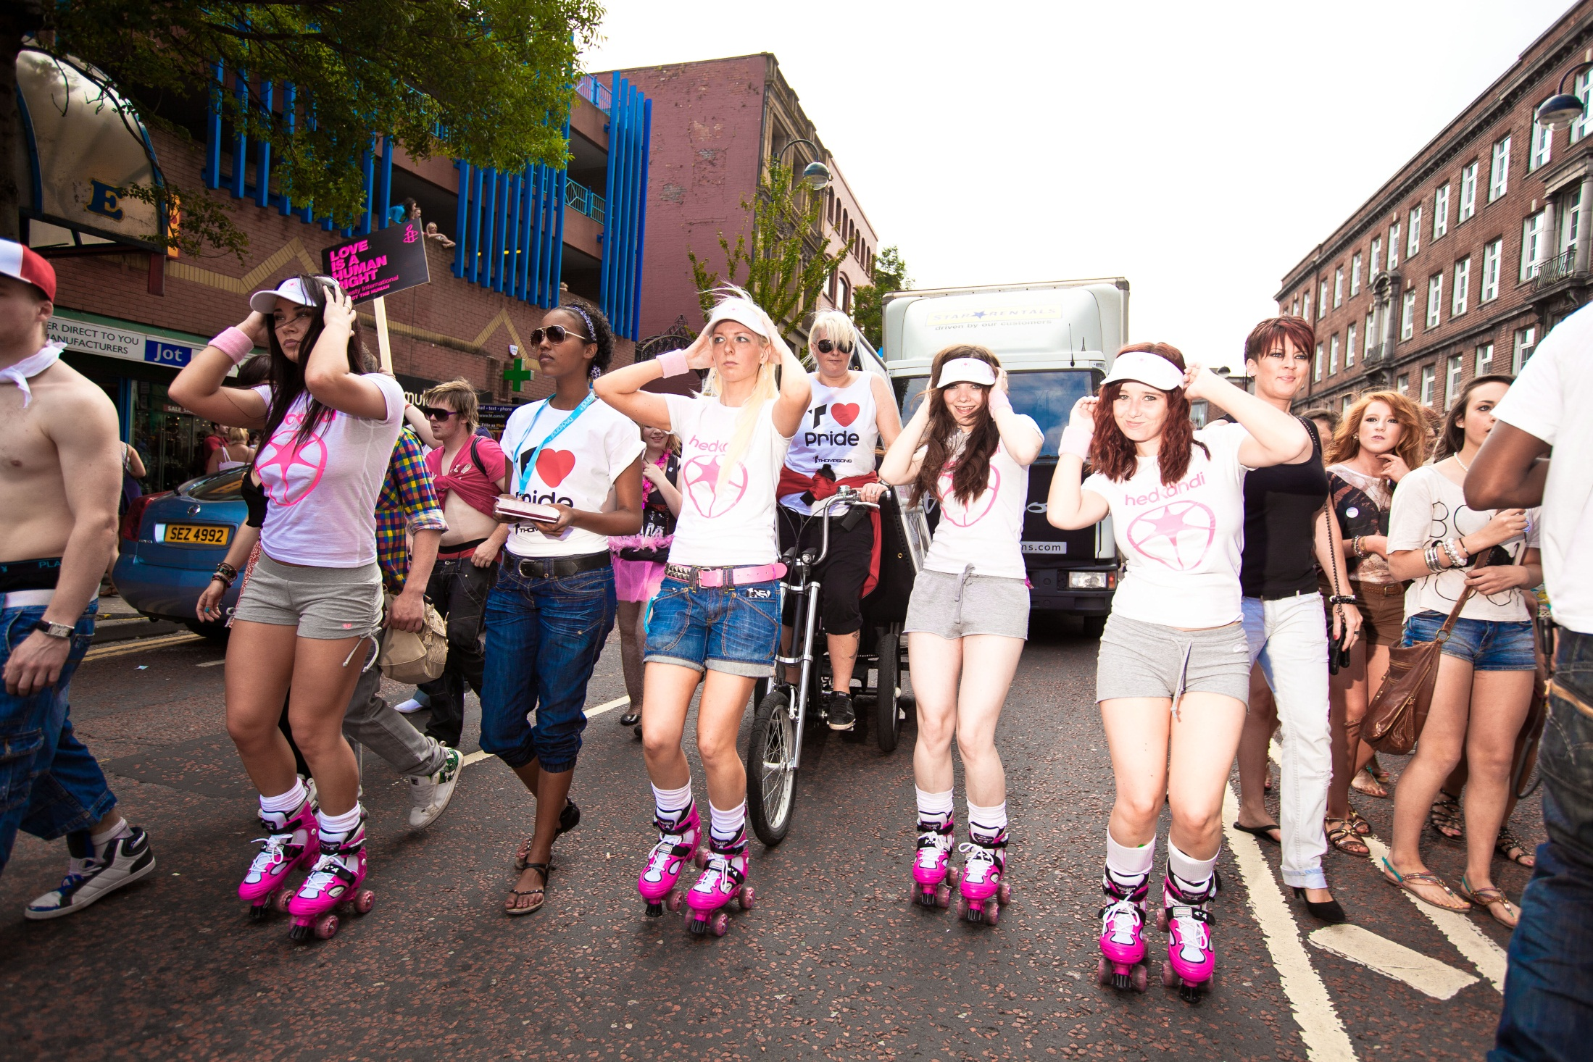

Slide 32
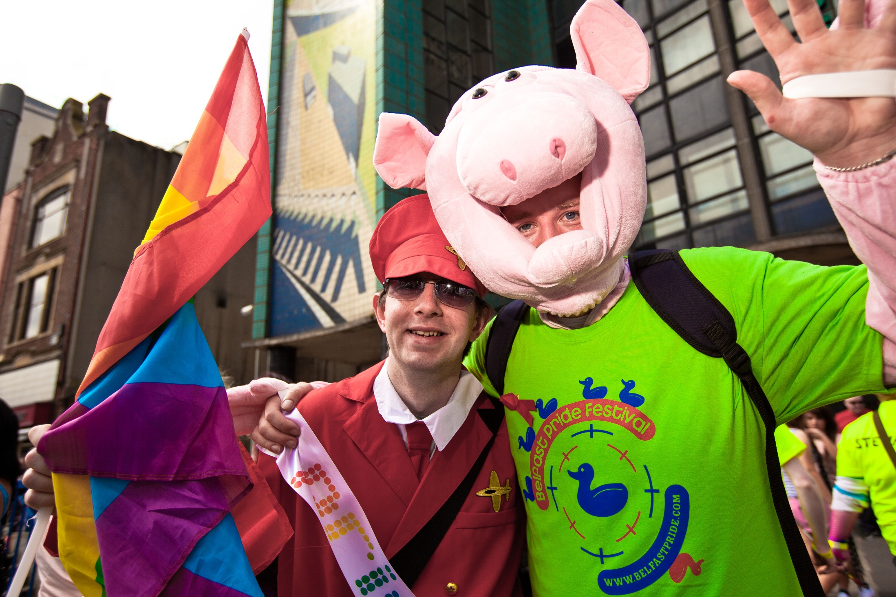

Slide 33
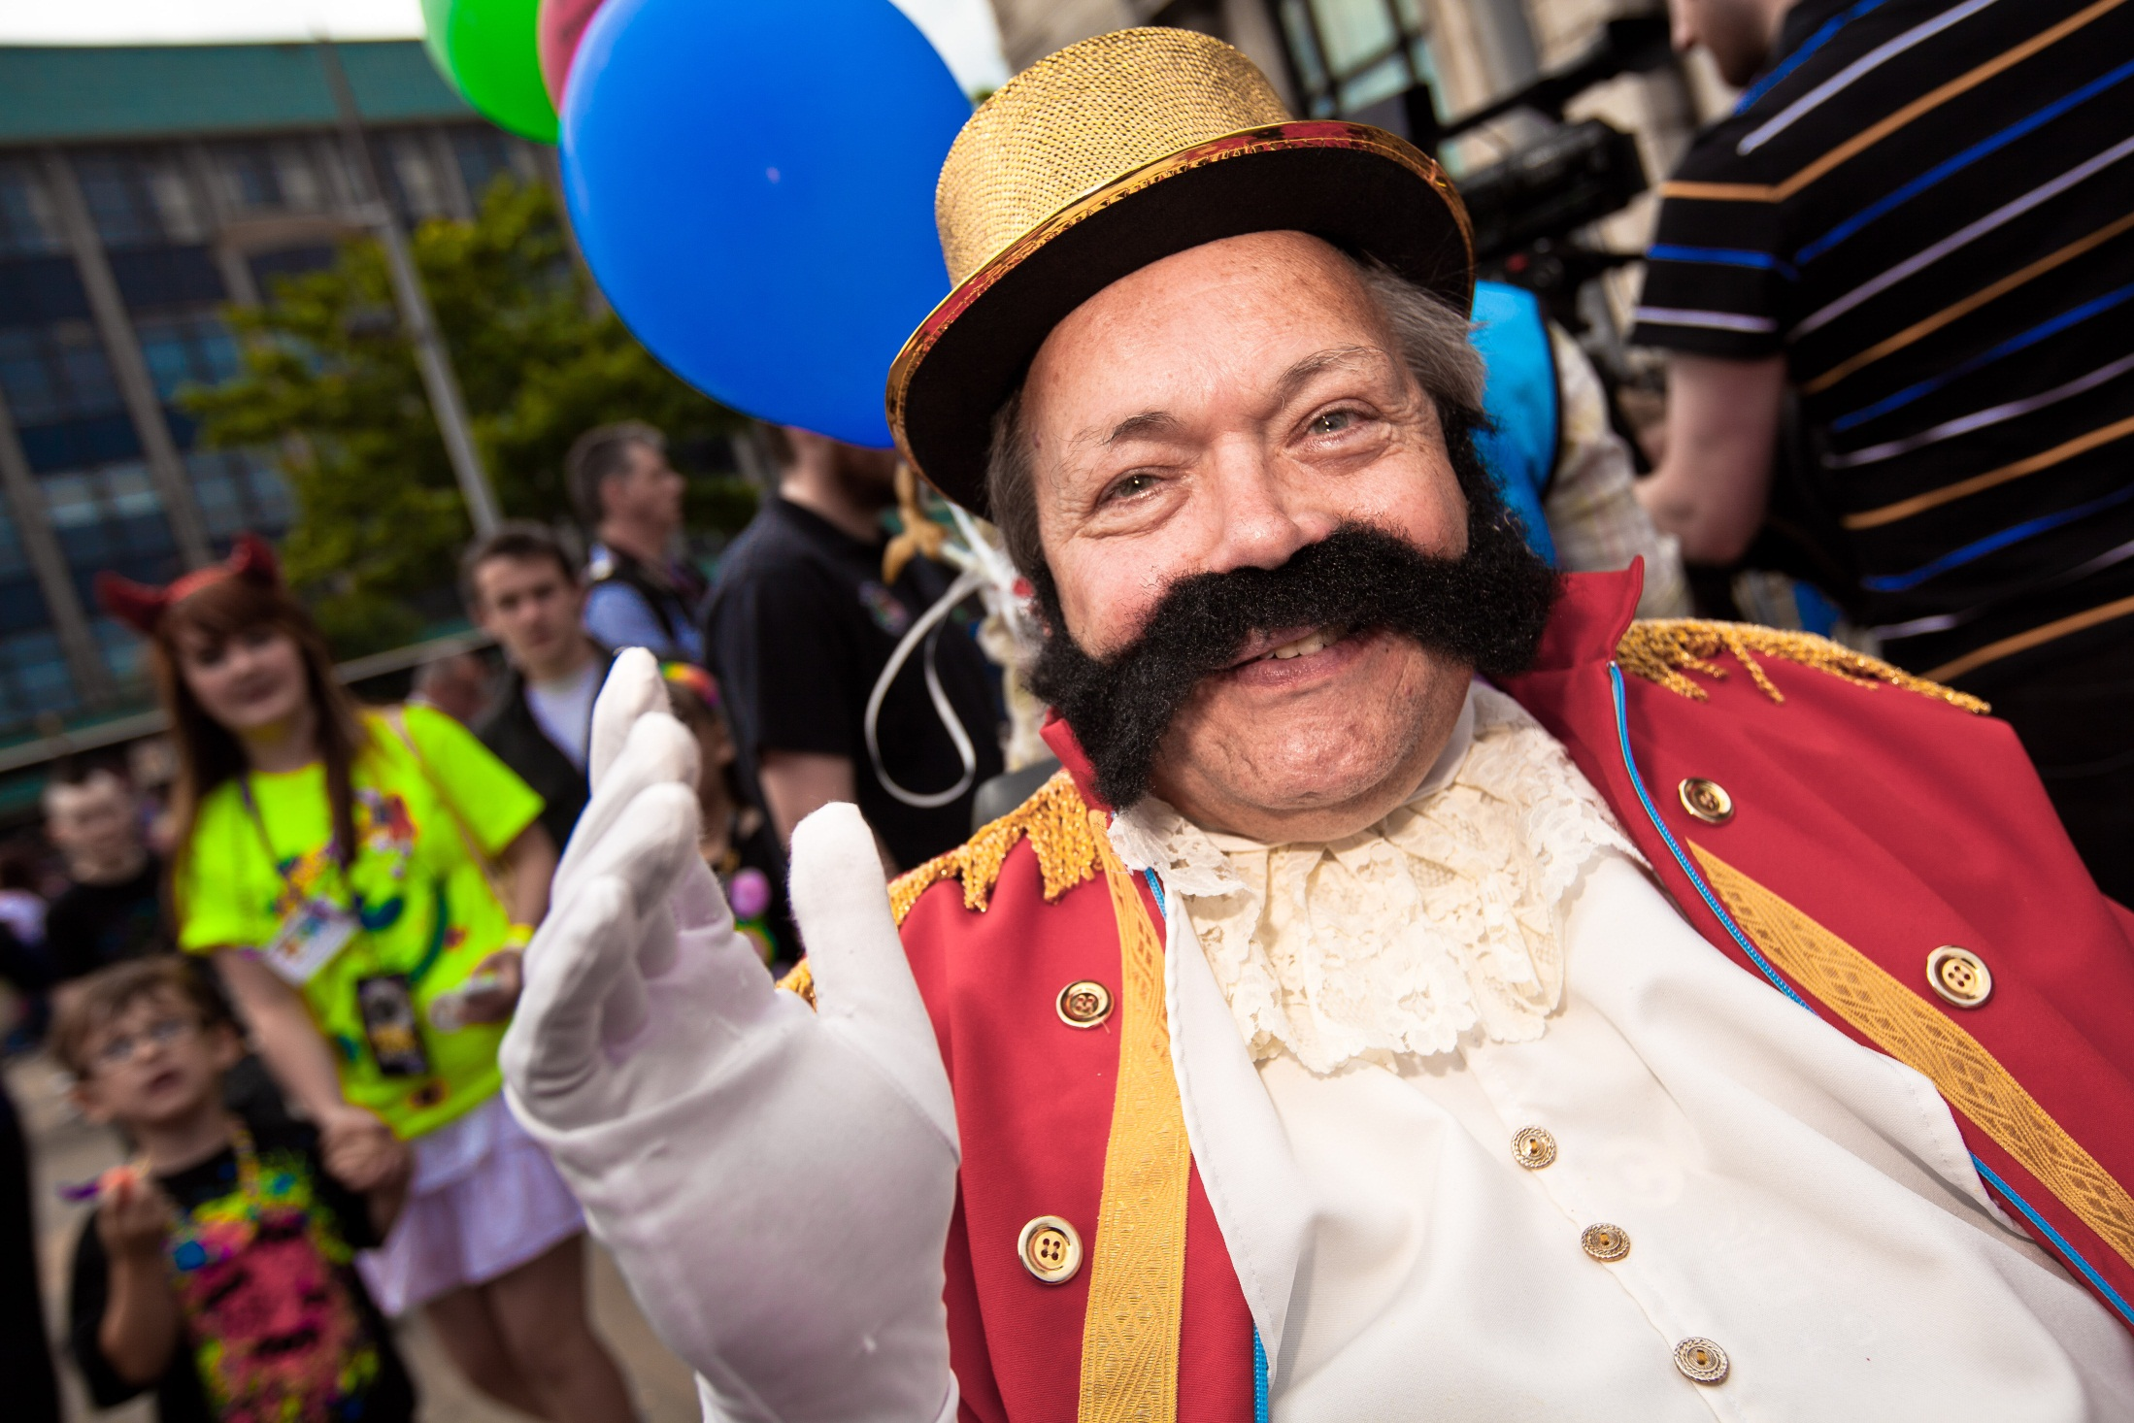

Slide 34
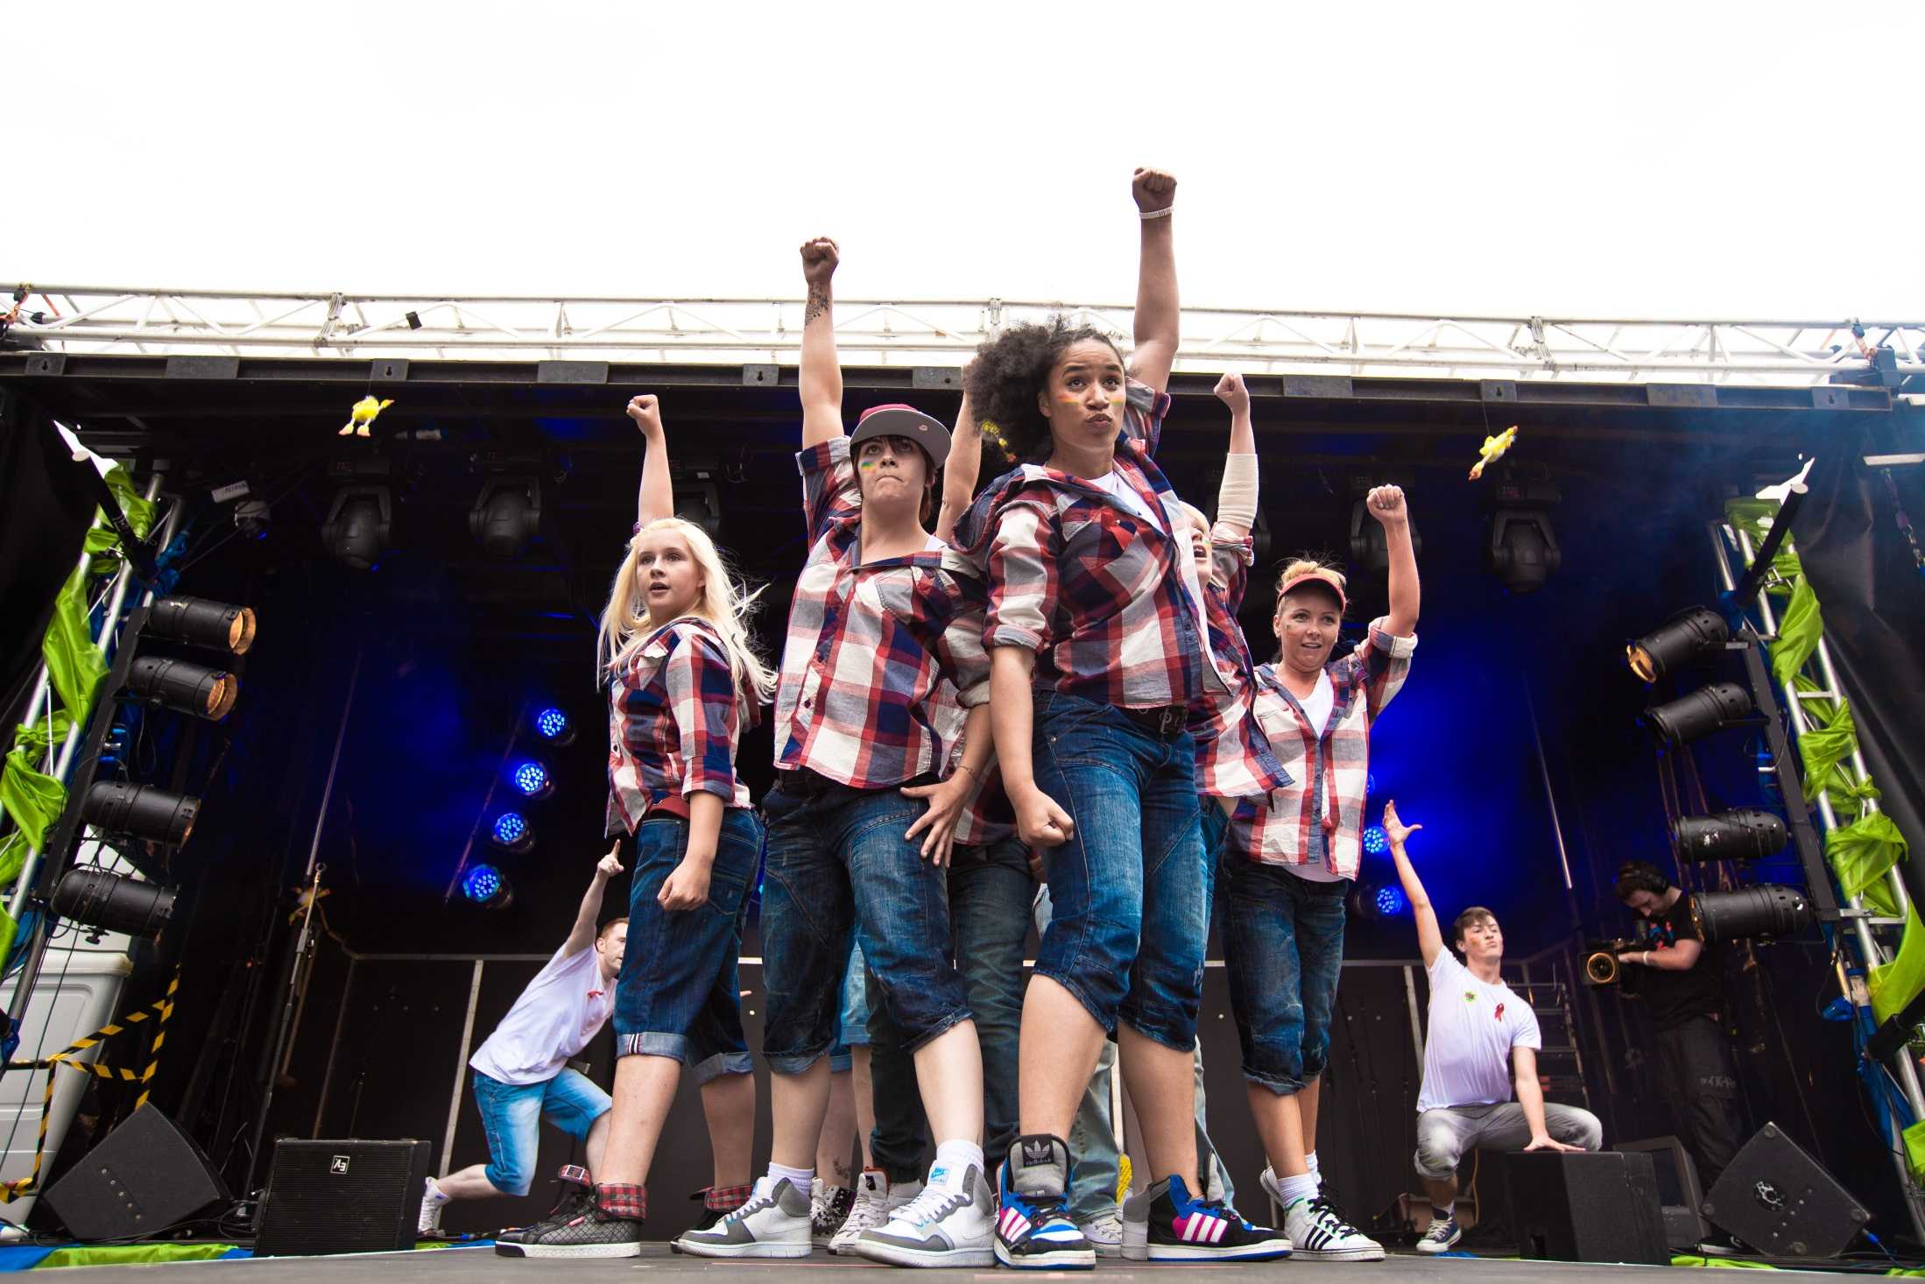

Slide 35
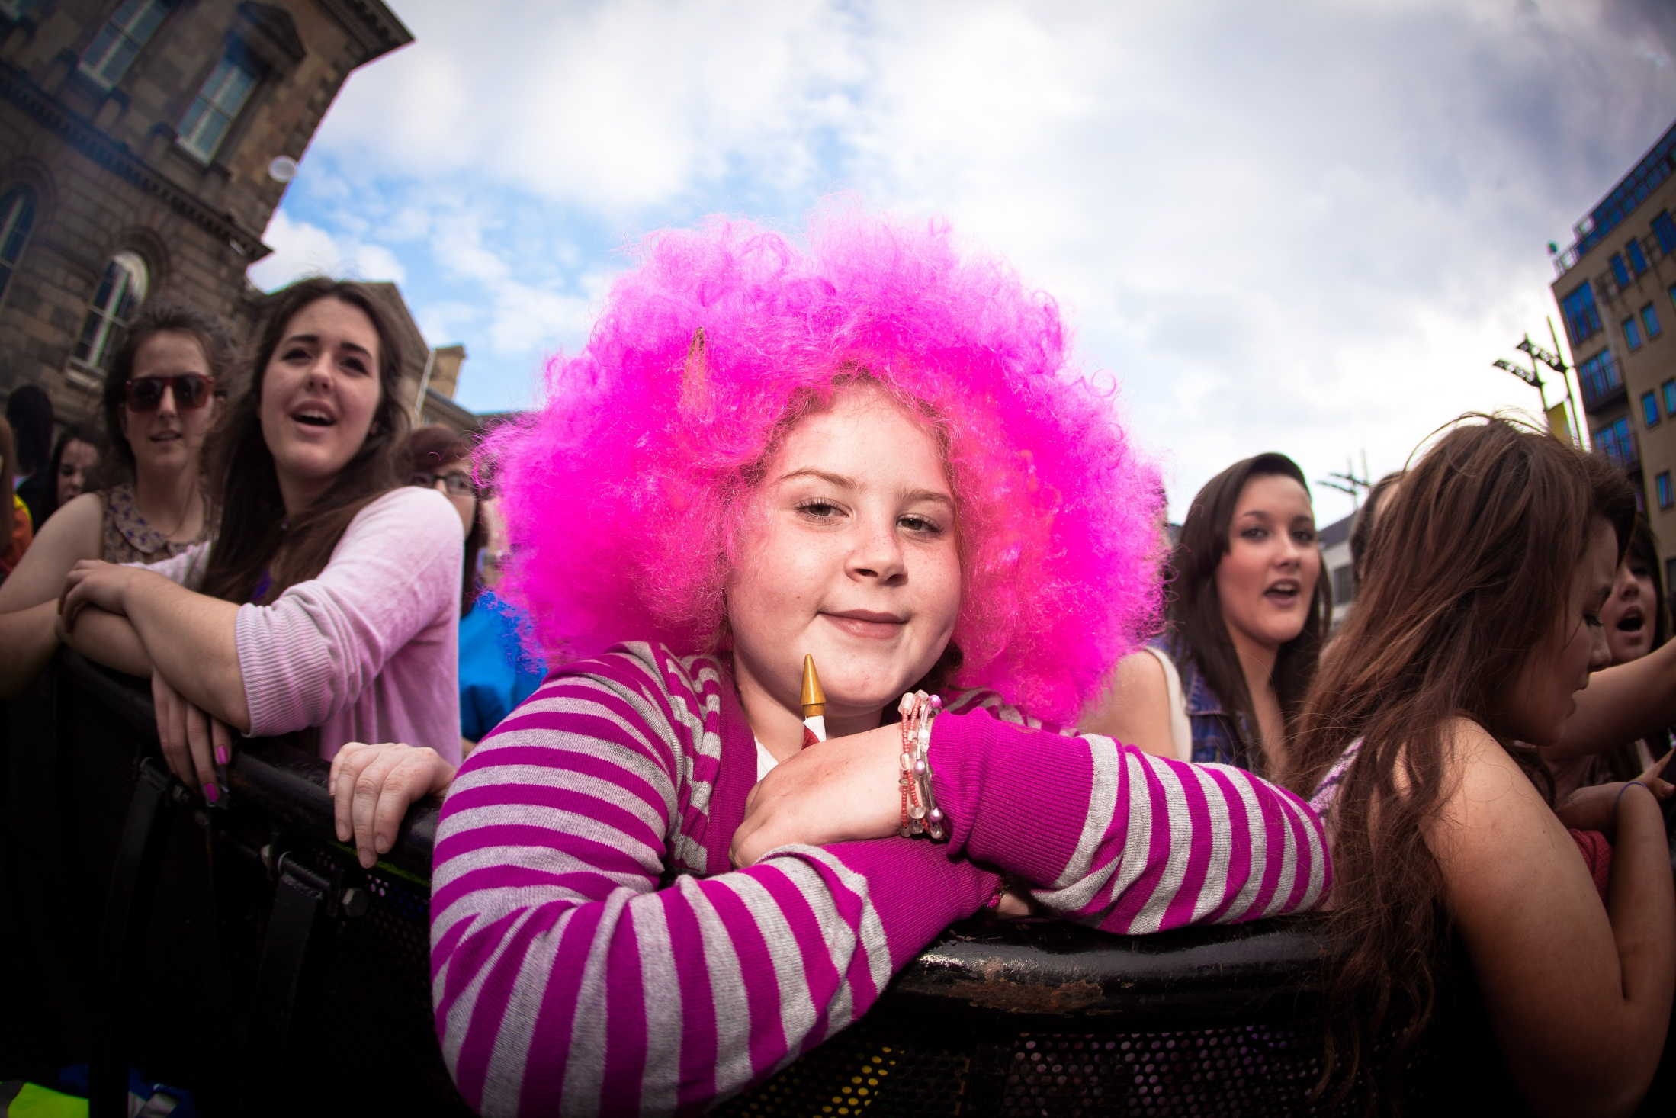

Slide 36
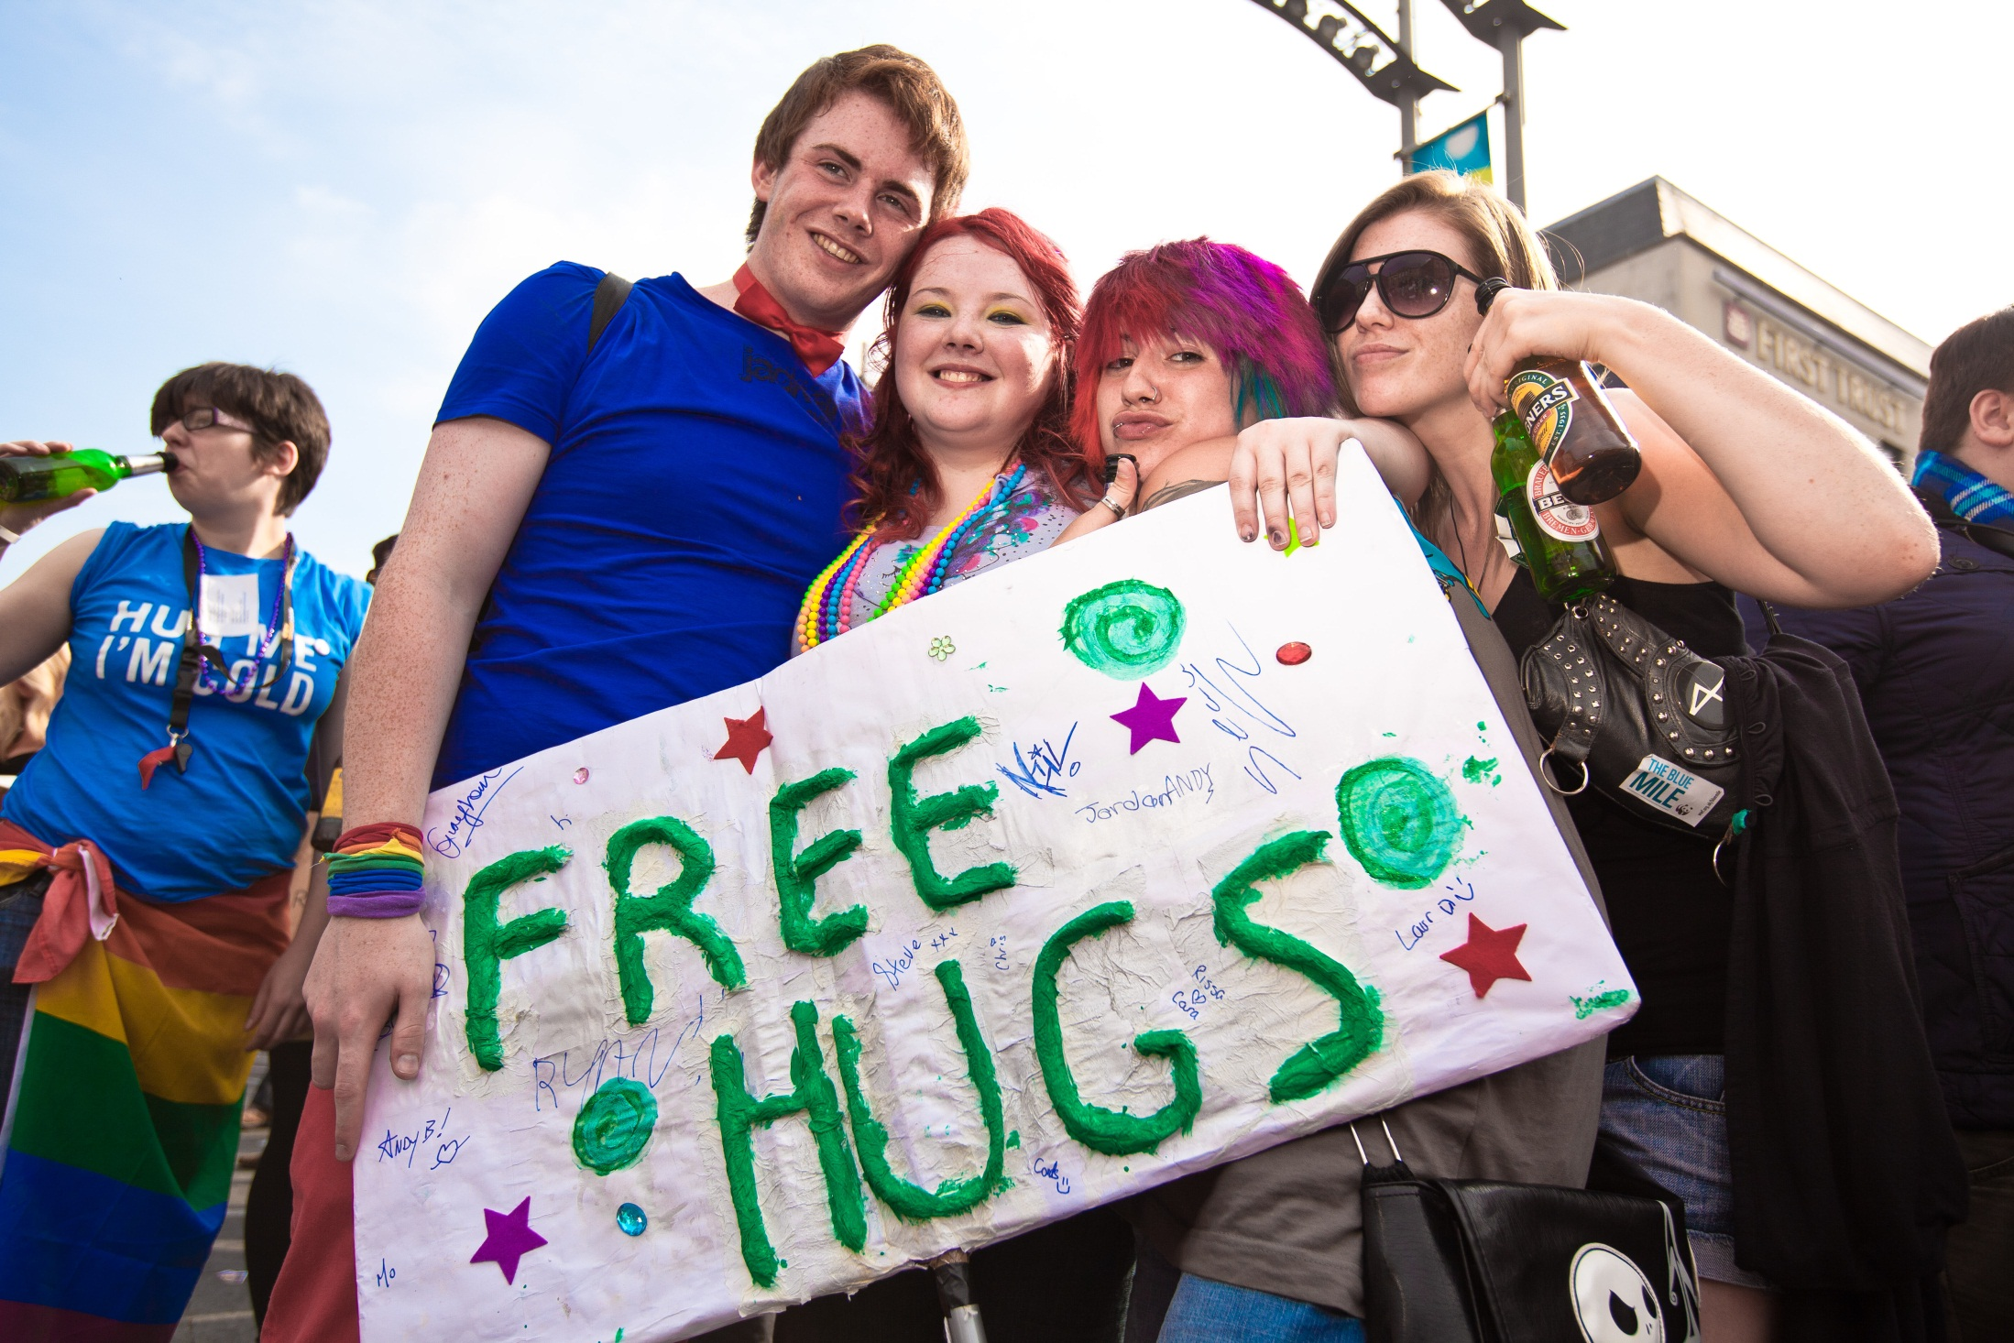

Slide 37
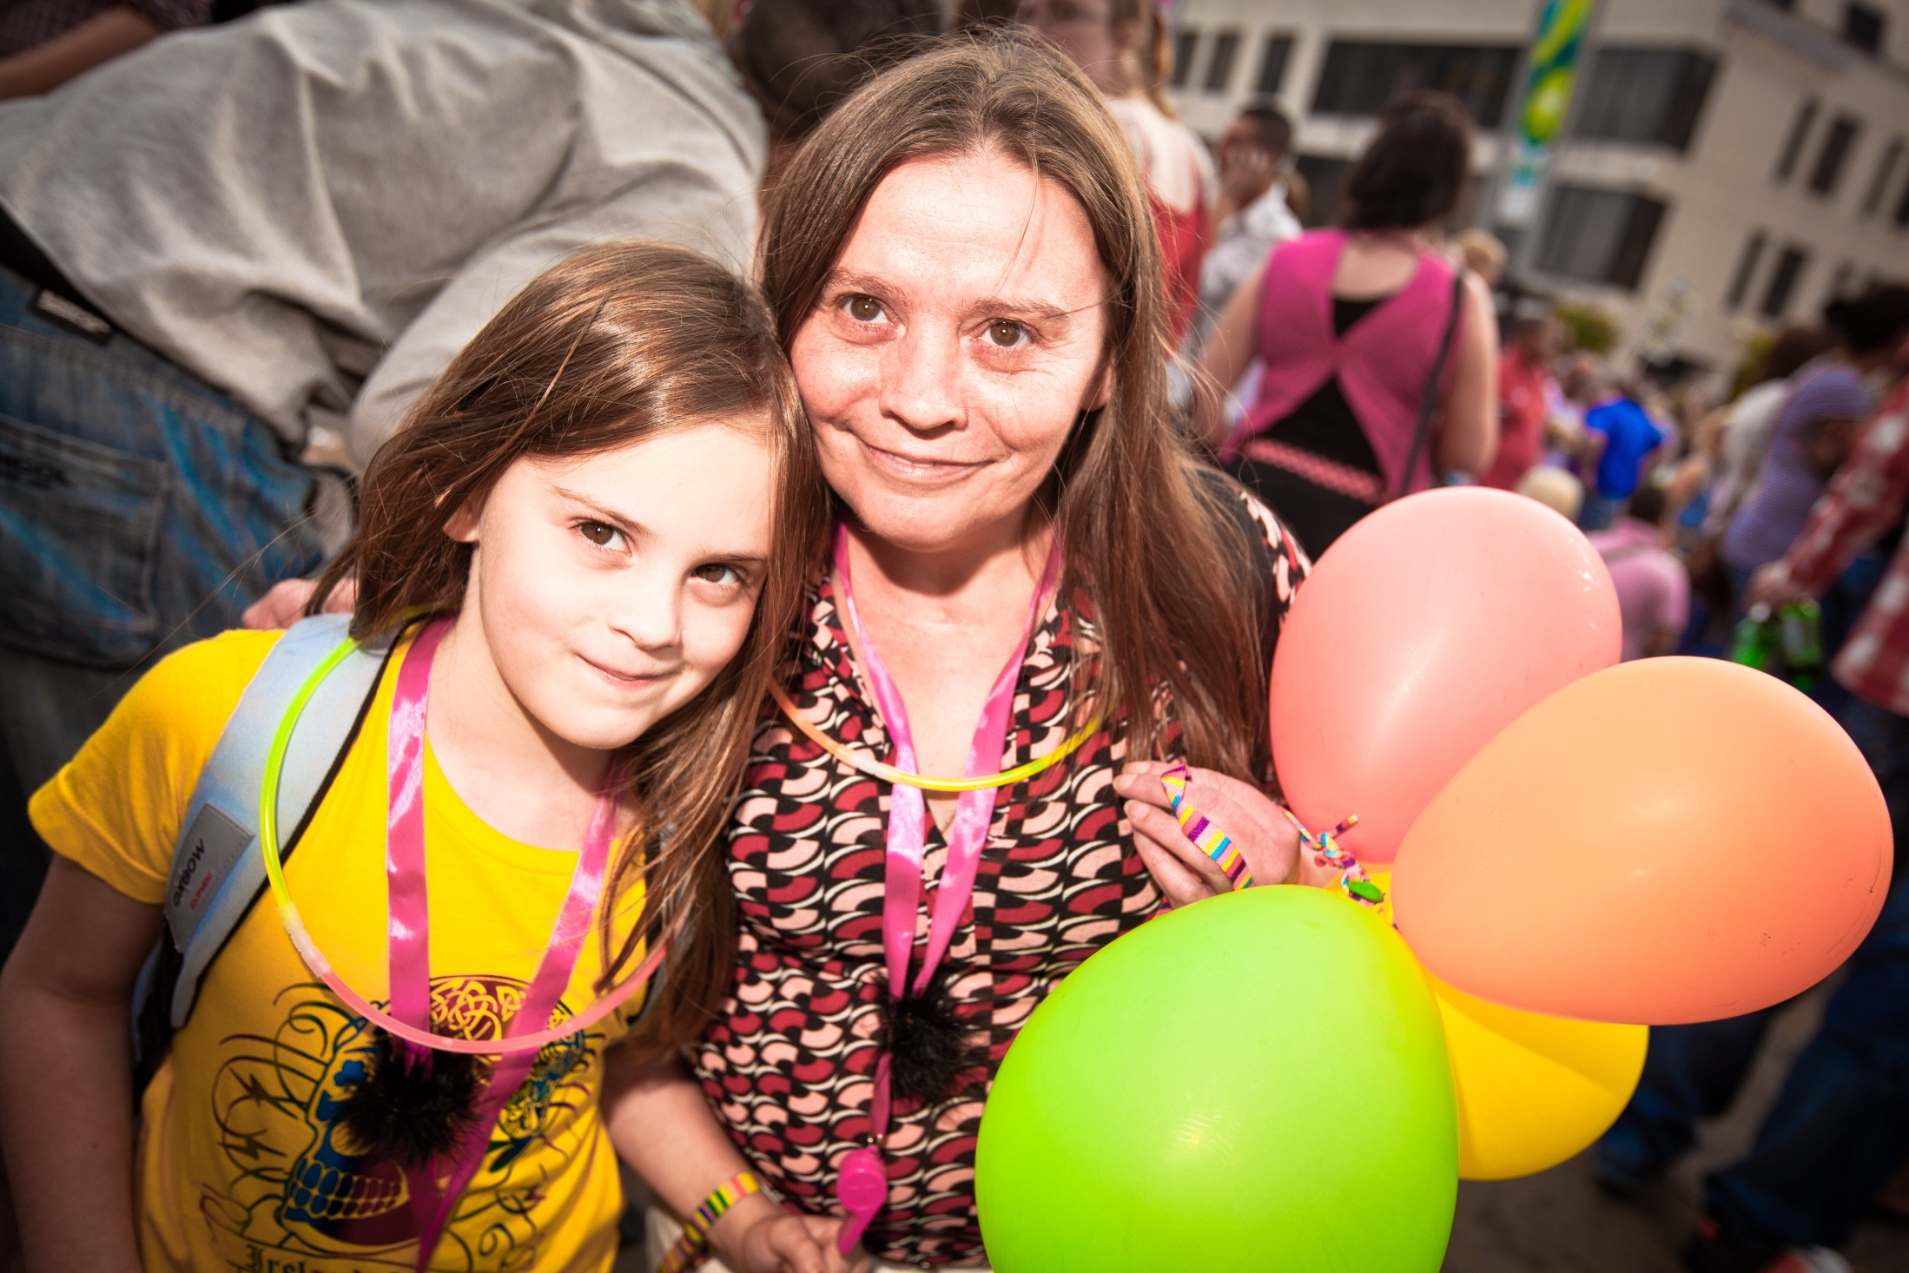

Slide 38
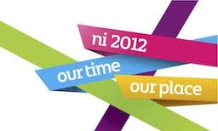
Return on Investment
Total Visitor Spend £500,000
Total Participant Spend £43,400 48
Total Spend outside NI £9,000 49
Total Direct Economic Impact £534,400

