Slide 1


#1City

Slide 2
One City Conference
On the cusp?
Paul Nolan
Peace Monitoring Report
Friday 11th May

Slide 3
Yearbook of Peace Processes 2011
82 armed conflicts brought to an end in recent decades
34% of these in peace agreements
Of the 14 for which there are complete figures:
- 4 improved on UN Human Development Index
(Croatia, Rwanda, Angola, El Salvador)
- 10 disimproved (incl. S. Africa, Nicaragua)
Source: Escola de Cultura de Pau, Barcelona

Slide 4
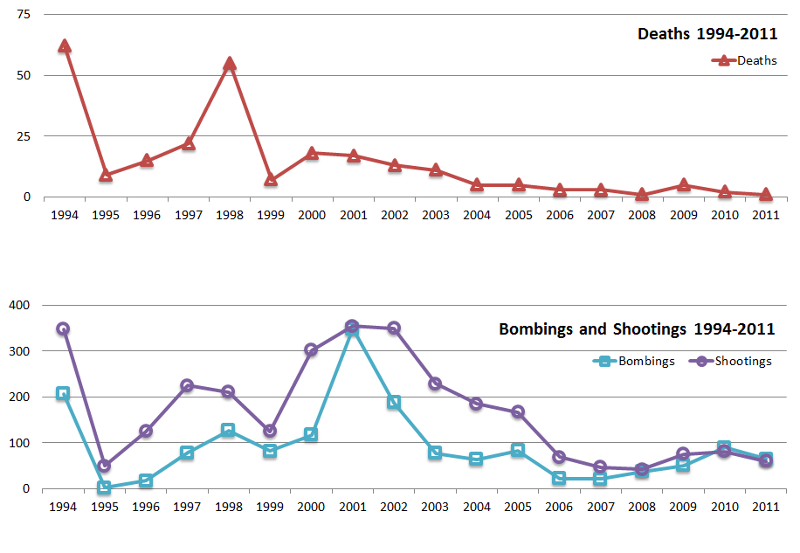
Security-related deaths

Slide 5
Security statistics 1994-2011

Slide 6
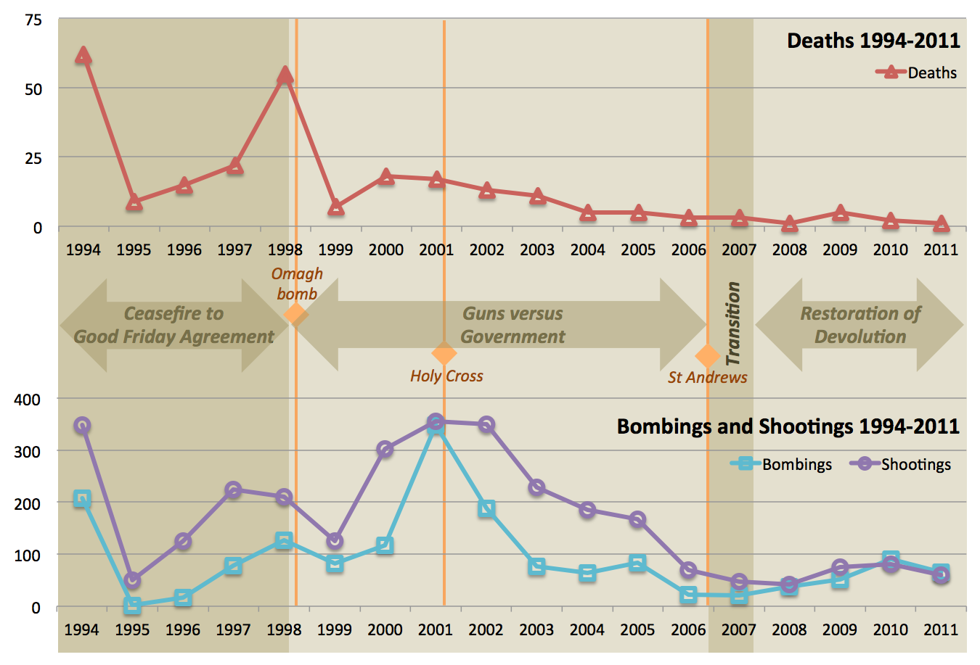
Timeline 1994 - 2011

Slide 7
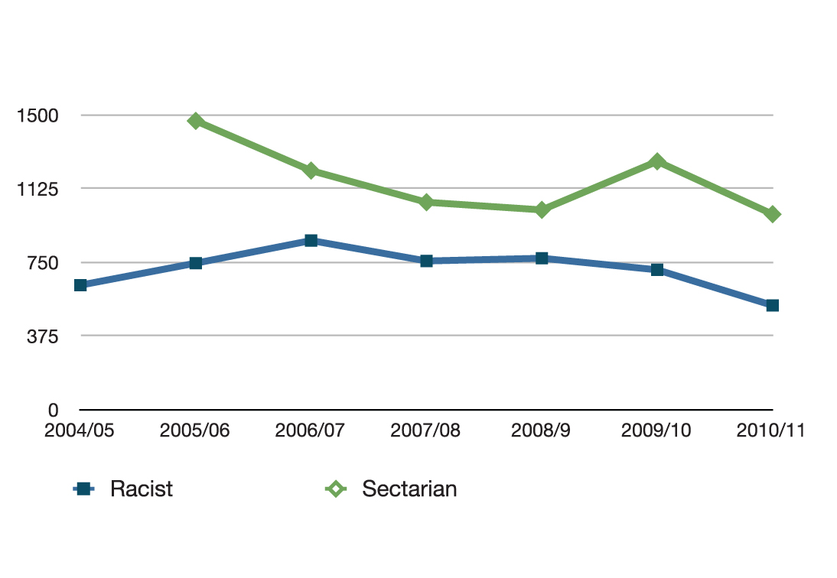
Decrease in sectarian and racist crime

Slide 8
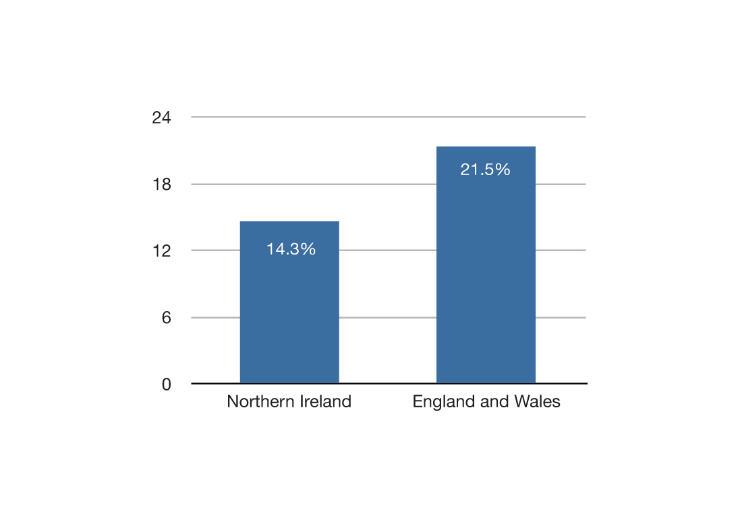
Crime: the risk of being a victim
Sources: British Crime Survey/NI Crime Survey

Slide 9
On the cusp
BUT….

Slide 10
Paramilitarism still a threat
Persistence of division
Recession that is still to bite

Slide 11
7
A new, confident, and neutral urban culture has emerged

Slide 12
Those who see town centres as safe and welcoming
On a scale of 1 to 10, those who score this at 6 or above:
2005: 31%
2010: 47%
Source: NILT

Slide 13
Belfast –city of festivals
Single identity festival/event: 12
Ethnic/international: 11
LGBT: 2
Open/non-specific: 29
Source: Belfast Festival Forum

Slide 14
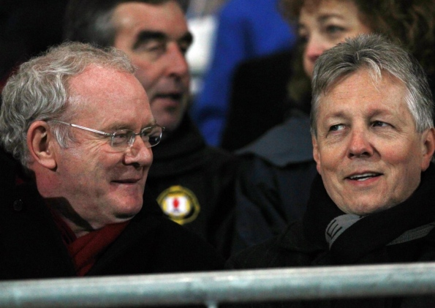
A new Northern Ireland, a new Belfast ?

