Slide 1
“The Home of Miracles”
Brian Friel, 2009

Slide 2
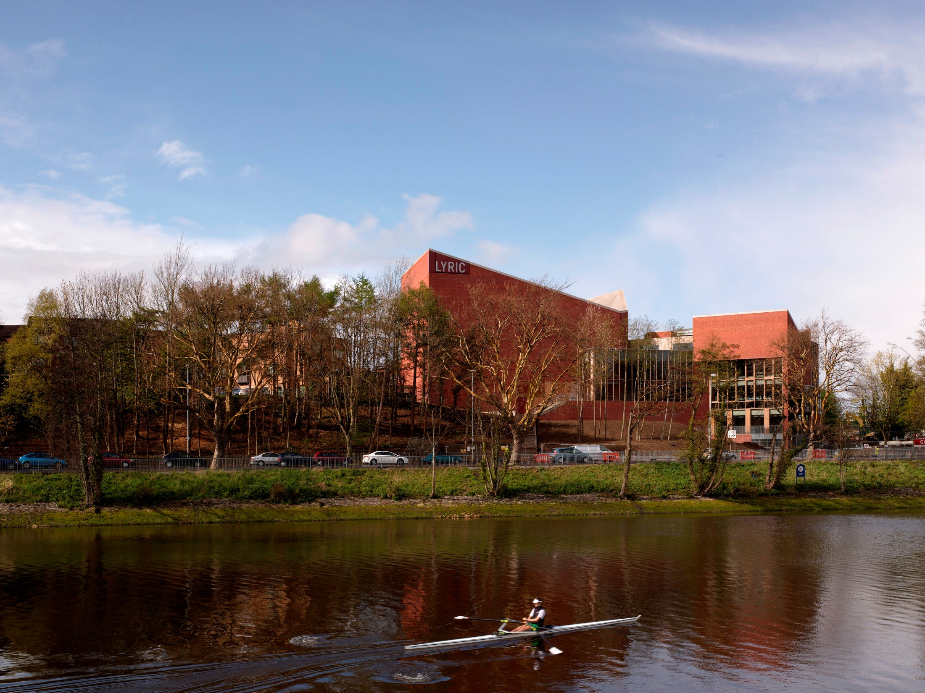

Slide 3
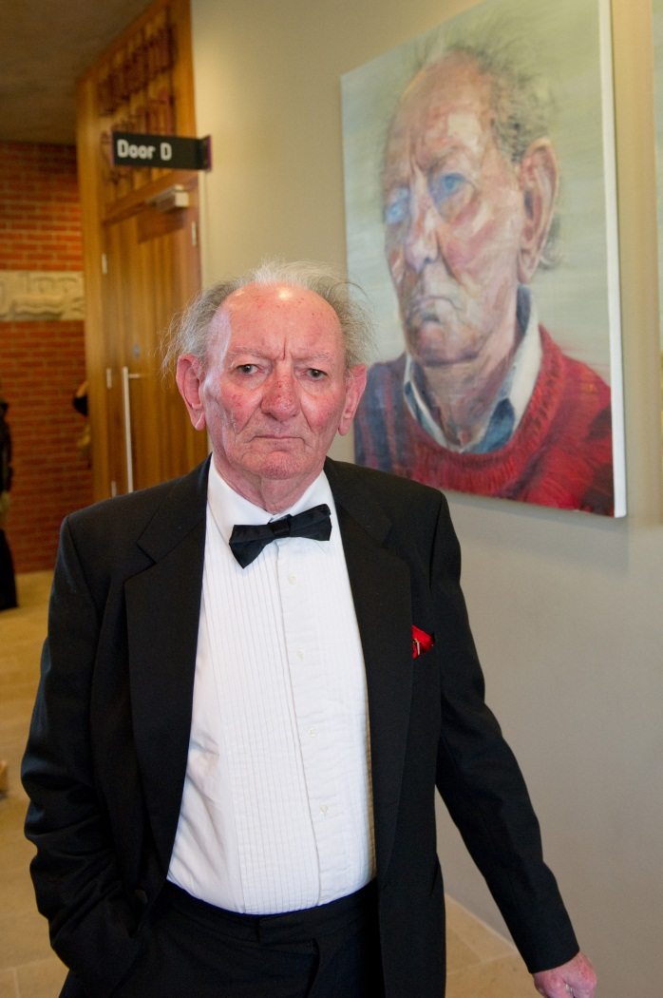
“A new theatre can be the most exciting building in any city . It can be the home of miracles and epiphanies and revelations and renovations.
And building a new theatre – especially in times like these – is both an act of fortitude and a gesture of faith in your community . Because what you are saying to that community is this:
This is your playhouse – come and play with us here”
Brian Friel 2009

Slide 4
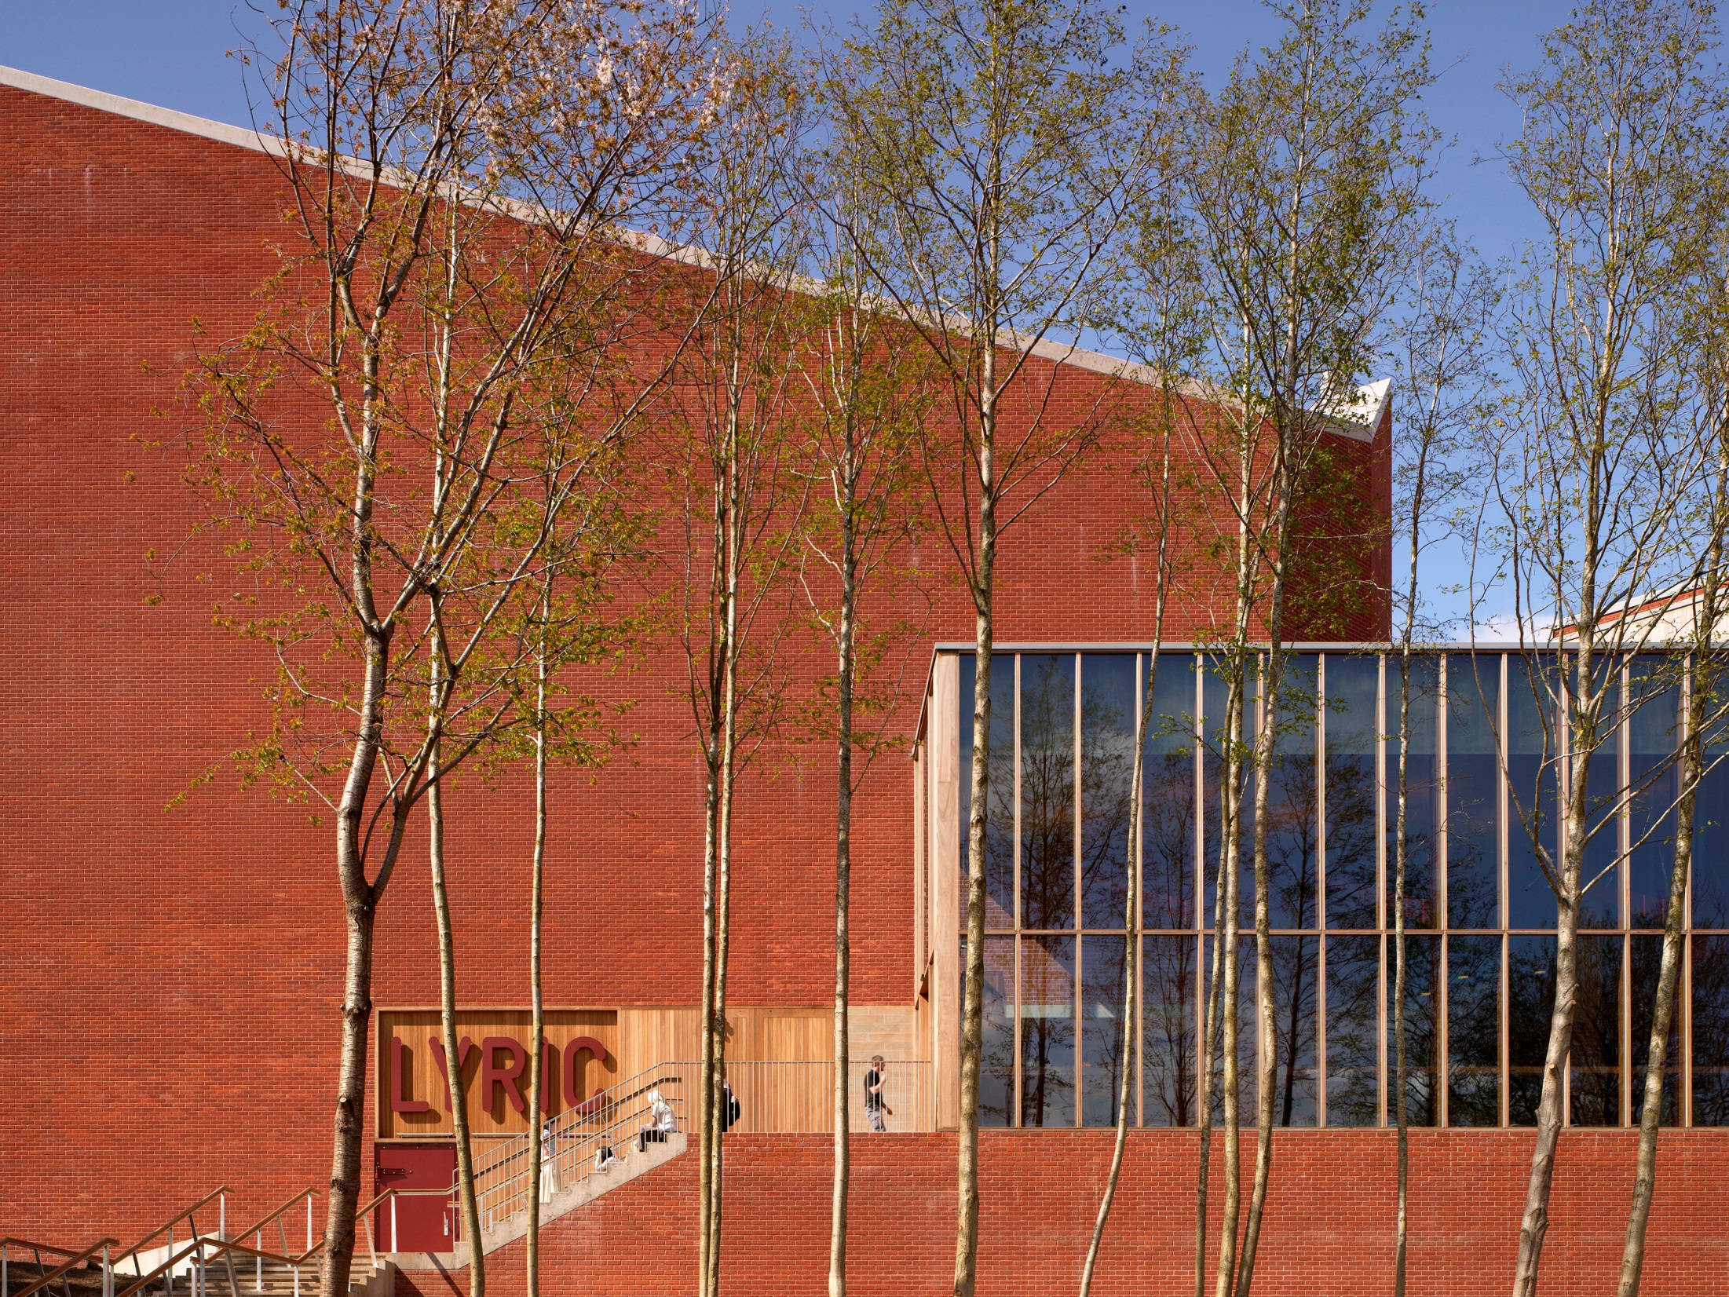

Slide 5
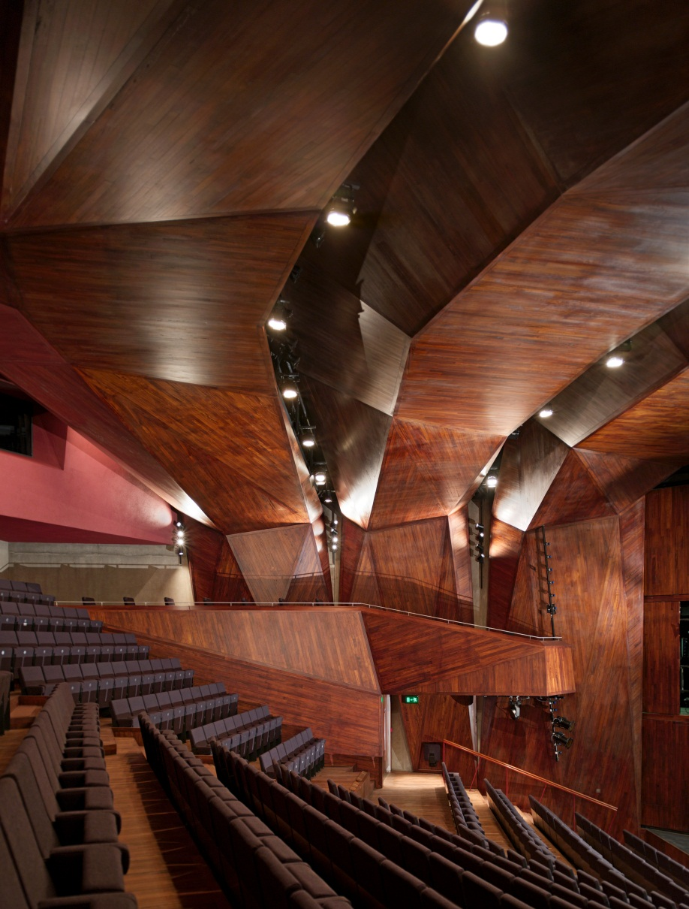
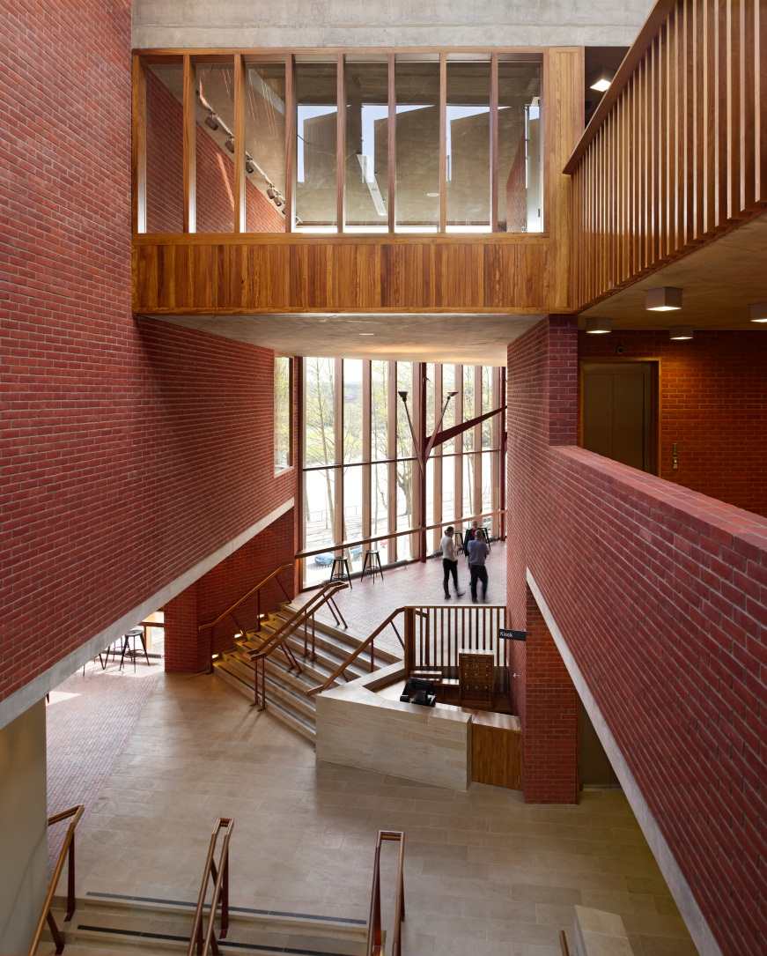

Slide 6
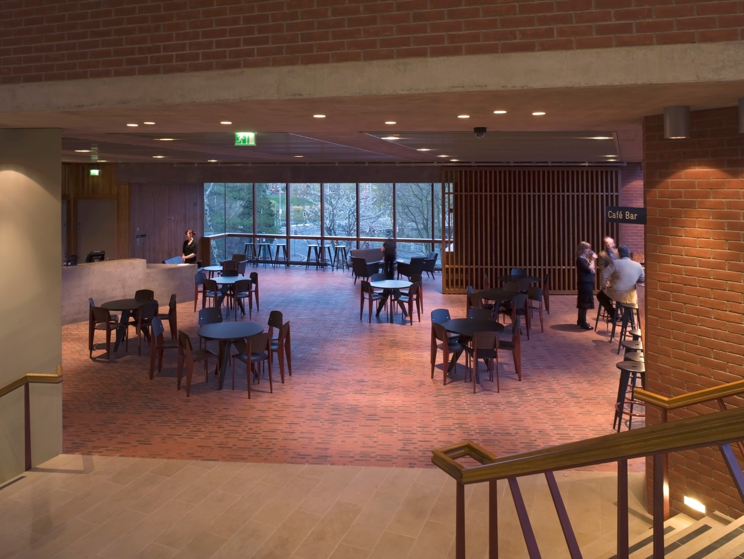

Slide 7
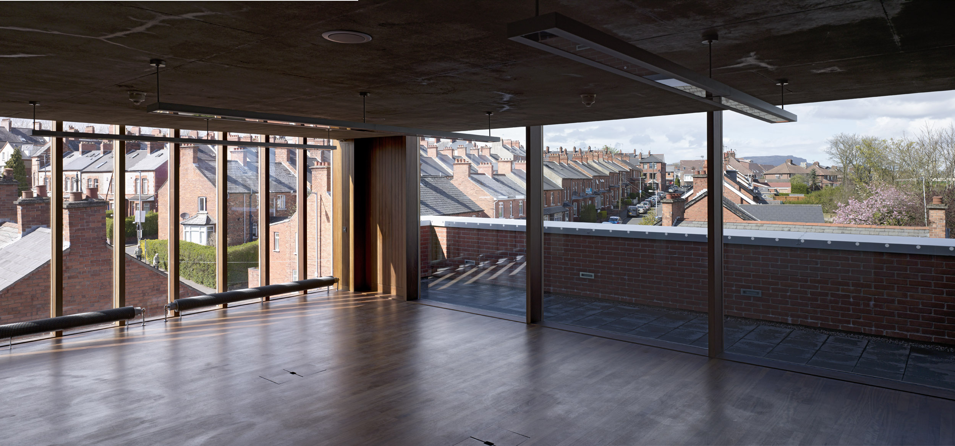

Slide 8
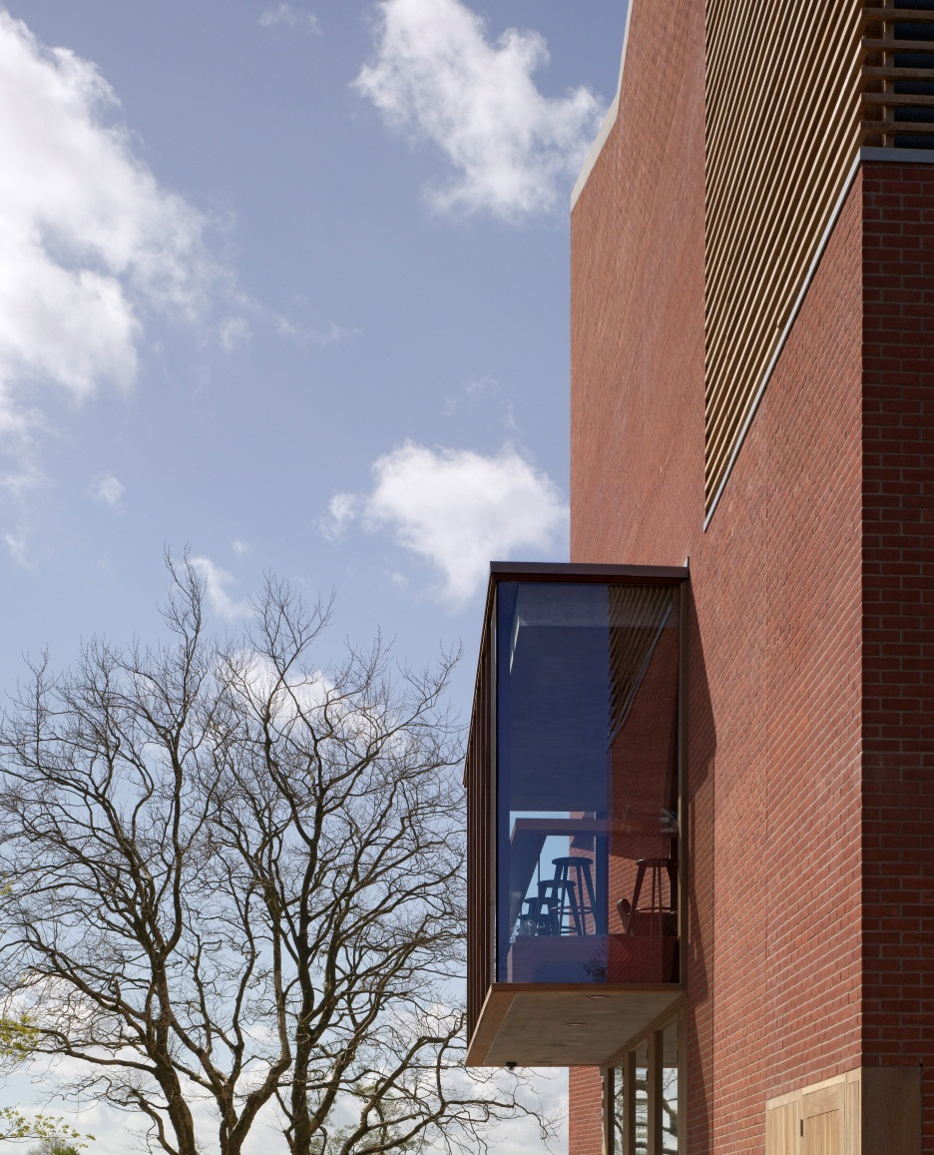
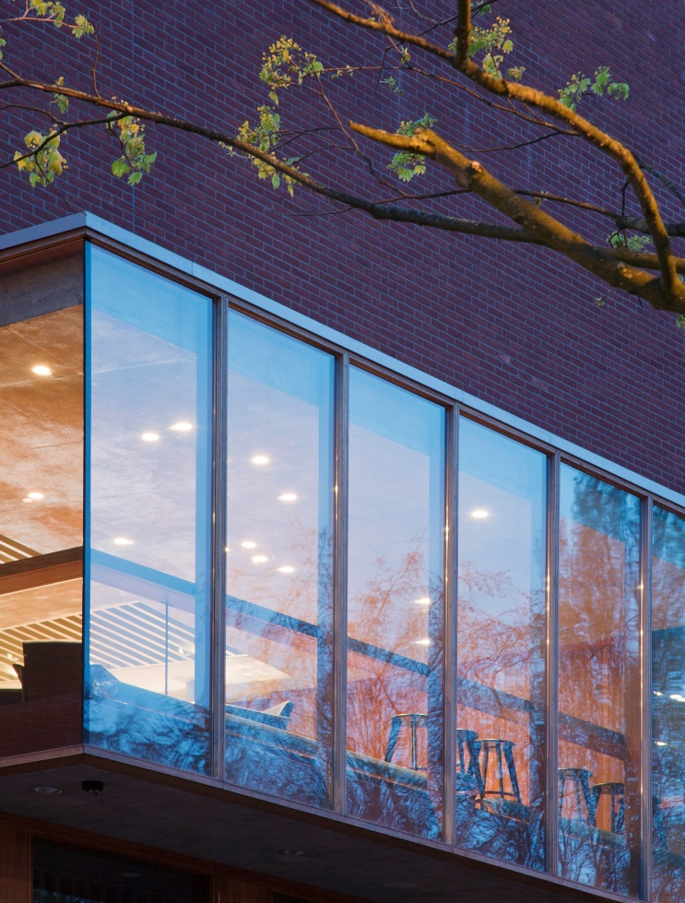

Slide 9
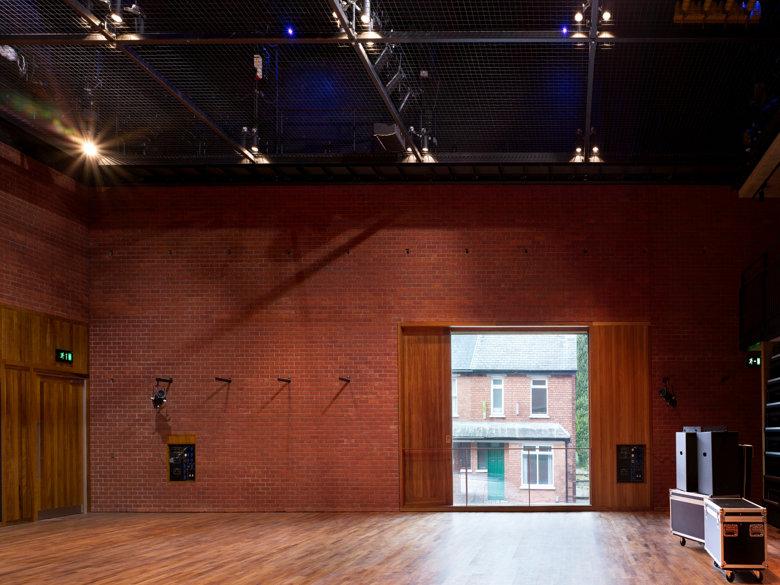

Slide 10
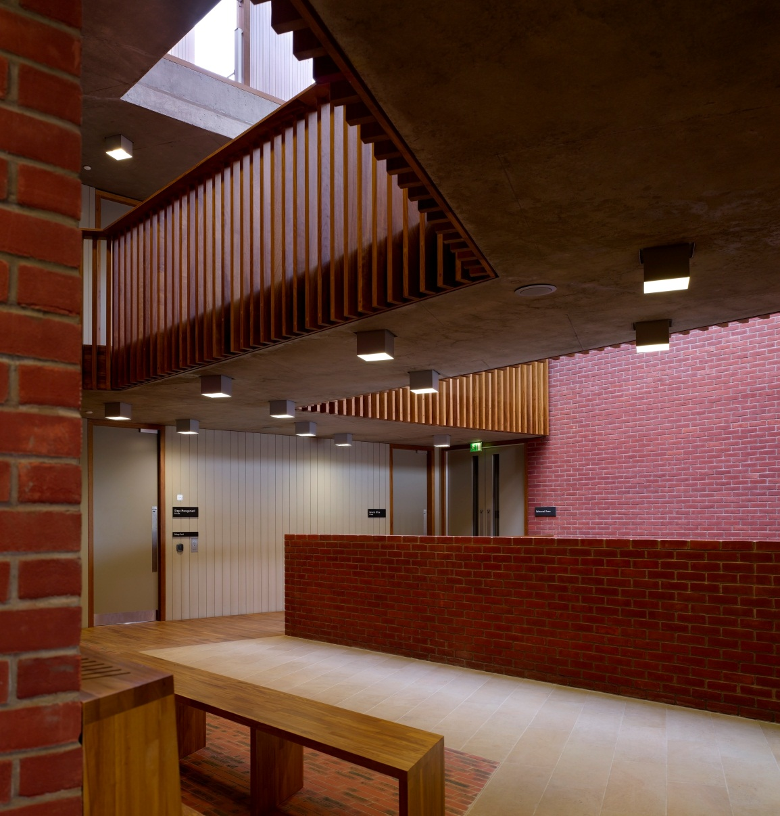
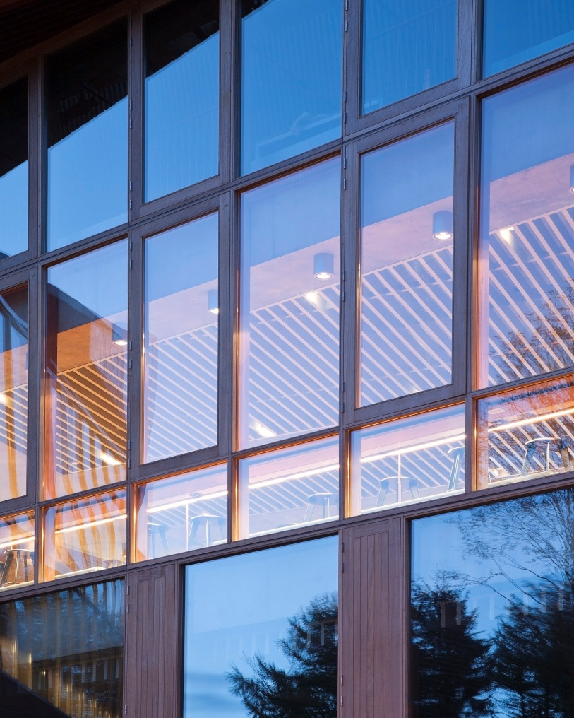

Slide 11
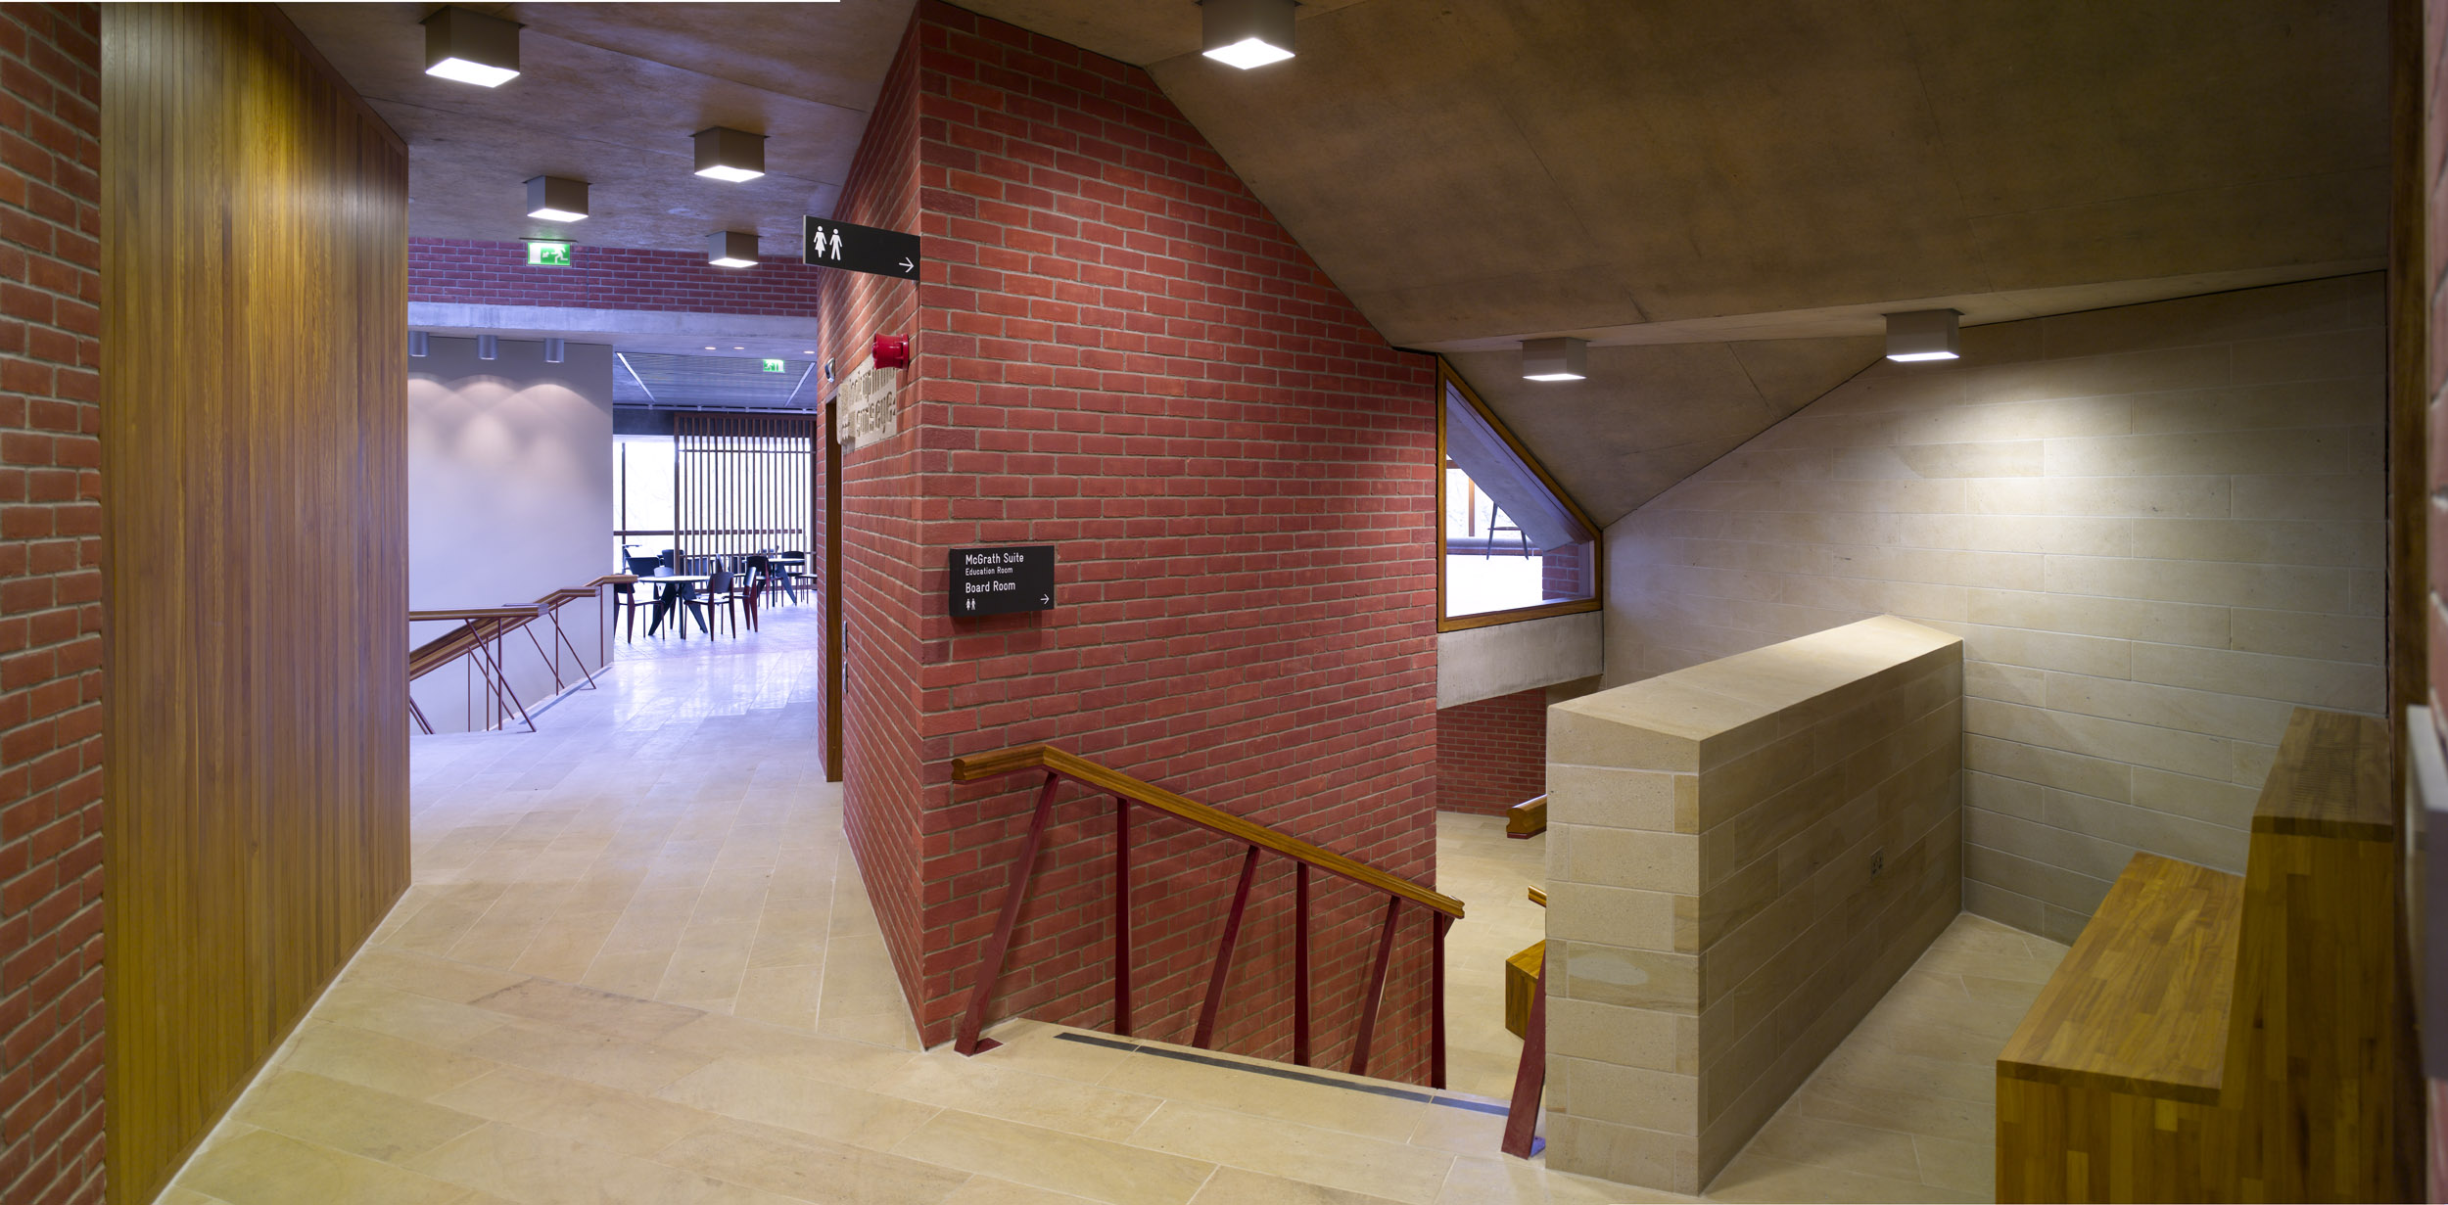

Slide 12
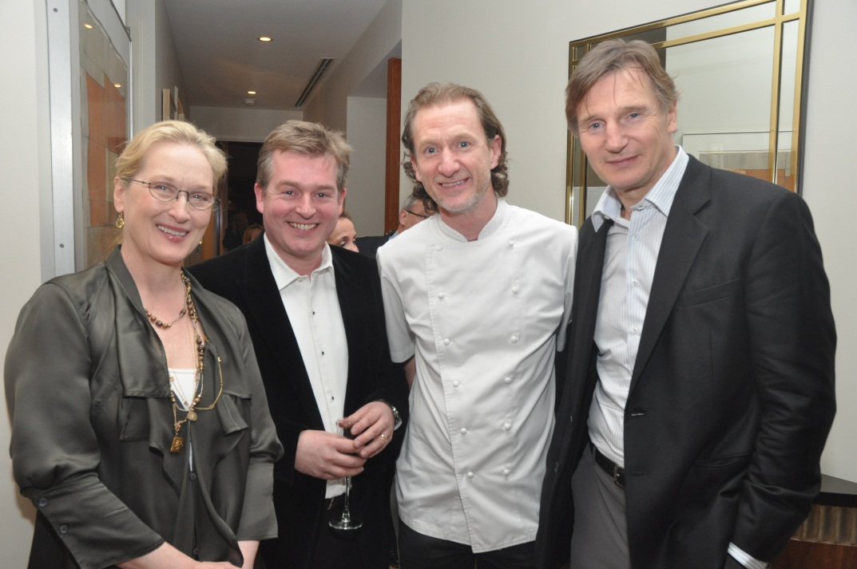
“You have taken the Lyric from a dream to a concrete idea, to a physical manifestation. You have made this building an actuality.
May it be a living, breathing monument to and for the spirit of the people of Northern Ireland. I congratulate you all, and send my warmest regards for this great achievement.”
Liam Neeson – Patron, Lyric Theatre

Slide 13
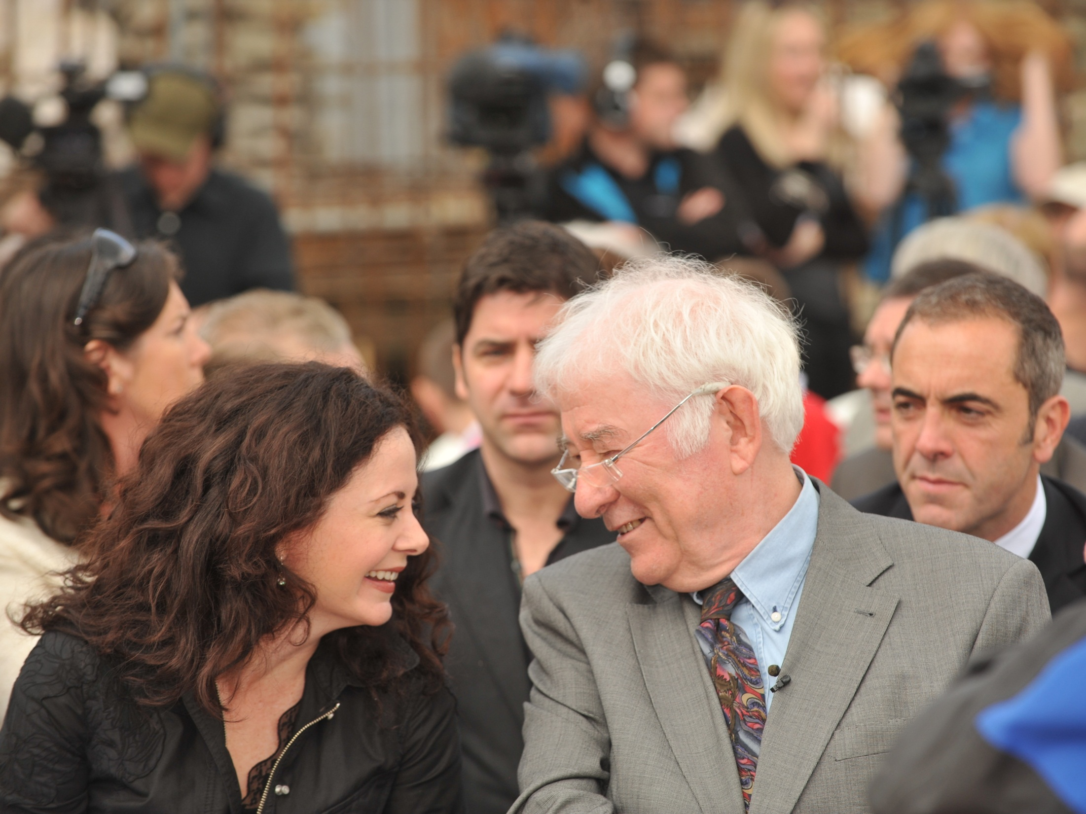

Slide 14
Perspective Architectural Magazine
“This is a wonderful and beautifully crafted building rooted in this place, in Belfast, and for this theatre company; it is neither generic nor rhetorical but insistent on that significance of particular place and occasion; such is architecture, such is theatre.”

Slide 15
The Architectural Review
“When you step inside, it’s a plain old-fashioned ‘wow’”.
“It’s a place people love to use. As they kept stopping me to say so”
“The sheer quality of the building hits you. The immaculate brick, stone and concrete….”

Slide 16

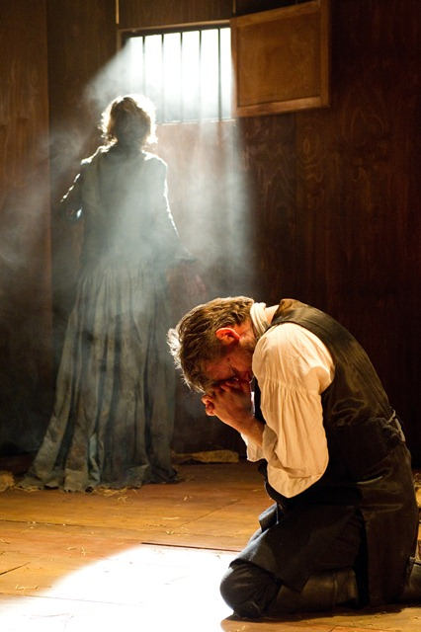
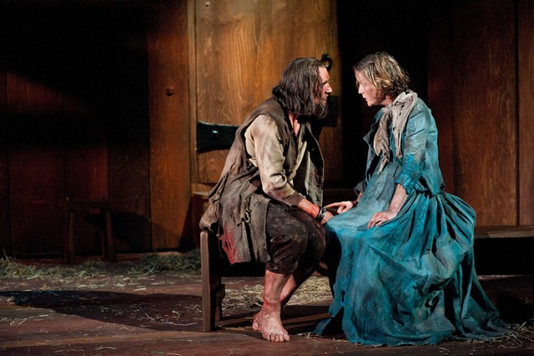
The Crucible

Slide 17
Critical Acclaim for The Crucible
The Guardian ****
Sunday Times ****
“Conall Morrison’s production is close to perfect”

Slide 18
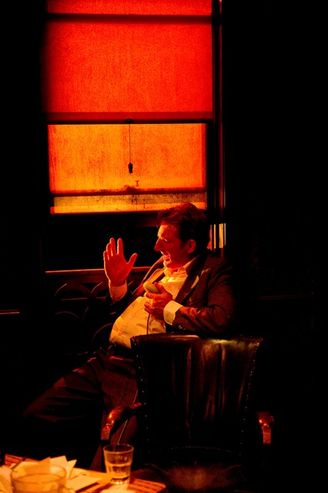
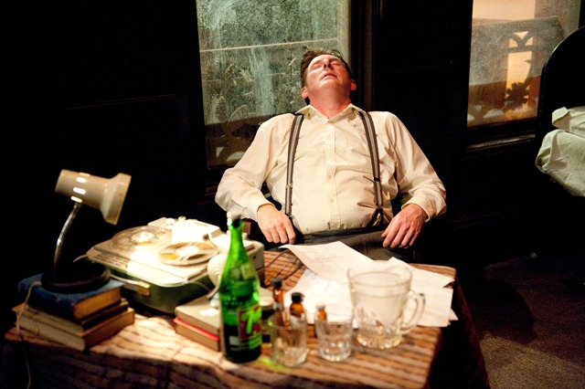

Brendan at the Chelsea

Slide 19
Critical Acclaim for Adrian Dunbar in Brendan at the Chelsea
British Theatre Guide
“Adrian Dunbar’s performance of Behan is extraordinary”
The Stage
“Adrian Dunbar’s riveting central performance”

Slide 20
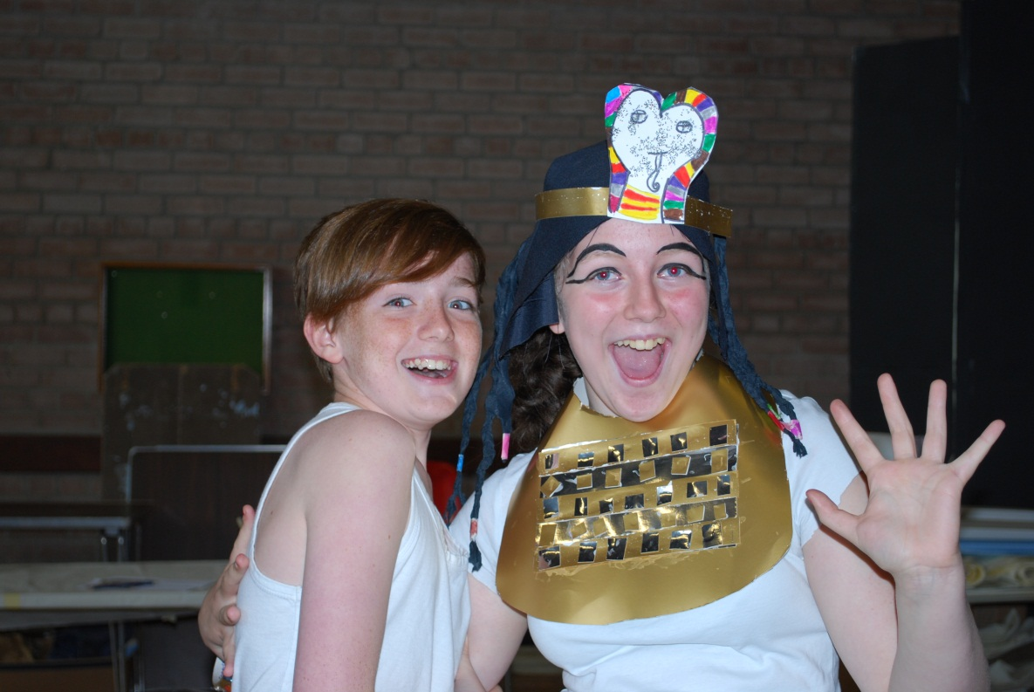
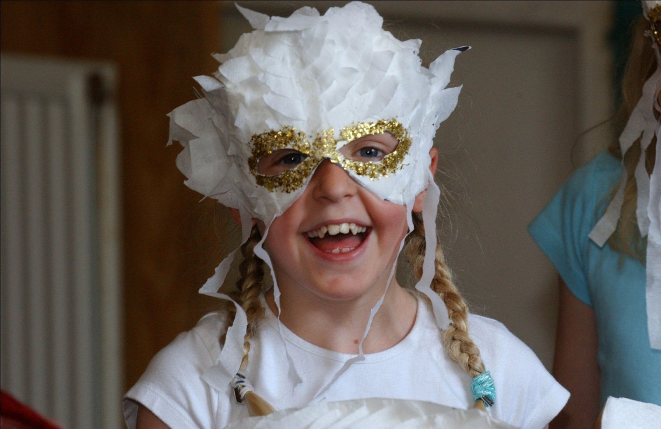
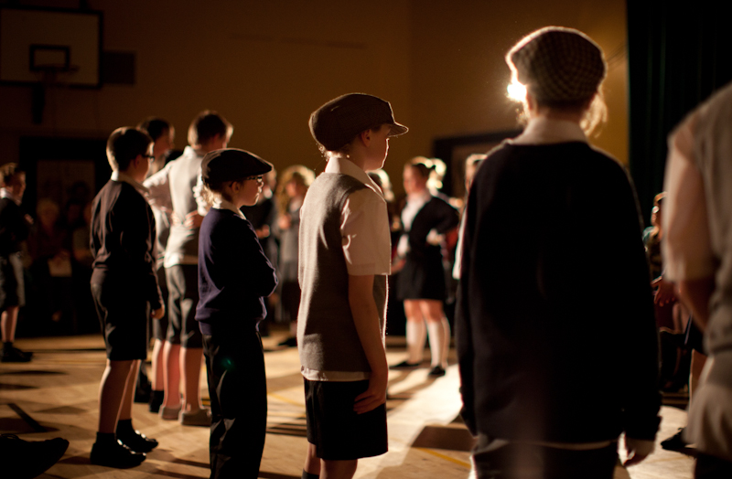
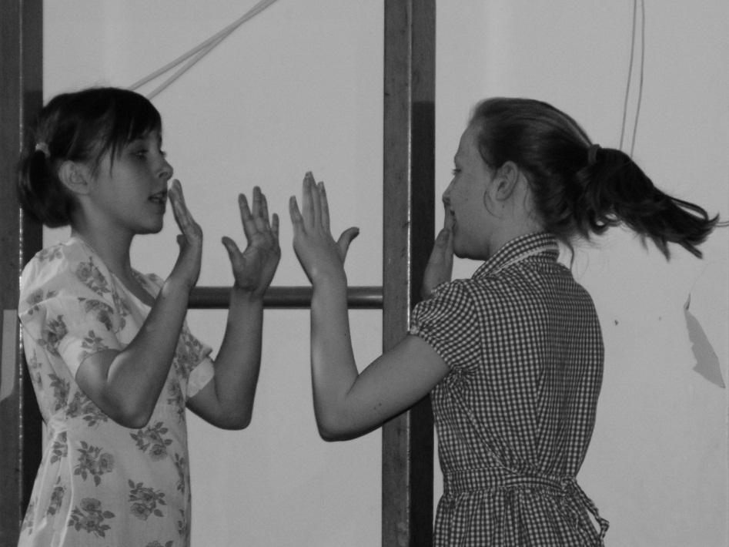
Creative Learning and Outreach

Slide 21
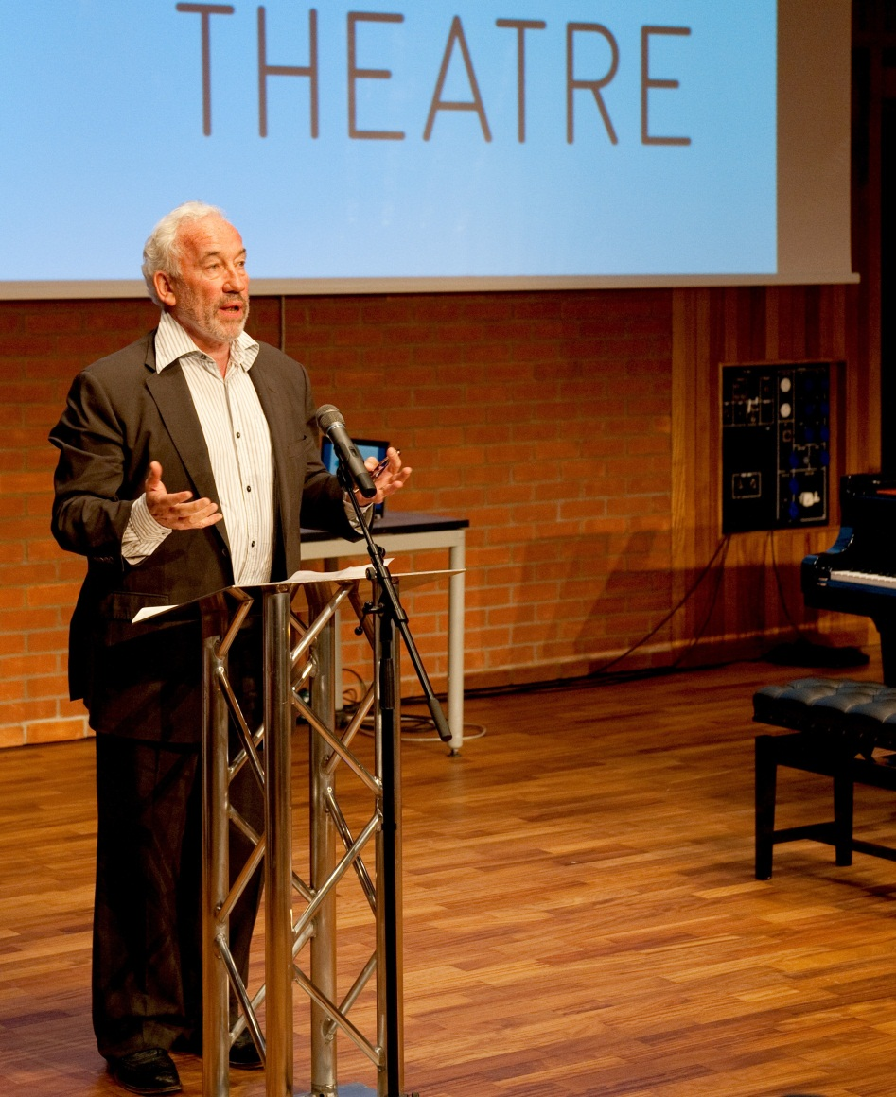
“The most wonderful new theatre in the world”
Simon Callow CBE

Slide 22
New York

Slide 23
New Belfast

Slide 24
New Lyric

Slide 25
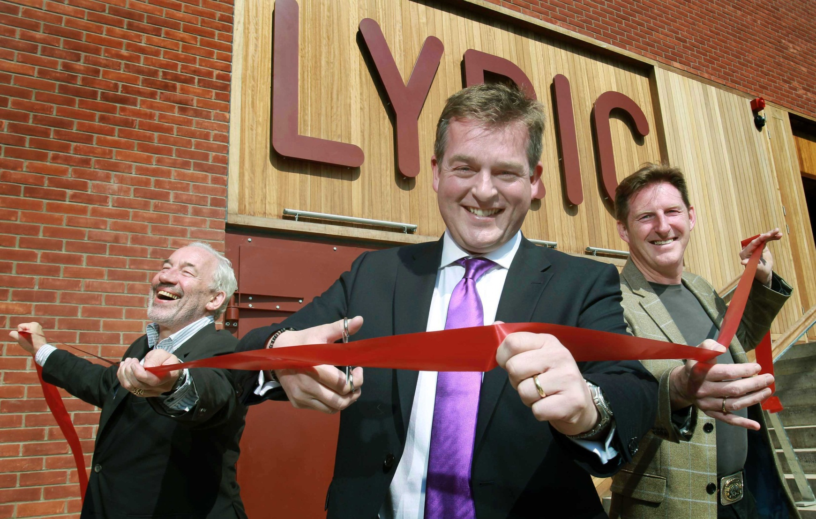

Slide 26
Thank You

